Slide 1

The Oslo Method Applied
to the Quasi-Continuum
of Excited Nuclei
Magne Guttormsen
Department of Physics and SAFE
University of Oslo

Slide 2
The Oslo Method
Measure particle-γ coincidences
Unfold γ spectra at each E ¹⁾
Apply the first-generation method ²⁾
Ansatz: First-generation matrix
P(E, E_{γ}) ∝ ρ(E - E_{γ}) ⋅ T(E_{γ}) ³⁾
Normalization
Examples of level density
¹⁾ M. Guttormsen et al., NIM A374 (1996) 371
²⁾ M. Guttormsen et al., NIM A255 (1987) 518
³⁾ A. Schiller et al., NIM A447 (2000) 498
Analysis of possible systematic errors of the Oslo method
A.C. Larsen et al., Phys. Rev. C 83, 034315 (2011)

Slide 3
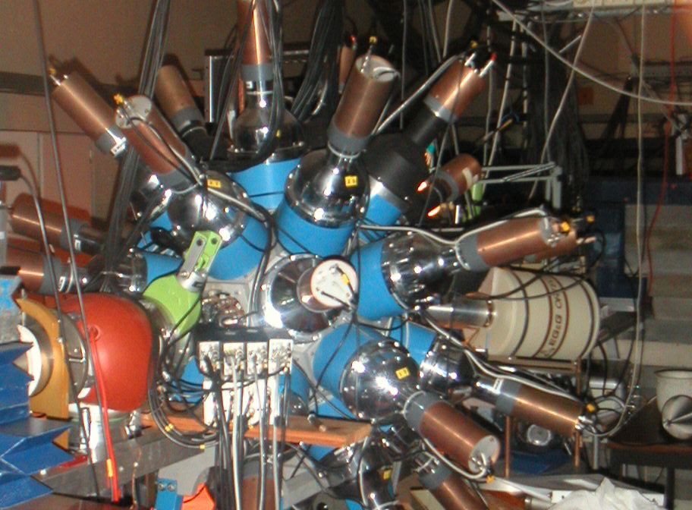
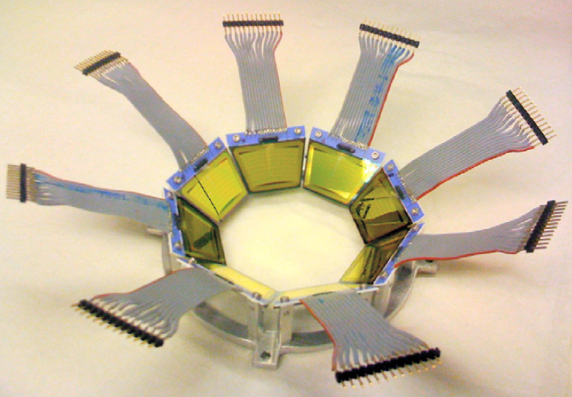
Experiments at OCL
12 MeV d on ²³²Th
24 MeV ³He on ²³²Th
Backwards:
ϑ = 40º – 54º
5”x5” NaI
γ
³He –beam
³He, α,d,t
∆E-E
^{M.Guttormsen,} A.Bürger, T.E.Hansen, N.Lietaer,
^{NIM A648(2011)168}

Slide 4
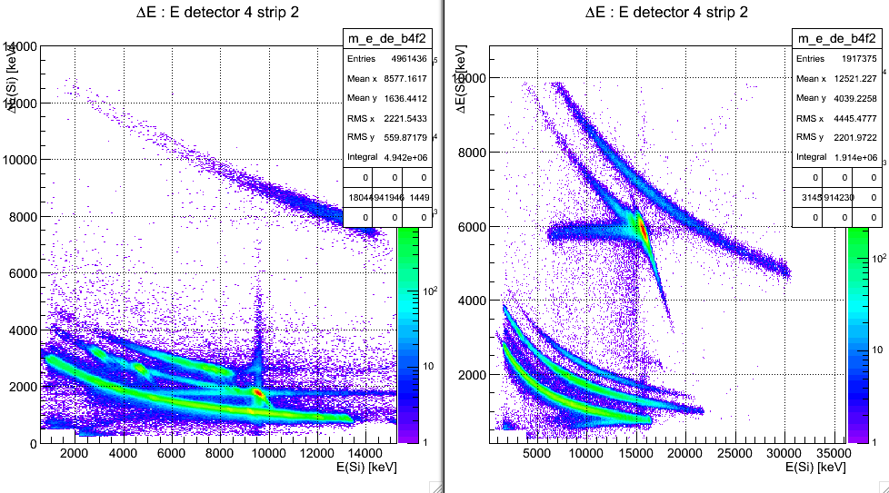
∆E-E bananas
(³He,α)²³¹Th
(d,d’)²³²Th (d,p)²³³Th
(³He,t)²³²Pa (³He,d)²³³Pa

Slide 5
Assumption for the extraction of first-generation γ-spectra
(d,p)
γ
E
(d,p)
The γ-energy distribution is the same
if the decay starts at E after γ-emission or
starts after the direct reaction into E.

Slide 6
Gamma-multiplicity

Slide 7
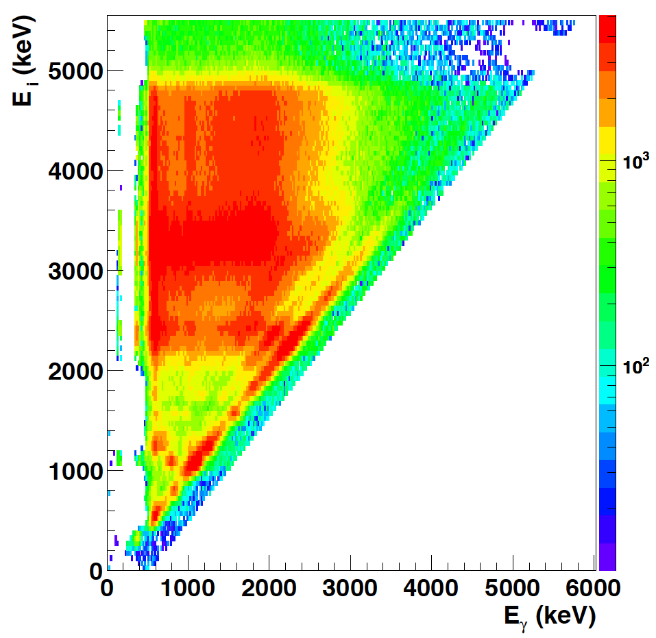
From total to primary γ-ray matrix
²³²Th(d,p) ²³³Th
E_{x}
γ
γ
γ
2-6ħ
spin

Slide 8
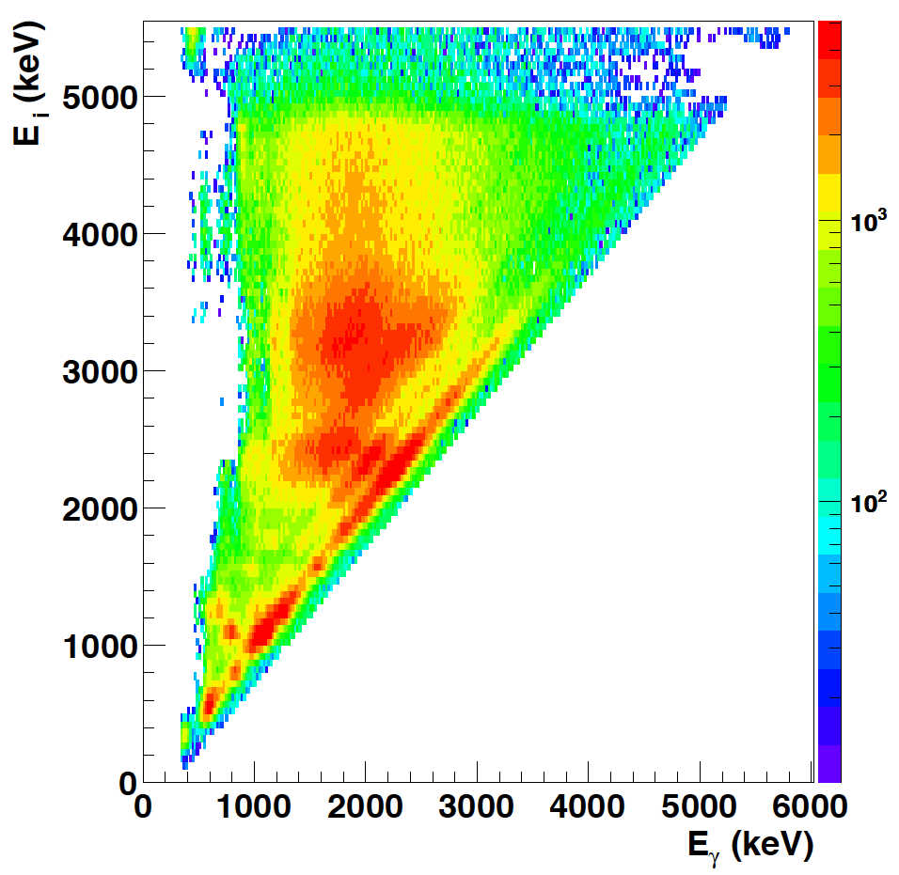
Primary γ-ray matrix
P(E_{x},E_{γ})
Level density Trans. coeff.
        ρ(E_{f}) T(E_{γ})
P(E_{x},E_{γ})

Slide 9
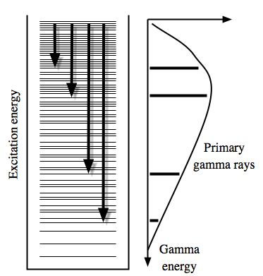
Multiplicative factors
Fermi’s golden rule
Brink hypothesis

Slide 10
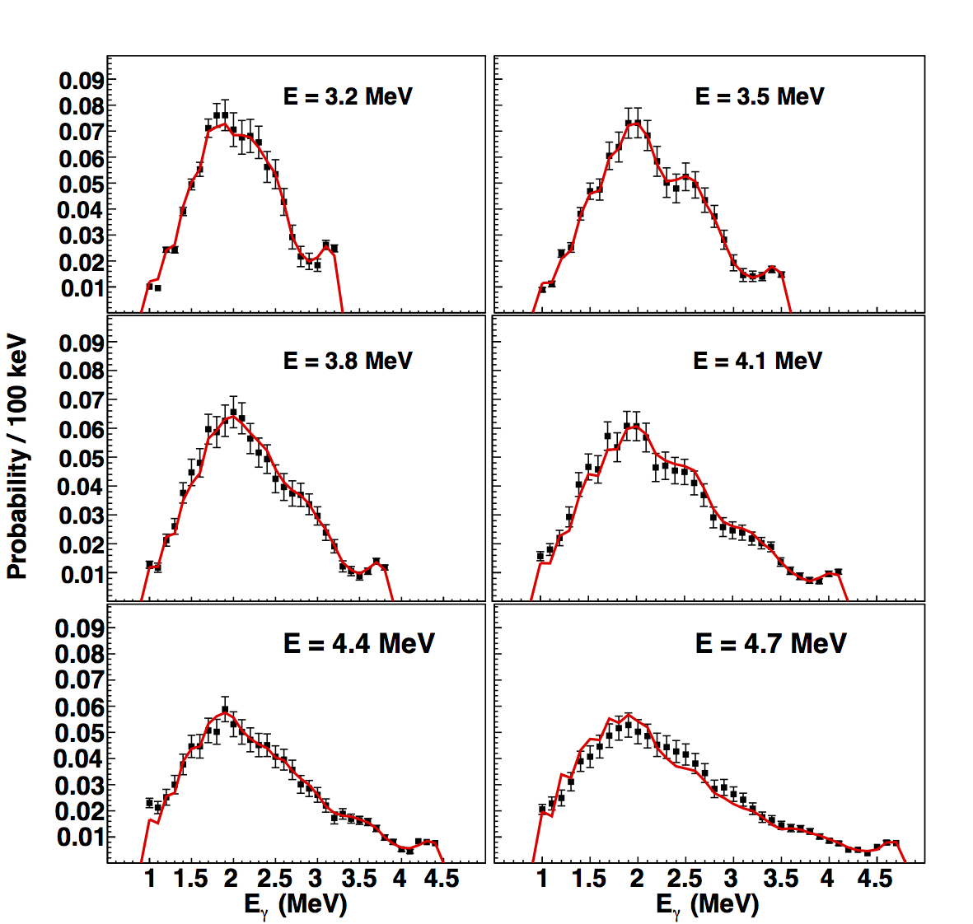
P(E_{x},E_{γ}) = ρ(E_{f}) . T(E_{γ}) ?

Slide 11
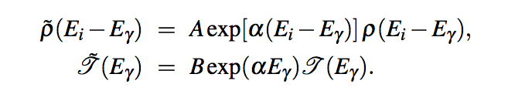
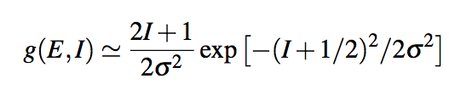
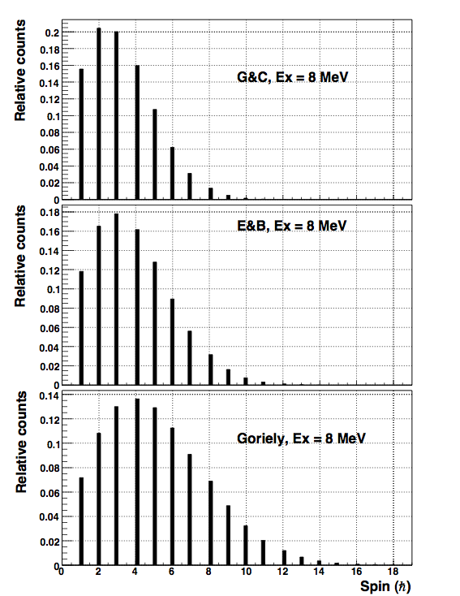
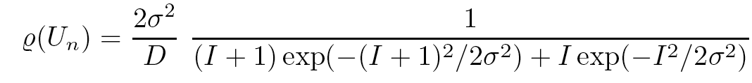
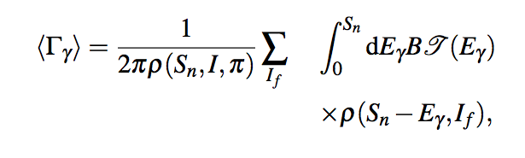
Normalization
⁴⁴Sc
Average level spacings D from neutron capture:
A. Gilbert and A.G.W. Cameron, Can. J. Phys. 43, 1446 (1965)
T. von Egidy and D. Bucurescu, Phys. Rev. C 72, 044311 (2005), Phys. Rev. C 73, 049901(E) (2006)
S. Goriely, HF+BCS Demetriou and Goriely, Nucl. Phys. A695 (2001) 95

Slide 12
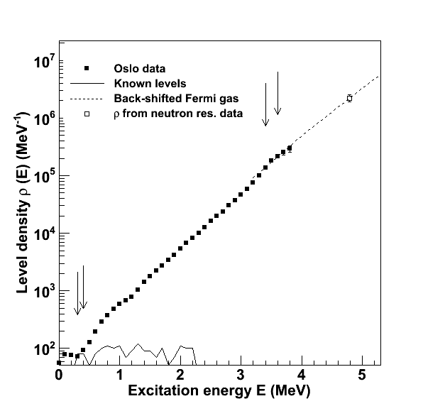
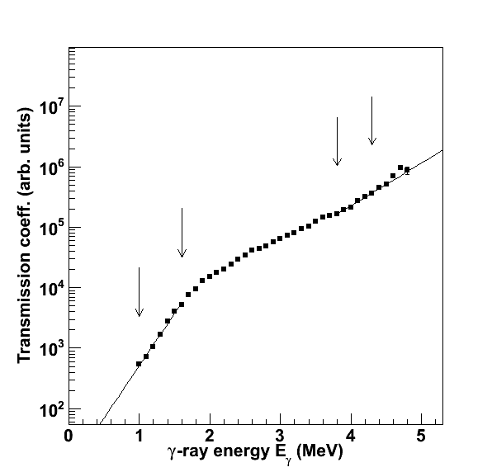
ρ(E_{f}) and T(E_{γ})

Slide 13
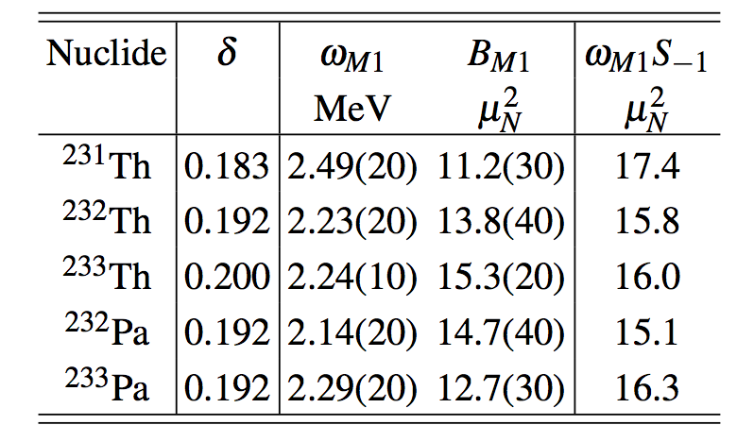
^{231,232,233}Th and ^{232,233}Pa
M. Guttormsen et al., PRL 109, 162503 (2012)
Inverse energy-weighted sum rule:
K. Heyde, P. von Neumann-Cosel, A. Richter, Rev. Mod. Phys., 82, 2365 (2010)

Slide 14
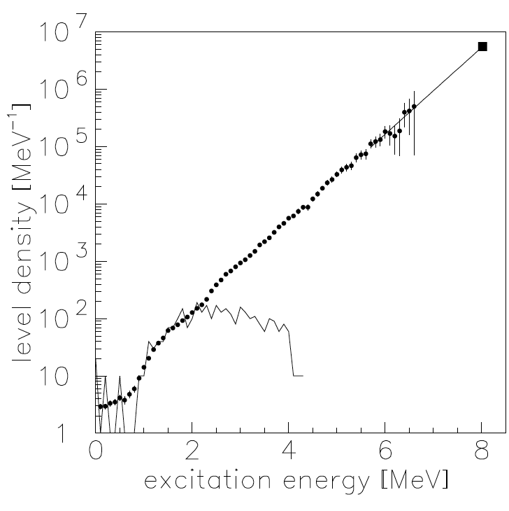
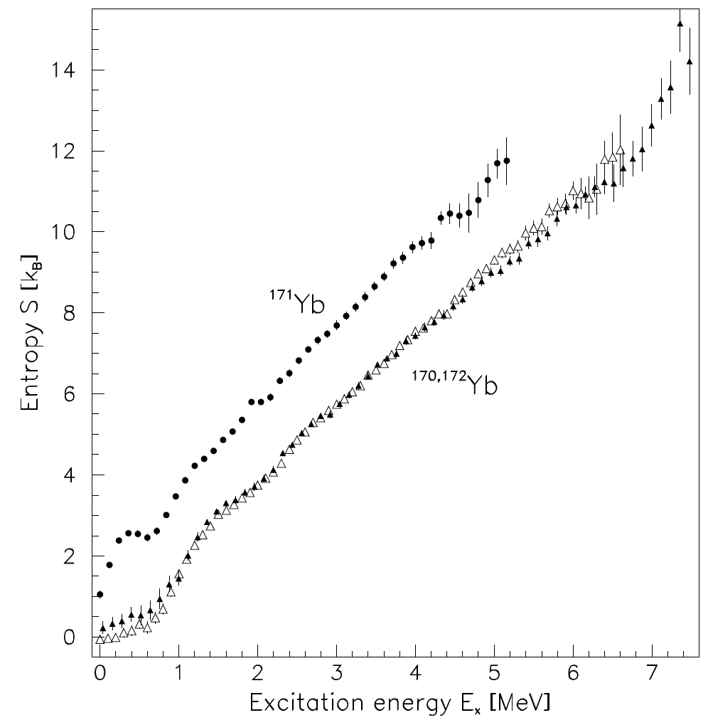
Thermal quasi-particles, the spectators of mid-shell nuclei

Slide 15
Thermal quasi-particles create level density
Cooper pair Broken pair
1 level 25 levels

Slide 16
A simple model for level density
- Combining all possible proton and neutron configurations
- Nilsson single-particle energy scheme
- BCS quasi-particles
j
Ω

Slide 17
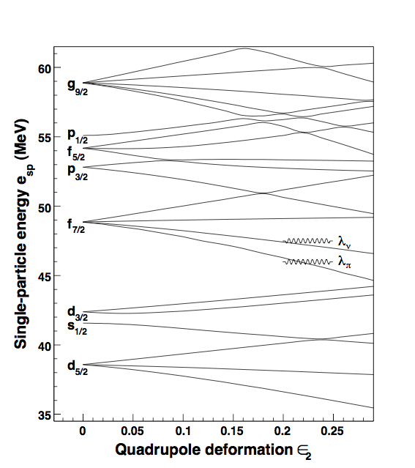
Nilsson level scheme
Model parameters:
= 0.066
= 0.32
= 0.23
20
1p 1n
1p 3n
1p 5n
1p 7n
3p 1n
3p 3n
3p 5n
5p 1n
5p 3n
7p 1n

Slide 18
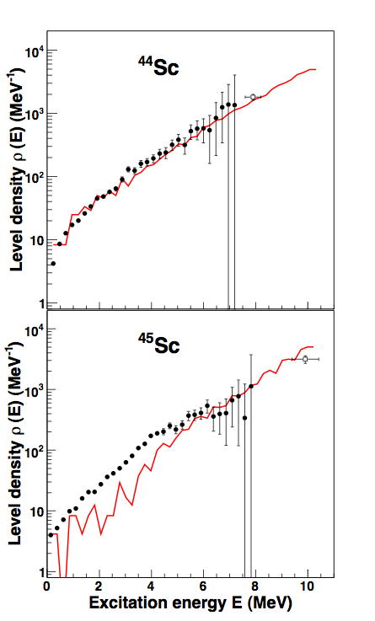
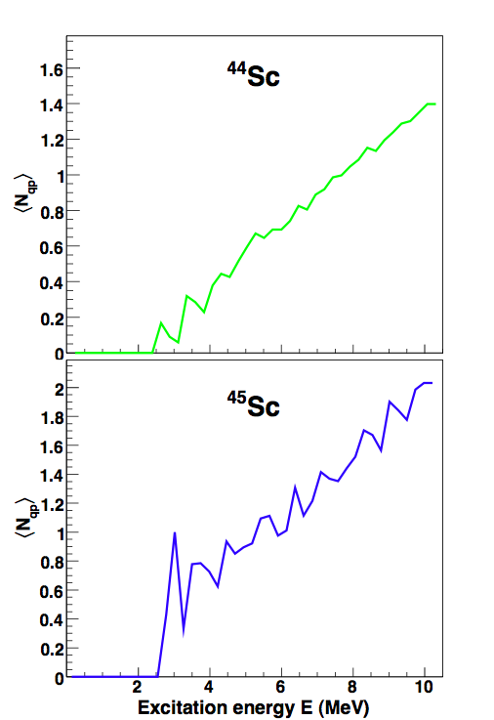
Level density and broken pairs
Level
densities
Number
of broken
pairs

Slide 19
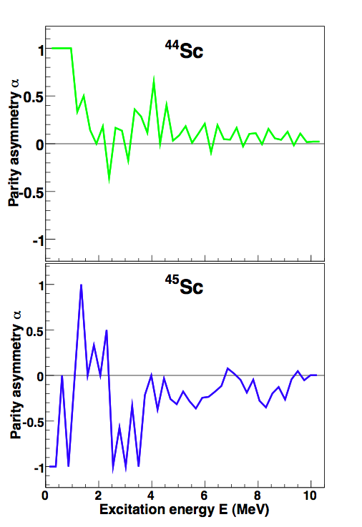
Parity asymmetry
U. Agvaanluvsan, G.E. Mitchell, J.F. Shriner Jr.,
Phys. Rev. C 67, 064608 (2003)

Slide 20
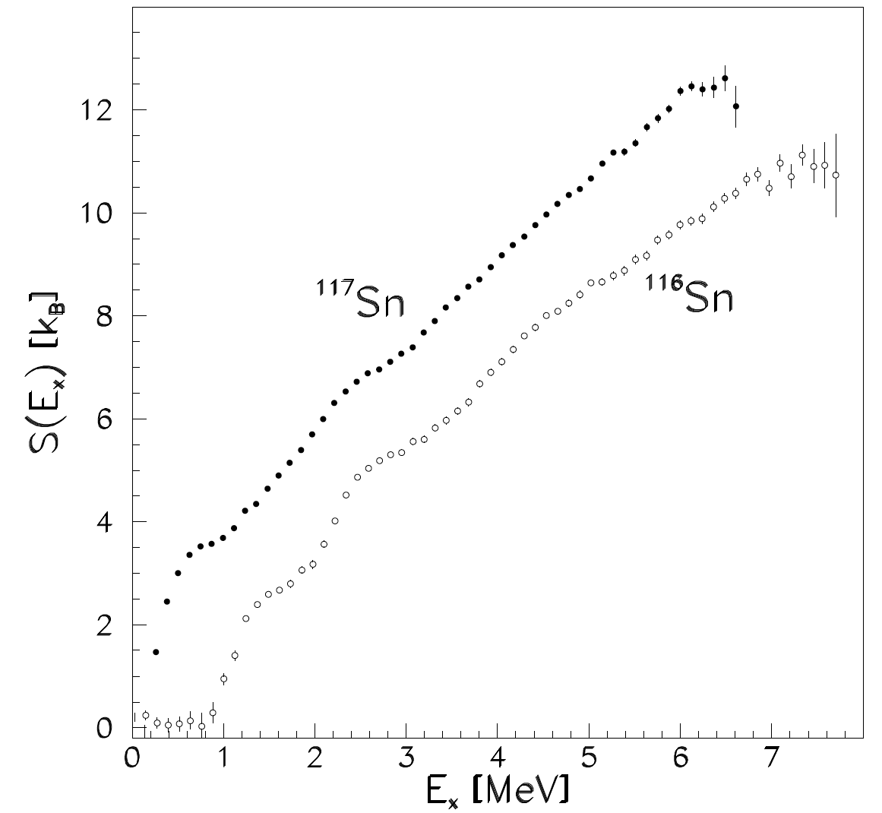
Titanium and tin
⁴⁶Ti

Slide 21
Summary
Simultaneous extraction of level density and γ-strength function
Examples from A = 40 – 230
Number of thermal quasi-particles determines number of levels
Constant temperature level density
Fluctuations for lighter even-even nuclei

Slide 22
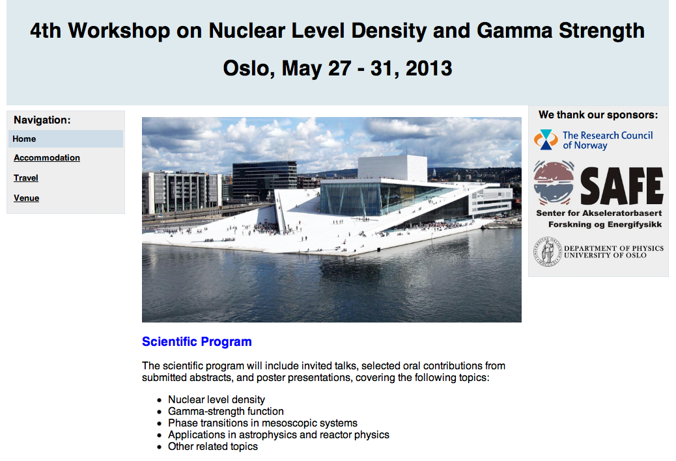
http://tid.uio.no/workshop2013/

