Slide 1
Simulating Γ_{γ} Distributions
What is Γ_{γ}?
How are Γ_{γ}’s measured?
What does the standard model predict?
Simulating Γ_{γ} distributions.
Constraining the Oslo method.
Testing the Porter-Thomas distribution

Slide 2
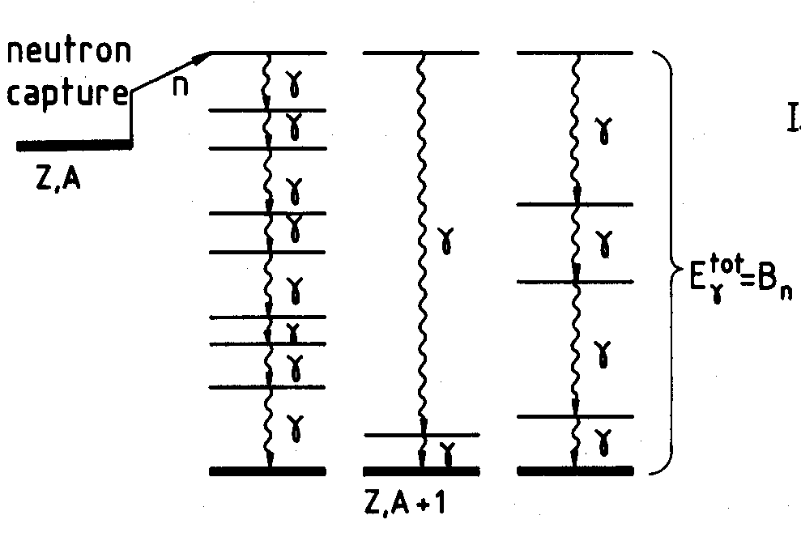
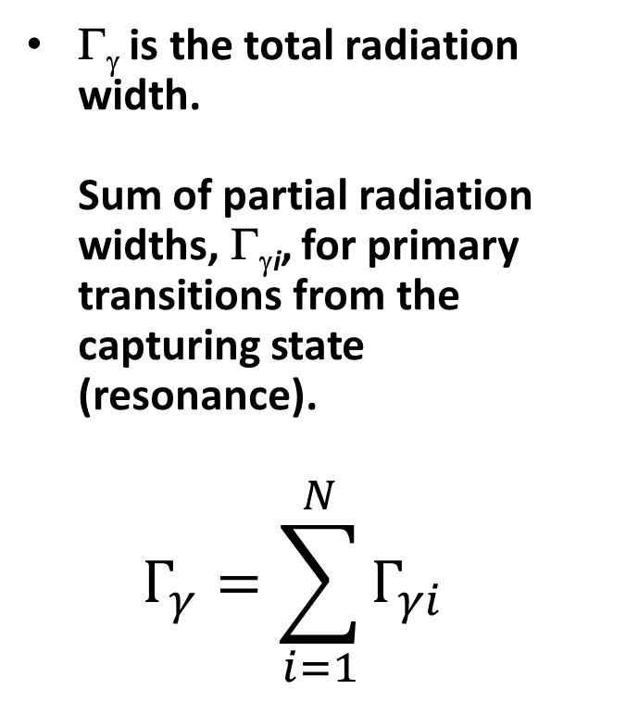
What is Γ_{γ}?
Γ_{γ} is the total radiation width.
Sum of partial radiation widths, Γ_{γi}, for primary transitions from the capturing state (resonance).
$Γ_{γ}=\sum_{i=1}^{N}{Γ_{γi}}$

Slide 3


Neutron Capture Cross Sections:
Neutron hits target and sticks
^{A}Z(n,γ)^{A+1}Z

Slide 4
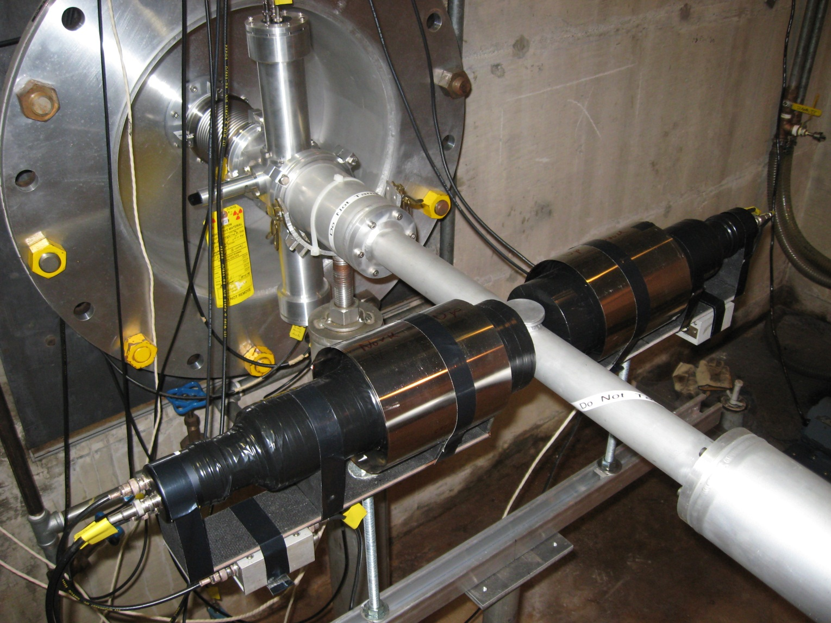
(n,γ) Measurements at ORELA Employ C₆D₆ Detectors
Flux monitor
γ-ray detectors
Neutron beam
Sample

Slide 5
How is Γ_{γ} Measured?
Γ_{γ} determined from R-matrix analysis of neutron-resonance data.
Typically need both neutron total (transmission) and capture data.
Capture area.
A_{γ}=g_{J}Γ_{n}Γ_{γ}/(Γ_{n}+Γ_{γ}).
Depth of transmission dip proportional to Γ_{n}.
Total width.
Γ_{t}=Γ_{n}+Γ_{γ}

Slide 6
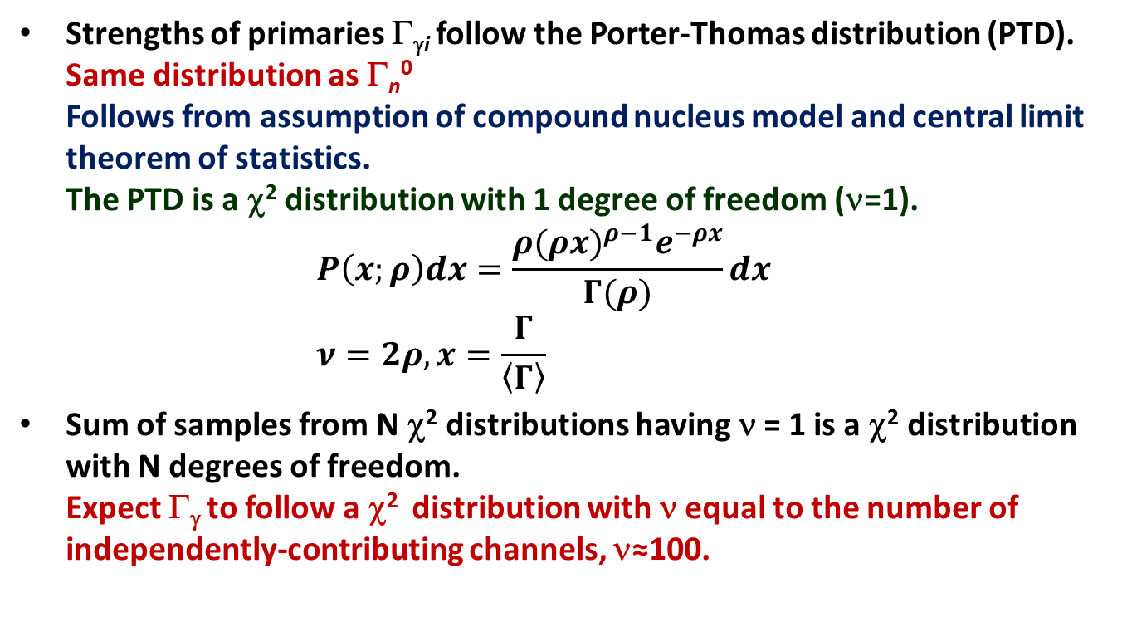
What Does the Standard Model Predict?
Strengths of primaries Γ_{γi} follow the Porter-Thomas distribution (PTD).
Same distribution as Γ_{n}⁰
Follows from assumption of compound nucleus model and central limit theorem of statistics.
The PTD is a χ² distribution with 1 degree of freedom (ν=1).
$P\left(x;ρ\right)dx=\frac{ρ{(ρx)}^{ρ−1}e^{−ρx}}{Γ(ρ)}dx$
$ν=2ρ, x=\frac{Γ}{\left\langle Γ\right\rangle }$
Sum of samples from N χ² distributions having ν = 1 is a χ² distribution with N degrees of freedom.
Expect Γ_{γ} to follow a χ² distribution with ν equal to the number of independently-contributing channels, ν≈100.

Slide 7
Comparison of Γ_{n}⁰ and Γ_{γ} Distributions
Neutrons, Γ_{n}⁰.
Single channel, ν=1.
PTD.
Very broad.
Gammas, Γ_{γ}.
ν~100 channels.
Very narrow.

Slide 8
Comparison of Measured Γ_{γ} to χ² Distributions
Example: ^{192,194,195,196}Pt.
Often seems to be an extra tail compared to χ² distribution.

Slide 9
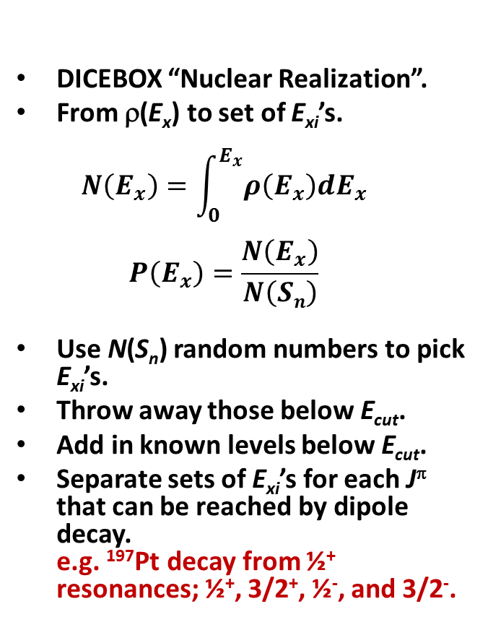
Simulating Γ_{γ} Distributions: Step 1
Generating a Level Scheme
DICEBOX “Nuclear Realization”.
From ρ(E_{x}) to set of E_{xi}’s.
$N\left(E_{x}\right)=\int_{0}^{E_{x}^{}}{ρ\left(E_{x}^{}\right)dE_{x}}$
$P\left(E_{x}\right)=\frac{N\left(E_{x}\right)}{N\left(Sn\right)}$
Use N(S_{n}) random numbers to pick E_{xi}’s.
Throw away those below E_{cut}.
Add in known levels below E_{cut}.
Separate sets of E_{xi}’s for each J^{π} that can be reached by dipole decay.
e.g. ¹⁹⁷Pt decay from ½⁺ resonances; ½⁺, 3/2⁺, ½⁻, and 3/2⁻.

Slide 10
Simulating Γ_{γ} Distributions: Step 2
Calculating the Γ_{γi}’s
E_{γi} = S_{n} – E_{xi}.
Calculate f_{X1}(E_{γi})’s.
Calculate “PTD” factor ξ_{i}².
ξ_{i}² randomly chosen from the PTD.
Generalize to allow ν≠1.
Γ_{γi} = D₀ ξ_{i}² f_{X1}(E_{γi}) E_{γi}³.
Calculate Γ_{γi} ’s for each J^{π} reached by dipole decay.

Slide 11

Simulating Γ_{γ} Distributions: Steps 3 and 4
Calculating Total Widths and Iterating
Sum Γ_{γi}’s to get total width.
$Γ_{γ}=\sum_{i,X,J}{Γ_{γi}}$
Iterate.
Use same level schemes, etc.
New Γ_{γi}’s by varying ξ_{i}² only.
Yields distribution of Γ_{γ}’s.
Shape of Γ_{γ} distribution due to:
Shapes of LD and PSF models.
“PTD” fluctuations.

Slide 12
Examples: LD and PSF Models in Talys
Five LD models.
1 – Const. T + Fermi Gas.
2 – Back-shifted Fermi Gas.
3 – Generalized Superfluid.*
4 – Goriely.
5 – Hilaire.
Five PSF models.
1 – Kopecky-Uhl Lorentzian.
2 – Brink-Axel Lorentzian.
3 – Hartree-Fock BCS.
4 – Hartree-Fock Bogolyubov.
5 – Goriely’s Hybrid.
*Didn’t use. Couldn’t normalize.

Slide 13
Talys Results for ‹Γ_{γ}›
Talys calculation with 4 LD and 5 PSF models.
Normalized LD models to ORELA D₀ = 153 eV.
LD models 1 and 2 normalized using “a”, models 4 and 5 using “c” and “δ”.
PSF models un-normalized.
Chose LD/PSF combinations which gave closest to ORELA value, ‹Γ_{γ}› = 85.9±1.8 meV, for simulations.

Slide 14
Simulation Results with Talys Models
All simulations using Talys models yielded Γ_{γ} distributions significantly narrower than measured.
Agrees with nuclear physics lore.
Decreasing ν results in much better agreement between simulation and data.
Another sign of violation of the PTD?

Slide 15
Simulation Results with LD and PSF from the Oslo Method
What was the experimental spin distribution?
Affects slopes of LD and PSF.
What is the true spin distribution?
Affects normalization of PSF and shape of simulated distribution.
Would be better to know more about low-lying levels in ¹⁹⁷Pt.
E_{cut} = 0.269 MeV.
Only 2 ½⁻ and 2 3/2⁻ levels.

Slide 16
Problems, Improvements, and Future Plans
How to decompose PSF data into E1 and M1?
Fit E1 and M1 is everything else?
Vice versa?
How to normalize slopes of LD and PSF?
σ is correct when simulated Γ_{γ} distribution matches data?
Ohio U. method?
Simulating ¹⁹⁴Pt+n Γ_{γ} distribution might be even more interesting.
More widths/better statistics.
Tail is more pronounced.
Simulate ⁹⁵Mo+n Γ_{γ} distributions.
Have 6 J^{π}’s.
Sensitivity to upbend?
Simulate ⁸⁸Sr, ^{116,120}Sn, ^{134,136,137}Ba,…
Preliminary!

