Slide 1
The problem
We all live within the attention economy
Devices reduce your ability to focus - in spite of being powerful tools
Part of the problem is in the design of the device (large colourful screens) and mode if input (touch and swipe invites consume and app switching)
Another key part is in the business models
  App and service owners benefit from existence of device
  Device providers depend on growth in apps to sell more hardware

Slide 2
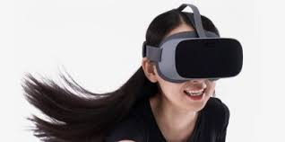
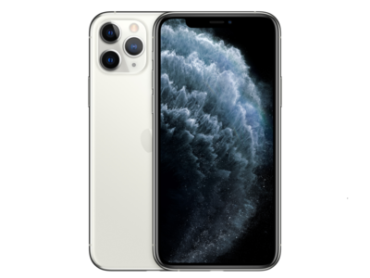
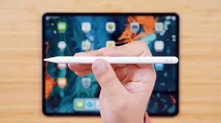
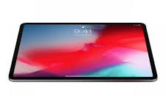
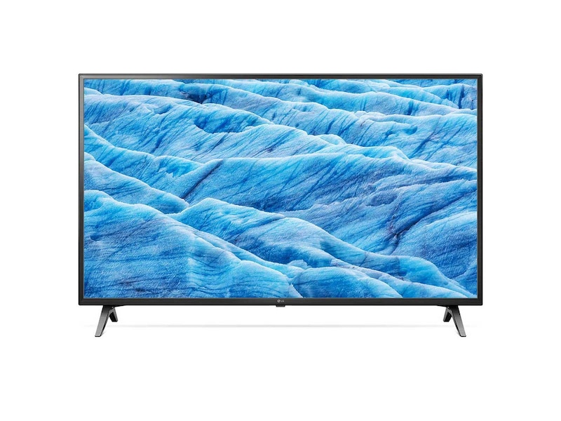
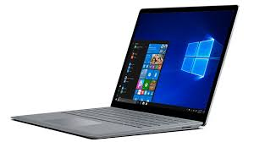
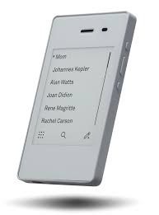
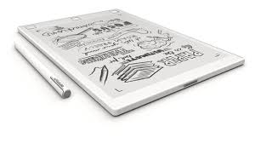
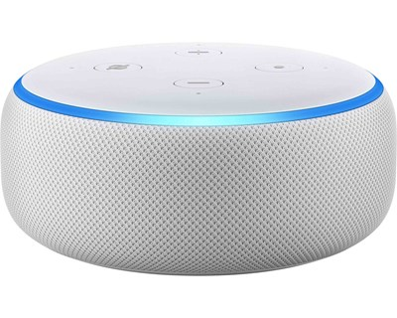
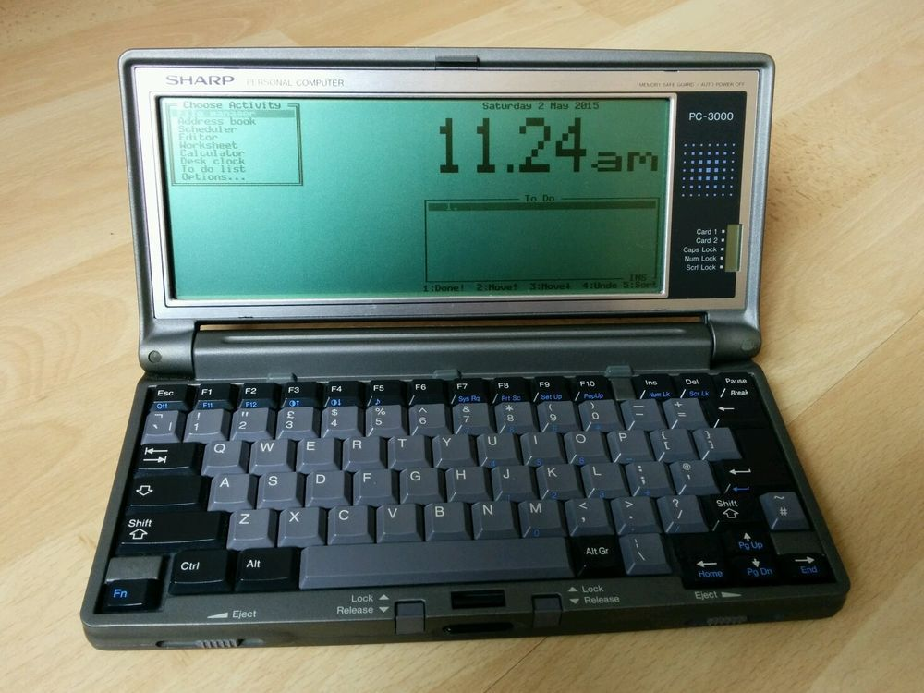
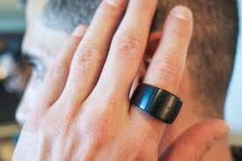
Input vs output : how immersive do we want to be?
High output
iPad Pro
iPad
limited input control
high input control
Low output

Slide 3
The problem - narrowed
Getting a break from your smartphone or ipad – and all their distractions - is becoming next to impossible.
The way the OS and UI is designed, opening one app (such as setting a timer) ineviatably leads to looking at another app (such as Twitter), and so the cycle goes on via Reddit, BBC News, the kids activities app and Netflix.
The net result? Lack of focus, connection, rest, sleep and increased exposure to commercial surveillance.

Slide 4
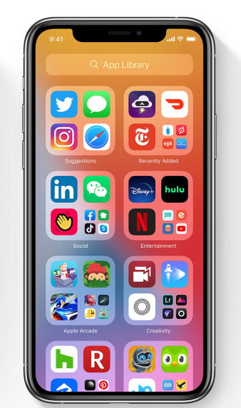
1
I was just going to text my fiance…
1
2
…then decided to do a short detour on Instagram to see if there was any response to our trip last week..
2
3
3
…which was in Flordia. I know Donald Trump was visiting there this week, might as well check if that got any coverage in New York Times…
4
4
4
…maybe theres a new a season of The Witcher on Netflix. It will be a long day today, might be good to crash upon.
6
5
Hey maybe there are some new wooden boxes for my DIY project on Pinterest?
6
No there’s not. There must be some videos on YouTube on how to build them for myself, though..
5
Whoops! 90 minutes passed already…and my nephew has been calling on me for for what, 30 minutes?

Slide 5

The rise of calm technologies
reMarkable
Blloc
Playfinity
Jooki
The Boring Phone
Freewrite
Kyocera KY-01L
Kindle

Slide 6
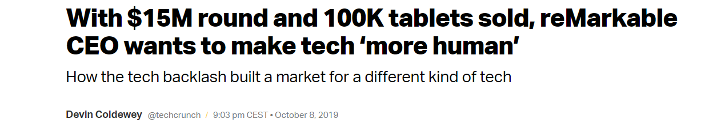
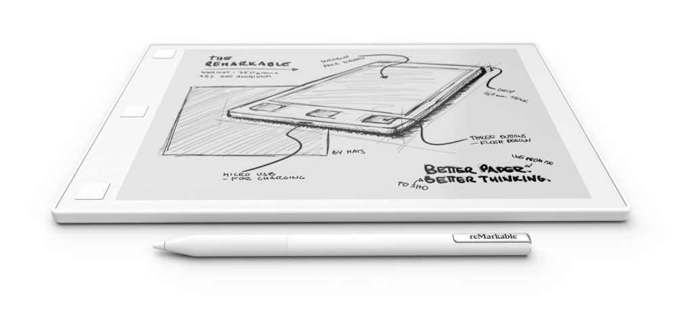
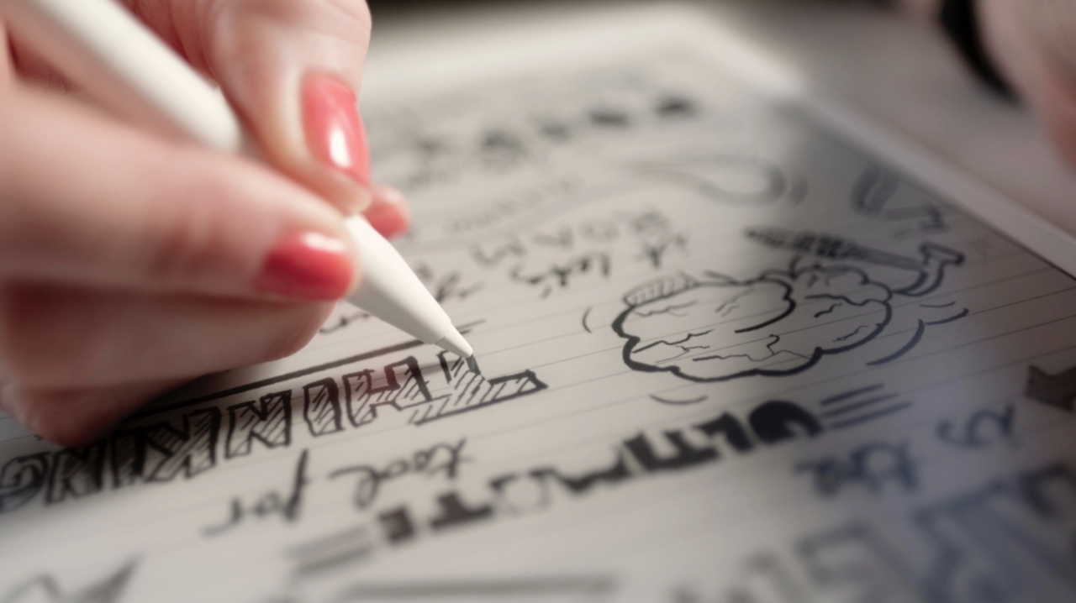
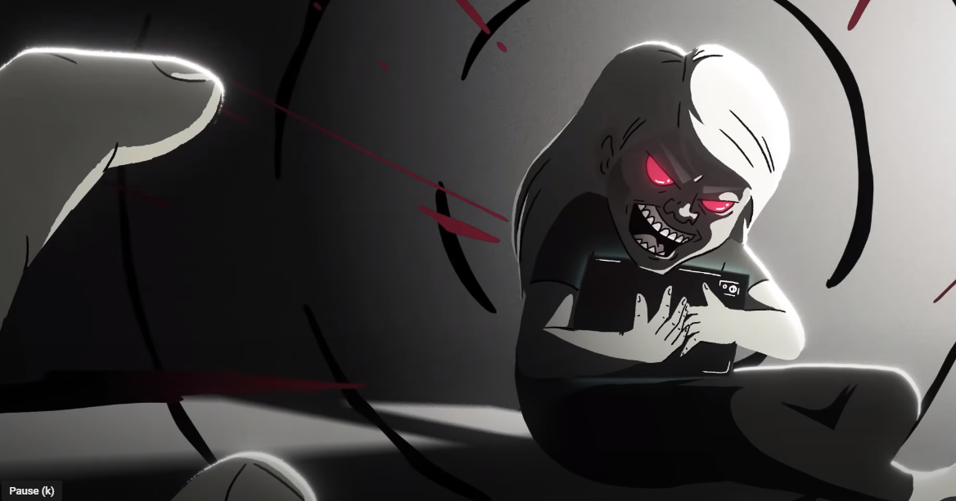
reMarkable
$399 – reMarkable II
[$599 – Apple iPad Air]
"Get your brain back"
https://www.youtube.com/watch?v=OcdxW2XF0v8

Slide 7
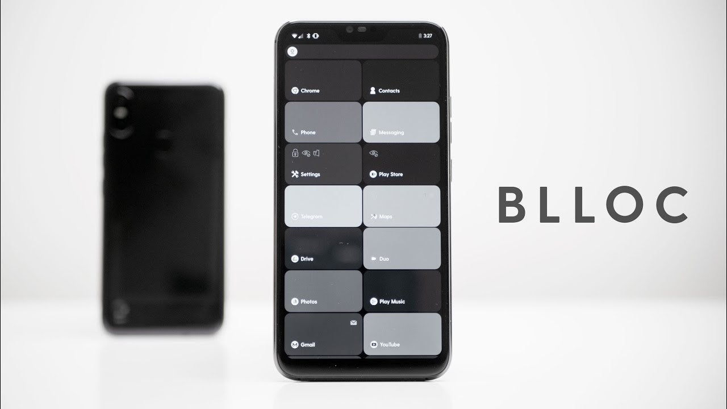
Minimalist phone
Minimalist UI
Android skin
Black and white
(can switch to color using fingerprint sensor)
$160
Berlin, Germany

Slide 8
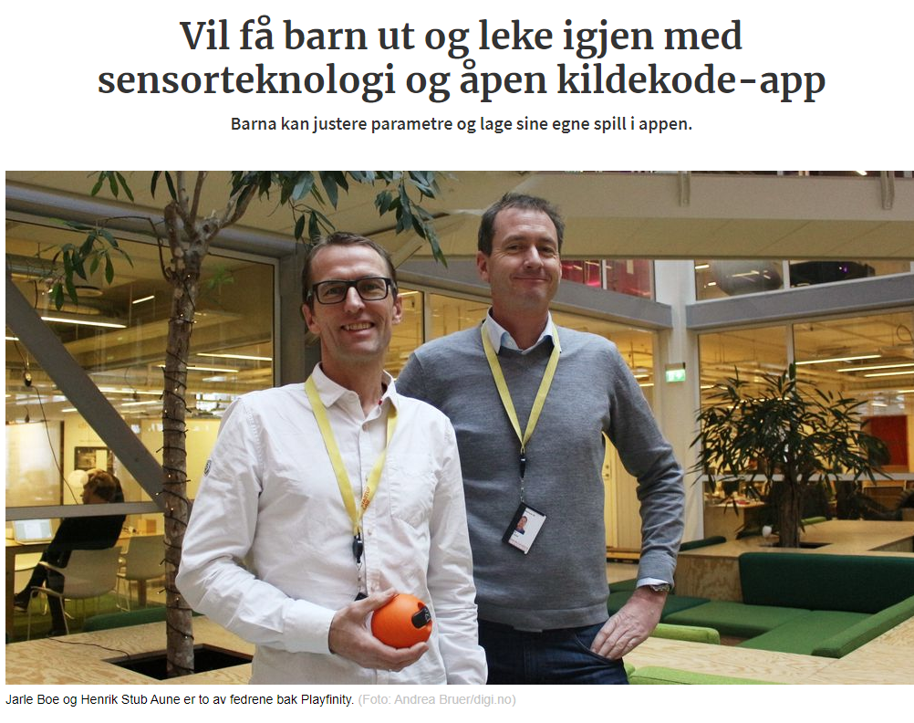
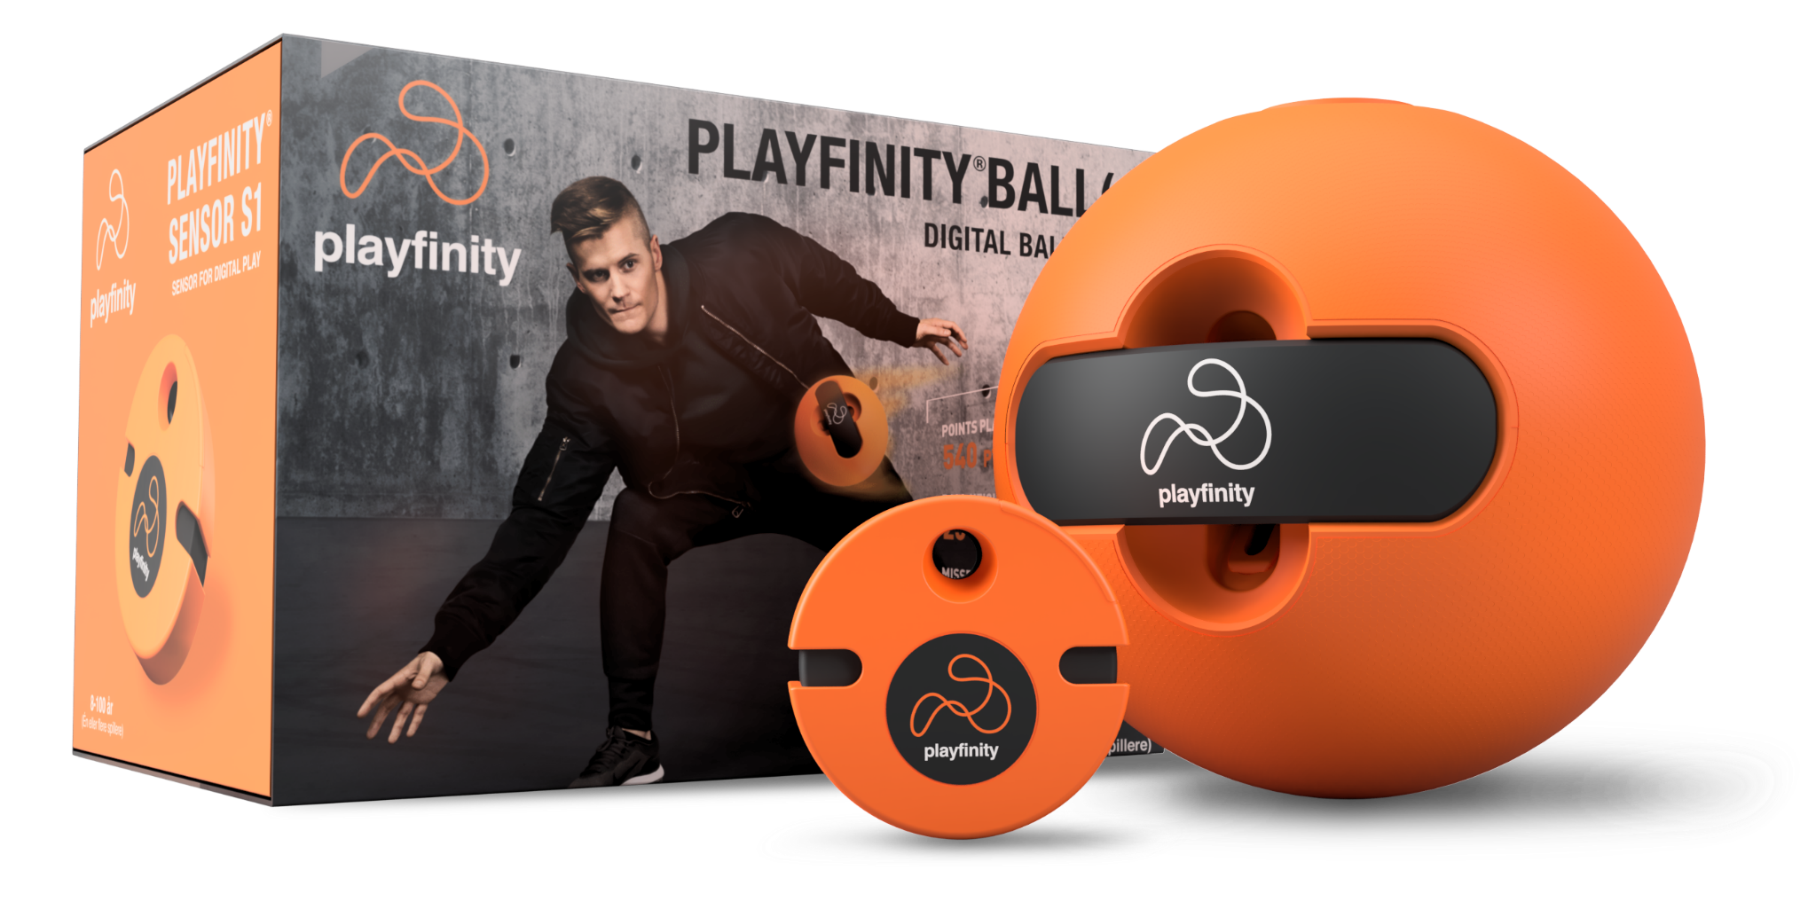
Playfinity
Oslo, Norway
NOK 249

Slide 9

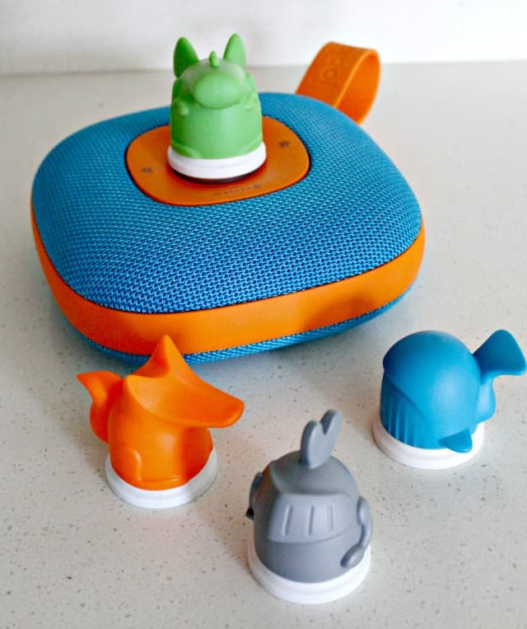
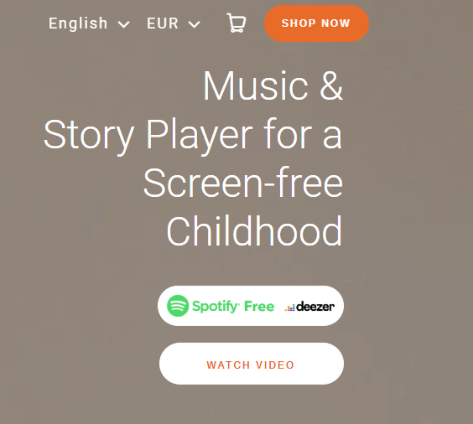
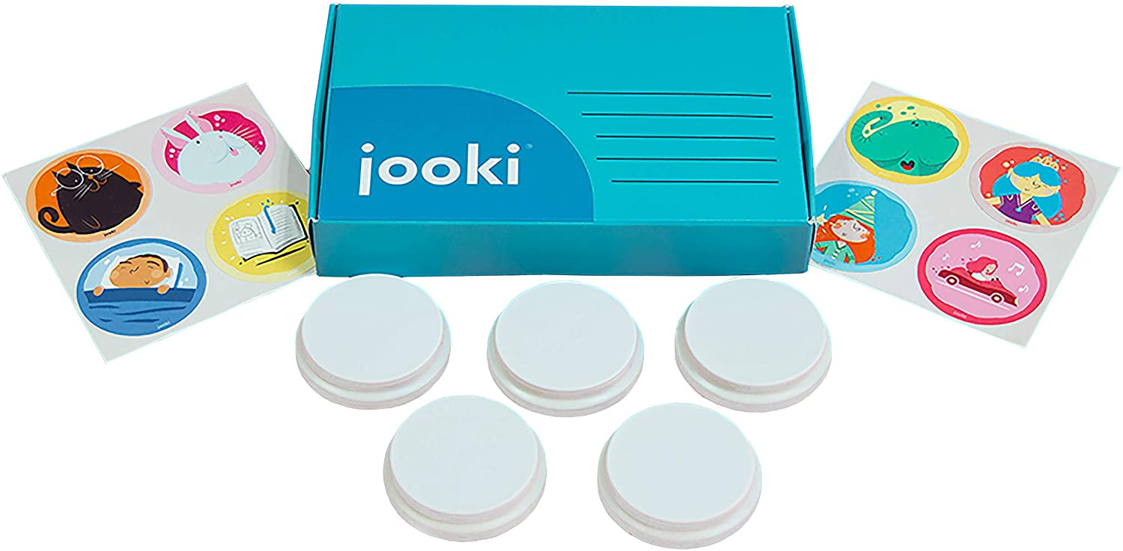
Jooki
$200
Belgium

Slide 10
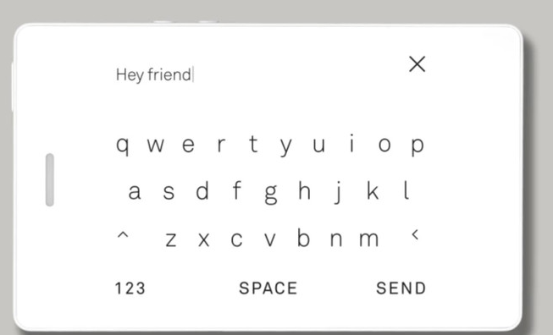
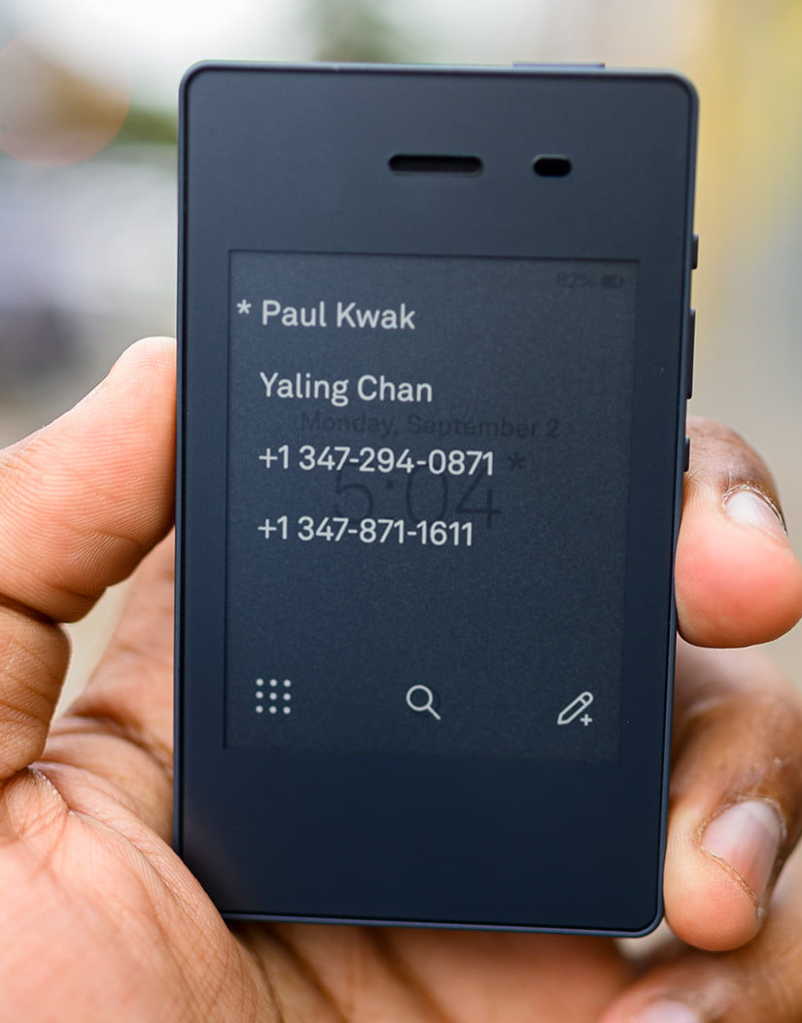
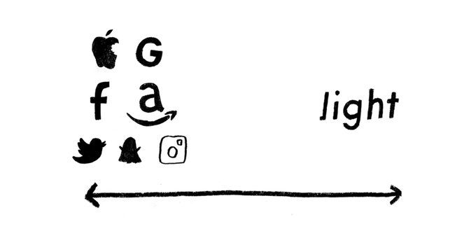
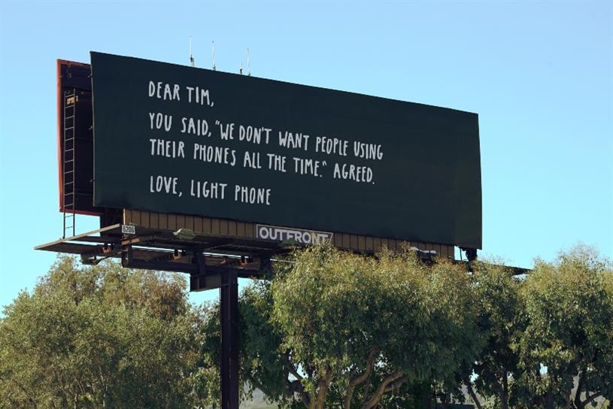
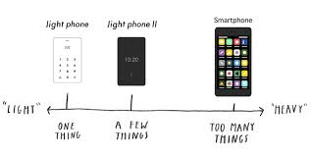
The Light Phone
New York
$300

Slide 11
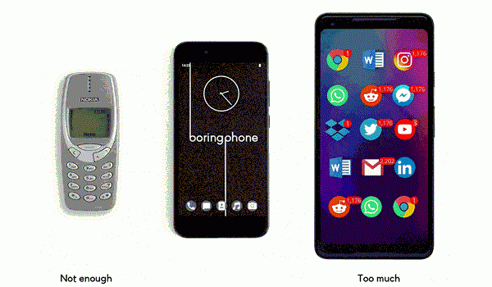

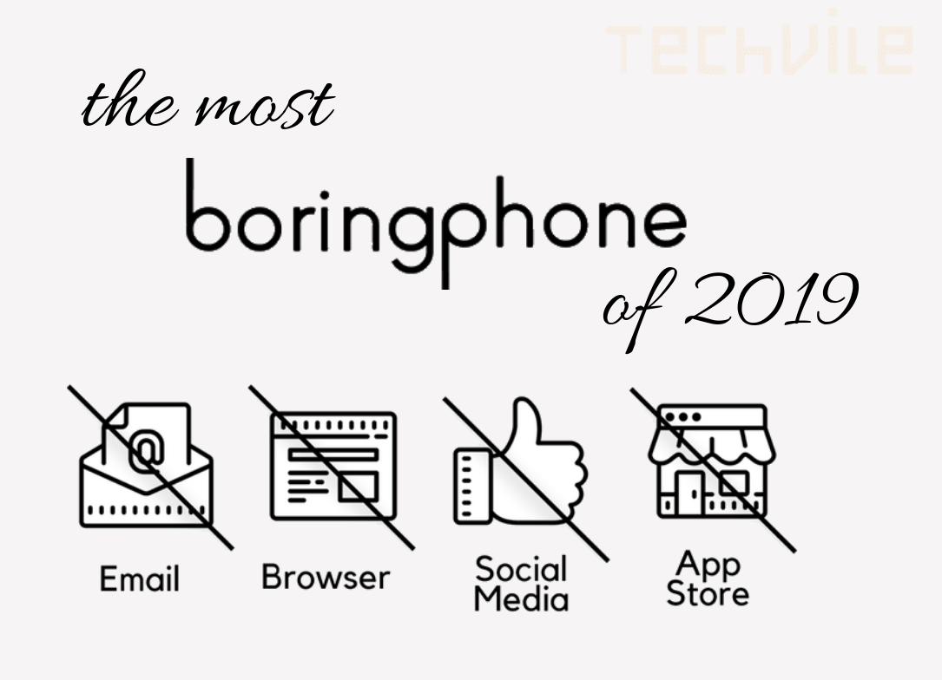
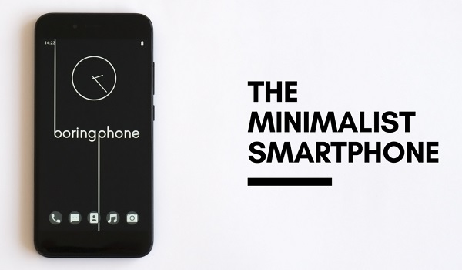
The Boring Phone
New Zealand
$350

Slide 12
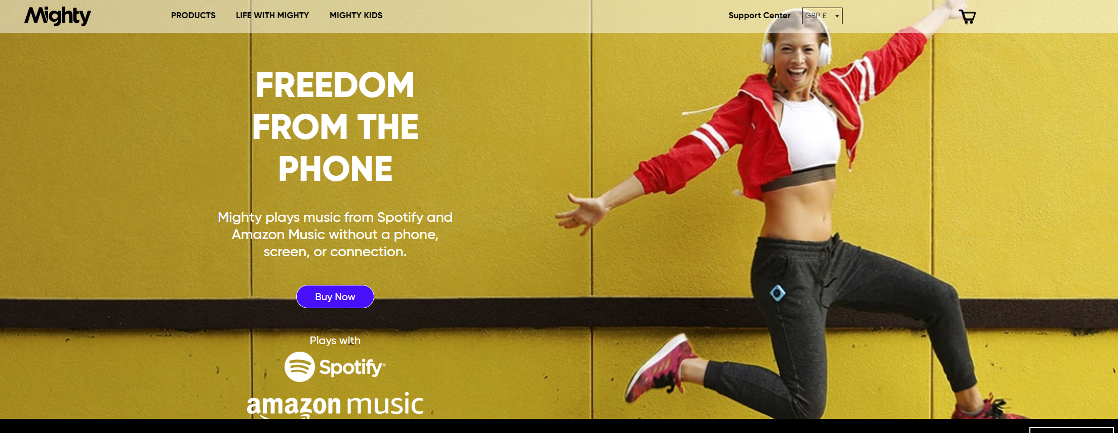
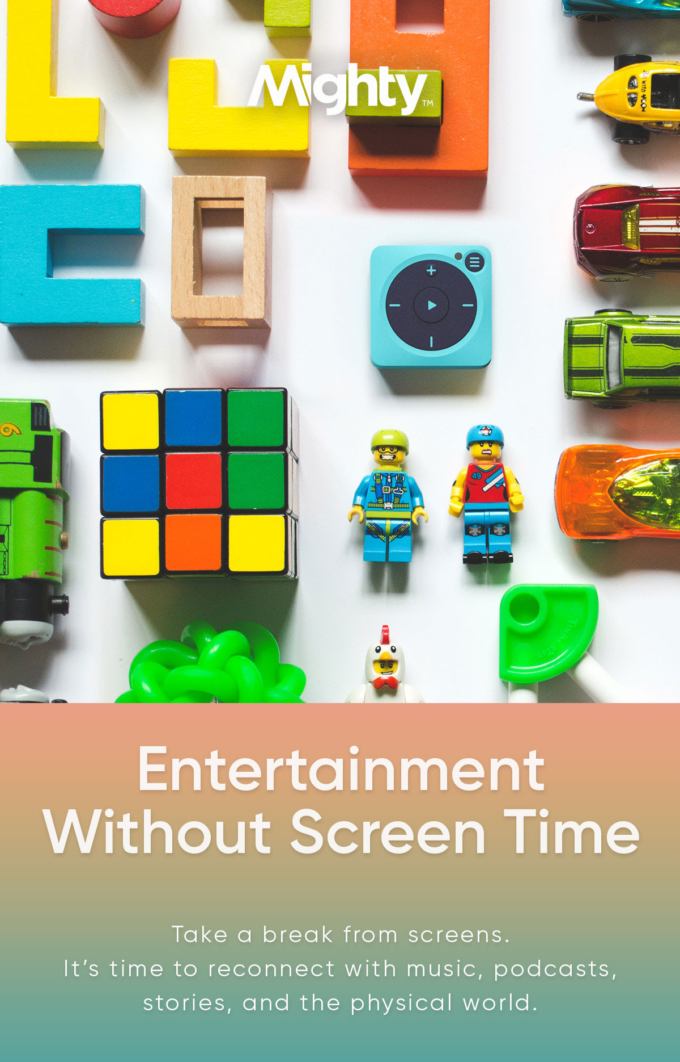
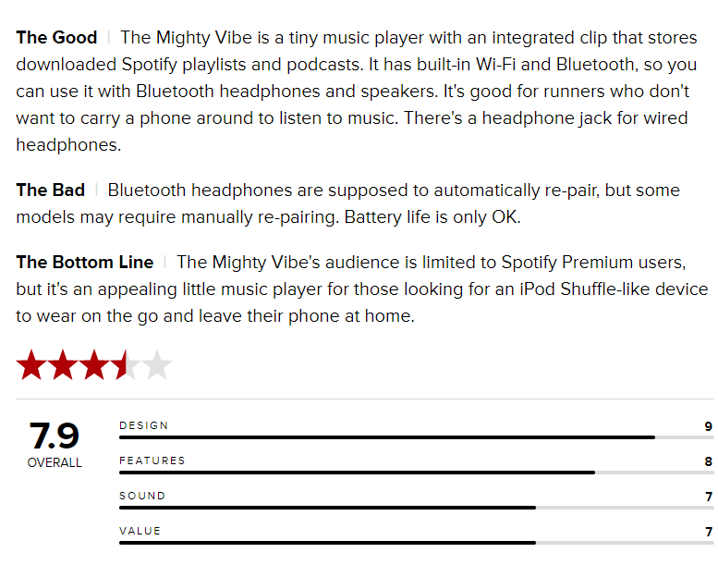
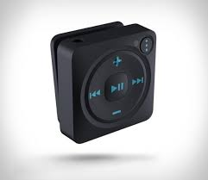
Mighty Vibe
$85

Slide 13
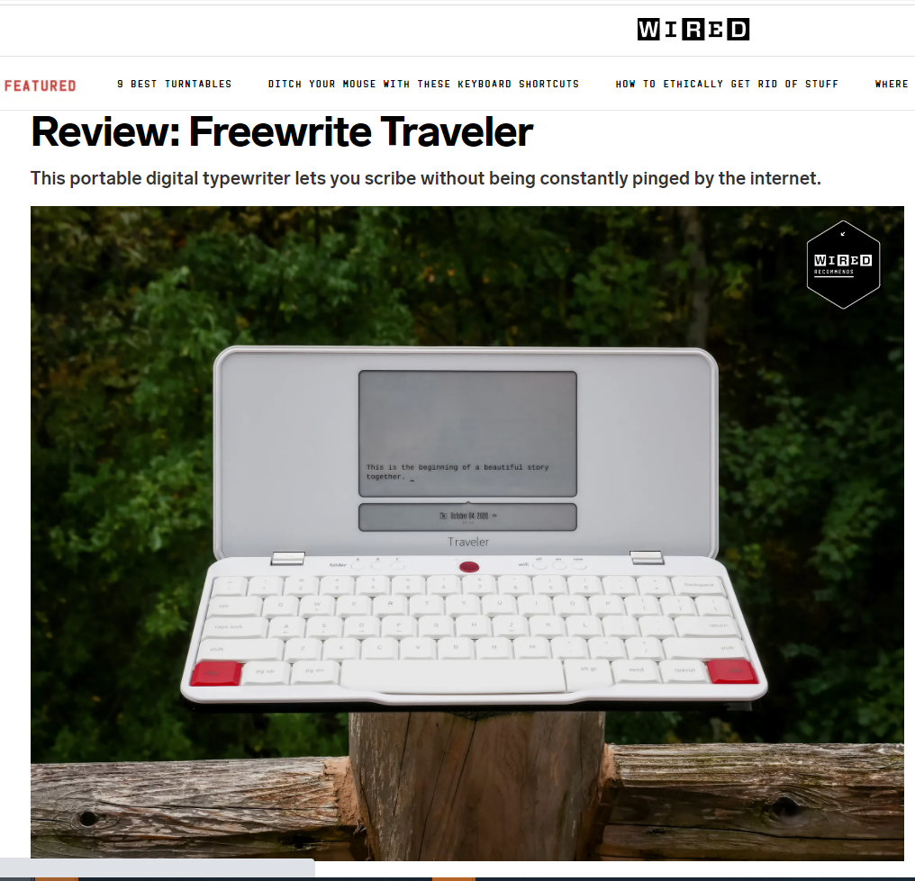
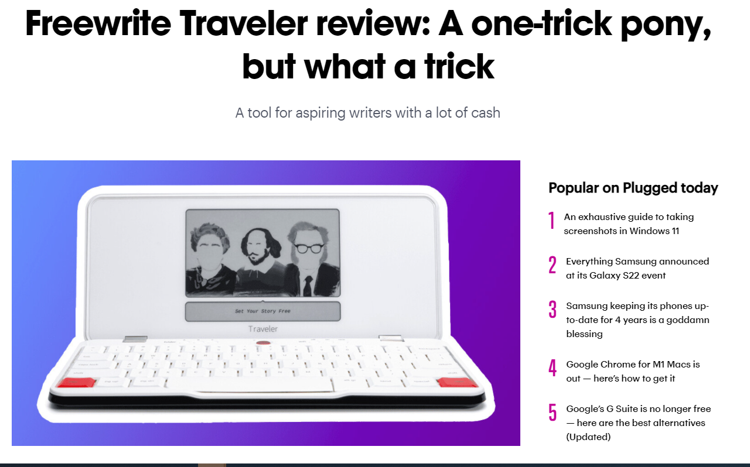
Freewrite

Slide 14
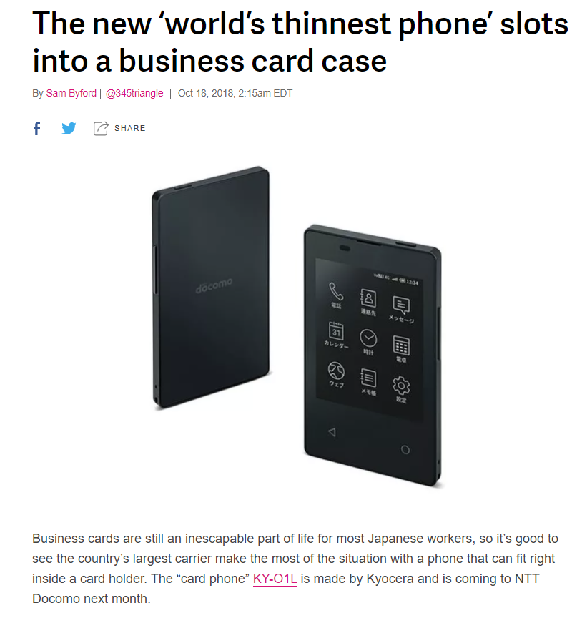
Kyocera KY-O1L

Slide 15
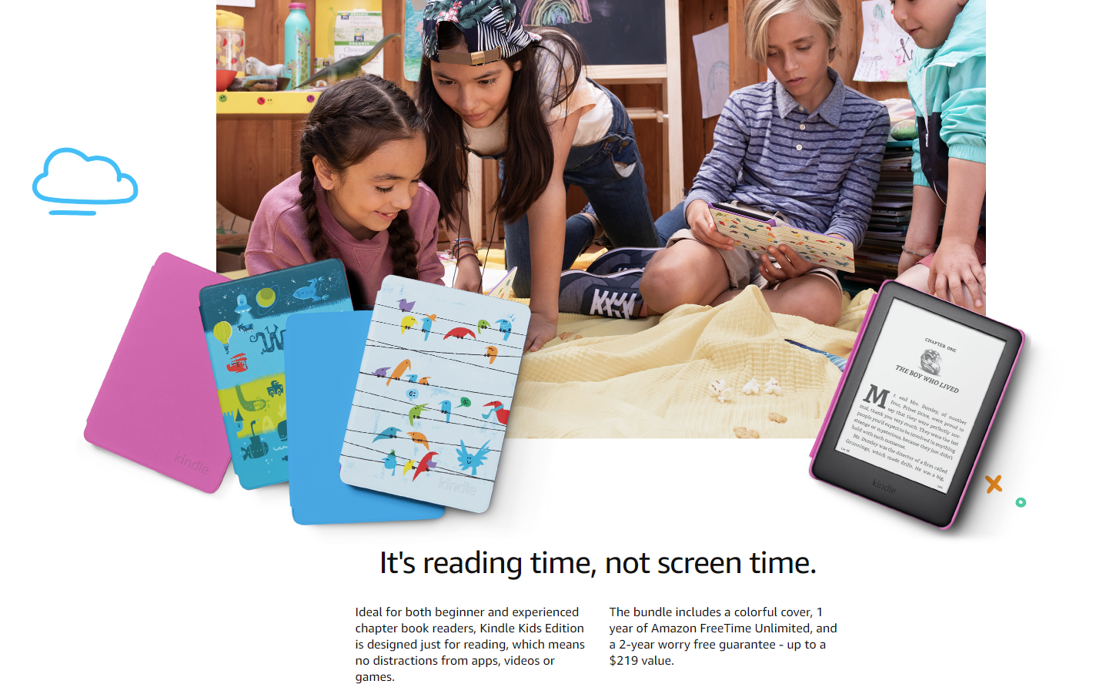
Kindle

Slide 16









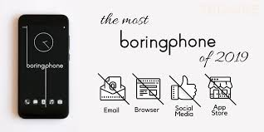




Slide 17
Criteria for good technologies
1
Ergonomic – should not distort our physical capabilities, but help them
Focus – should not decrease our attention span
Supportive of direct human-human interaction
Non-addictive, i.e. should be easy to leave behind
2
3
4

Slide 18
Example Projects
…that could shaped into MSc projects & theses

Slide 19
#1: The oPhone
Move away from distractive apps and take digital control

Slide 20
Problem: Today’s smartphone with their big screen and minimum of buttons invites consumption and scrolling over control and creativity.
Solution: Turning the screen-to-button ratio upside down, we build a phone with a small screen in the center and a relatively high number of buttons surrounding it, providing both fast keyboard input as well as short-keys for the most popular functions.
The operating system is chat-based, which means short commands such as "pay 20 NOK for parking" or "set GPS to first metro station" are typically used. This is more similar to smart home assistants than old-fashioned smartphones, and is enabled (or made realistic) by the high number of keys available.

Slide 21
Unlike a smartphone, the number of keys are maximized relative to the size of the screen
Some keys are programmable, and have their own programmable on-key screen. This enables shortcuts, adding to the users control
The OS is chat-based, and avoids displaying apps and icons altogether. This reduces the risk of "just checking twitter" when you meant to make a call

Slide 22
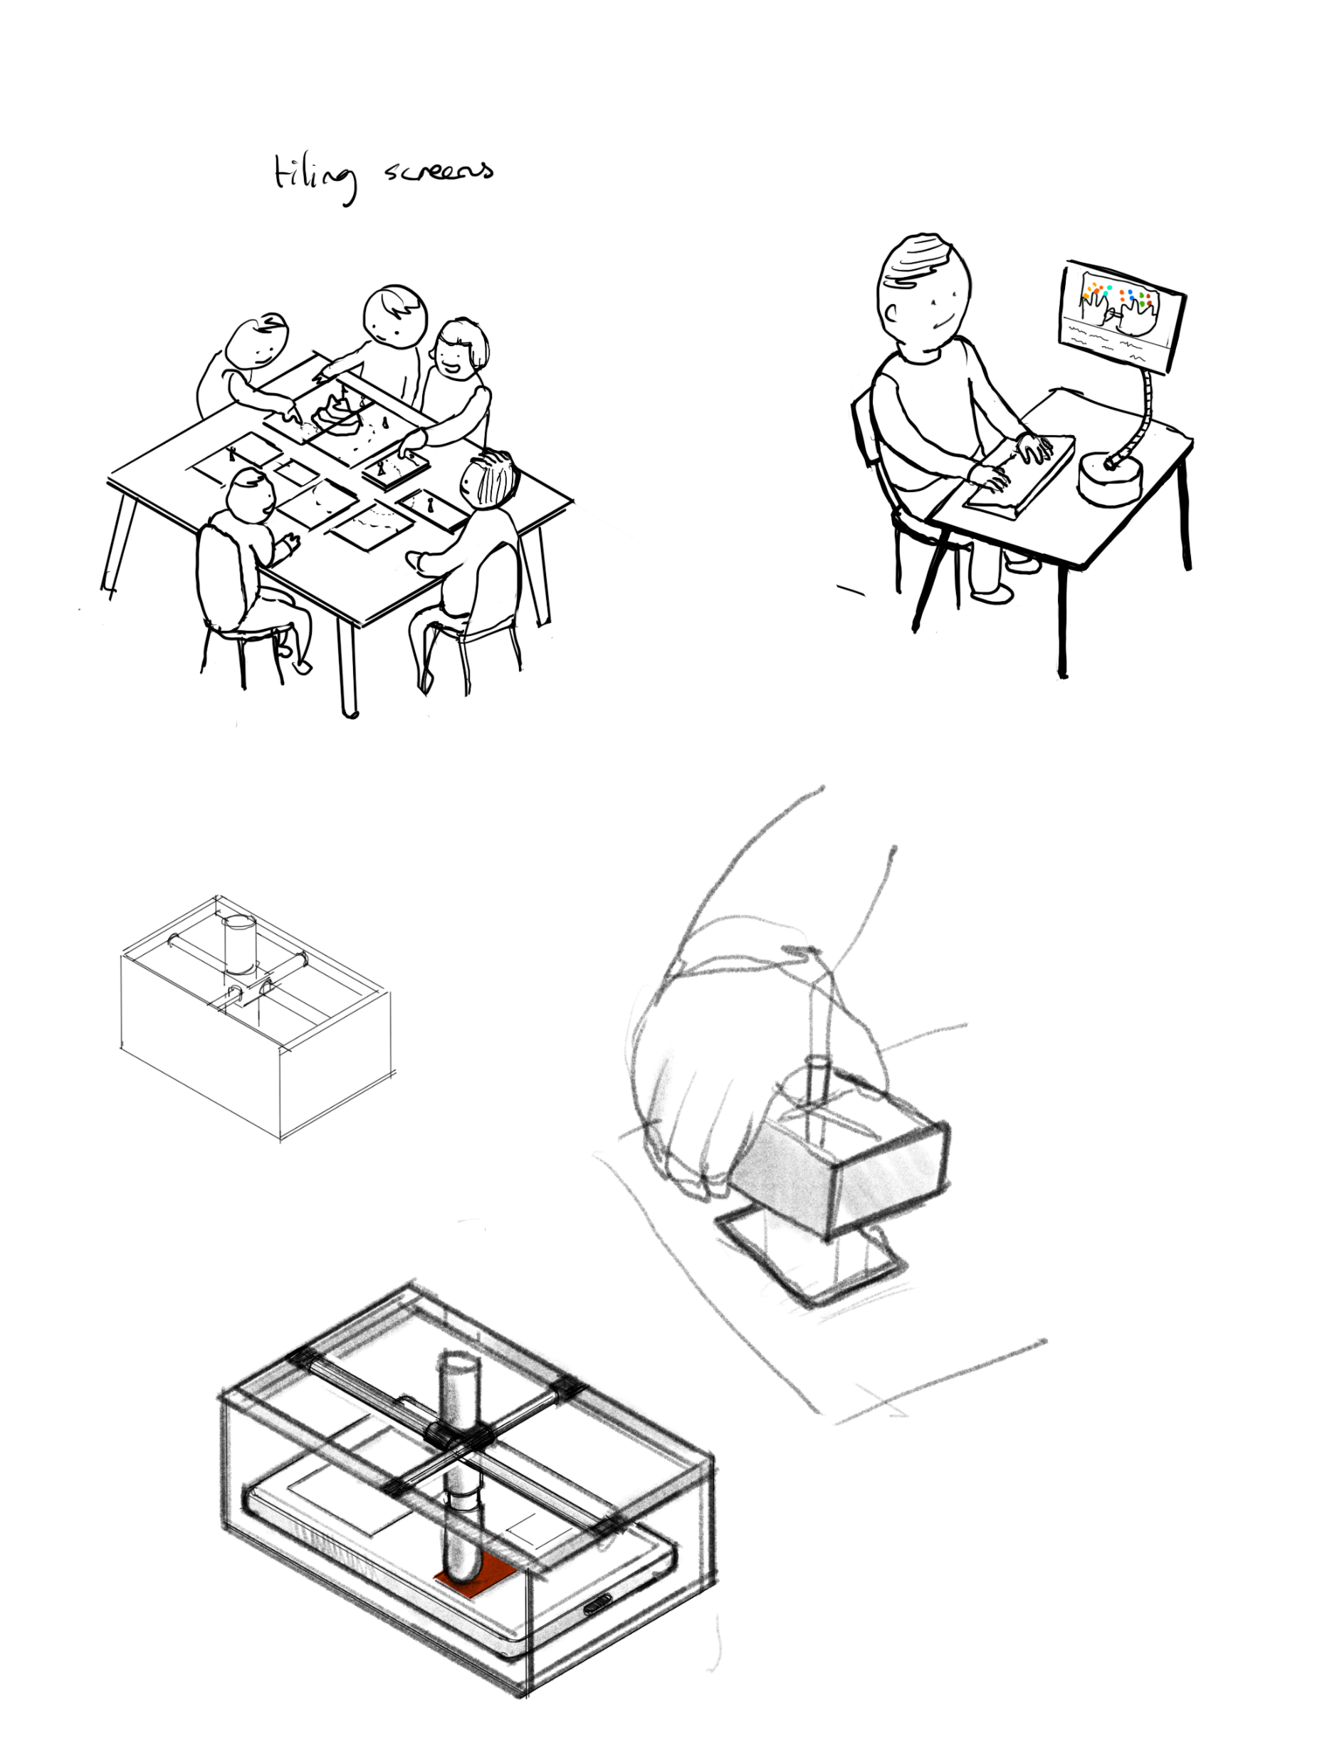
#2: Social phones
Change the social dynamics of using a smartphone with your friends

Slide 23
Problem: Smartphones tend to be a distraction, not only when you are by yourself but also when meeting others. Picking up the phone in the middle of a conversation can easily become a habit reducing the level of intimacy and connection.
Solution: Create a new set of opportunities and a new dynamic around the smartphones by tiling them and use them for on-site social interaction.
The smartphones can be put on a table and their relative locations determined either by using sound (locating relative positions of microphones and speakers via acoustic signals), or via touch protocol, where the phones are first placed on the table and then neighboring points on the phones pressed simultaneously.
Games can then be built which uses the full size of the combined screens, and where the games become richer the more people join in – or the bigger and more complex the tilings of the screens become

Slide 24
The relative positions of the screens can be computed in a number of ways, including (a) acoustic/ultrasonic localization with built-in speakers and microphones, or (b) a startup (multi-) screen tapping session to get the relative positions
Complex patterns of smartphones lead to complex and interesting 'levels' in the games
Additional hardware, such as specific, senseable bord-game pieces can be introduced

Slide 25
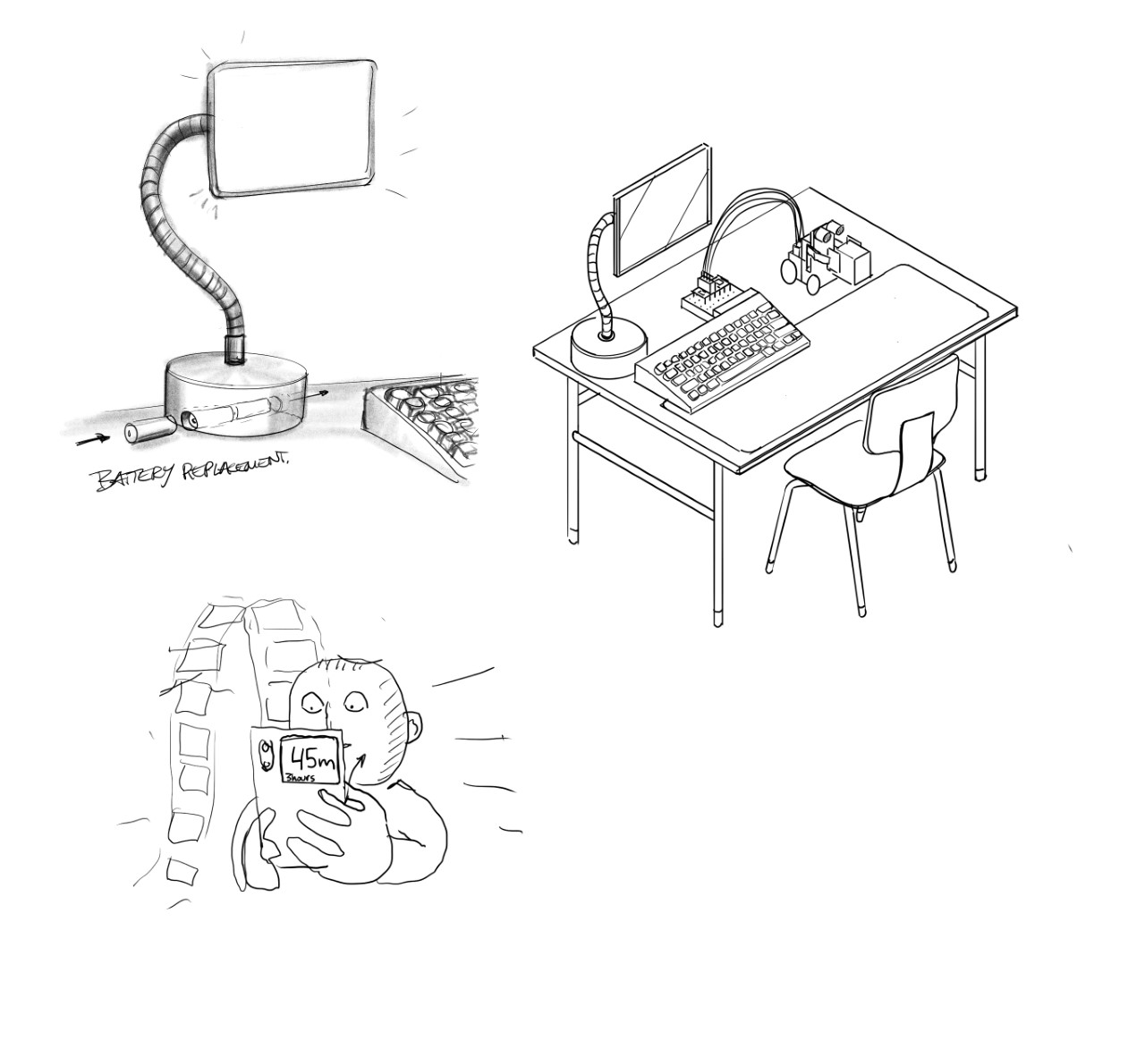
#3 NorCode
A dedicated school PC for coding and robotics, free from colorful apps

Slide 26
Problem: Schools introduce iPads and Chromebooks that are not particularly well suited for teaching kids key digital skills like coding and robotics. Instead, they are faced with a well of colorful apps associated with unclear learning goals, with a physical design not well suited for growing bodies. The kids soon become part of the digital data collection regime of the big tech companies.
Solution: A dedicated PC with its own teaching universe, disconnected from the web and from streaming. Flexible and ergonomically designed for children, and featuring its own teaching program packages. The device itself is low power with a simple screen where the action happens away from the screen itself, using actuators, sensors and robots as natural output modalities.

Slide 27
Low action, low power screen: Low color screen, e-Ink or moncrome. The goal is not scrolling but coding
Connection for robots and sensor. The primary output is not what happens on the screen but on your desk
Ergonomic adjustment of the screen to fit the childs height
Exchangable battery pack.
2 batteries per device. So that the device can be placed on the desk without needing cables. A class set box of batteries is continously charged
Large touch pad (optional). A mouse or a small touchpad is not ideal for a child's fine motor develoment.

Slide 28
#4 Mobile butler
Create a new tech ecosystem on top of existing ones.

Slide 29
Problem: Lots of features you would want such as «universal away message» are not available in iOS or Android. These devices also invite you to spend more time than you might like browsing gaming and scrolling.
Solution?: «Wrap them in», and provide your own interface to your smart phone
A housing device that can simulate touch input and read the screen. The touch input can be created with a stylus held in place by servo motors above the screen.
Your own interface could be a wrist band, a small screen with buttons or other device. An in-the-housing camera sees what happens on screen and uses machine learing to drive the interaction using the stylus

Slide 30
The device is portable and can be fit into your backpack or purse. It becomes a personal device, an extension to your smartphone.
Computer vision and AI processing happens on the device itself.
Any app or function on the smartphone can be invoked via the touch mechanism, driven by servos
New devices can be connected. For instance, a minimalist wristband which tells you who has called and when.
An alternative design solution could be to avoid the "double servo" solution, and instead use 4 servos with string/rubber attached to a ball which acts as the "finger"

Slide 31
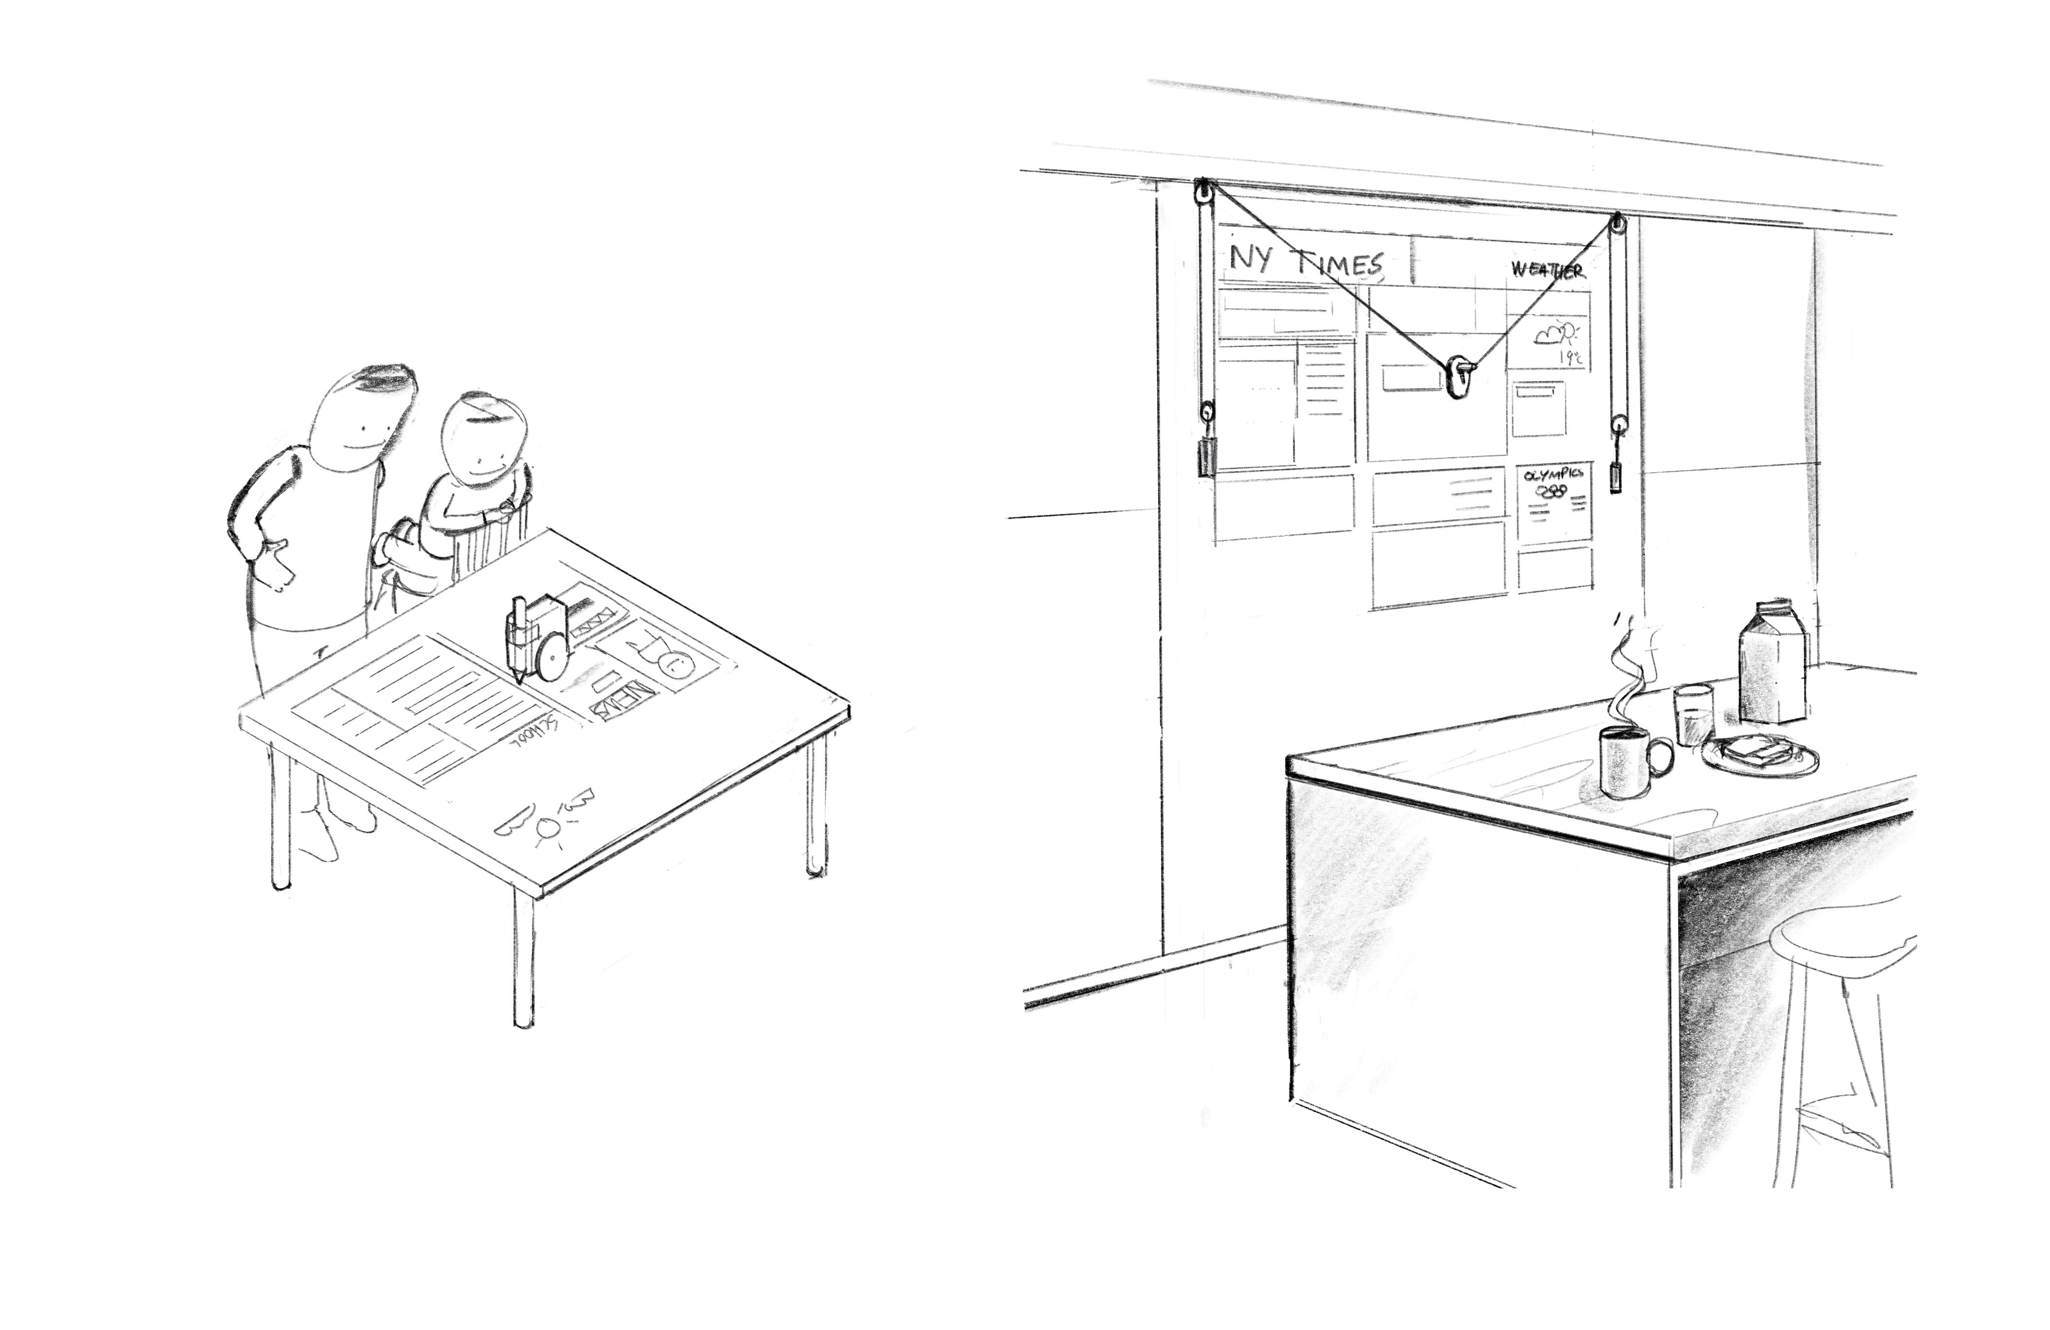
#5 Plotbot
Get your morning news without risking distraction ("unclickable news")

Slide 32
Problem: Today’s screens benefit from multiple sources of data but have the downside of being easily over-used for scrolling, surfing, browsing and other non-creative activities.
Solution: Maintain the data sources, but change the level of interaction by making the screen read-only
Create a plotter for your home that can hang on a whiteboard or wall and which draws your news, messages and calendar appointments on it, using a whiteboard marker. It could also work on a table or surface, such as a kitchen table with a glass covering

Slide 33

#6 Scrollometer
Get instant feedback on your scrolling and browsing habits

Slide 34
Problem: We all know the experience of scrolling just a little more to see if something positive, new or interesting pops up. "Doomscrolling" is one aspect of this. It is really hard to detect when this is happening, and also to know to which extent you have already built a habit of it.
Solution: Combine accelerometer sensing with NFC for charging. Create a sleeve for your smartphone containing a few accelerometers and an e-ink screen on the backside. This e-ink screen shows your scrolling stats.
The accelerometers detect when you are scrolling using Acoustic Pulse Recognition (APR). The sleeve gets its power from the smartphone itself through NFC and uses some of this power to display your scrolling stats on the back of your sleeve – so you see it when you put down your phone on the table.

Slide 35
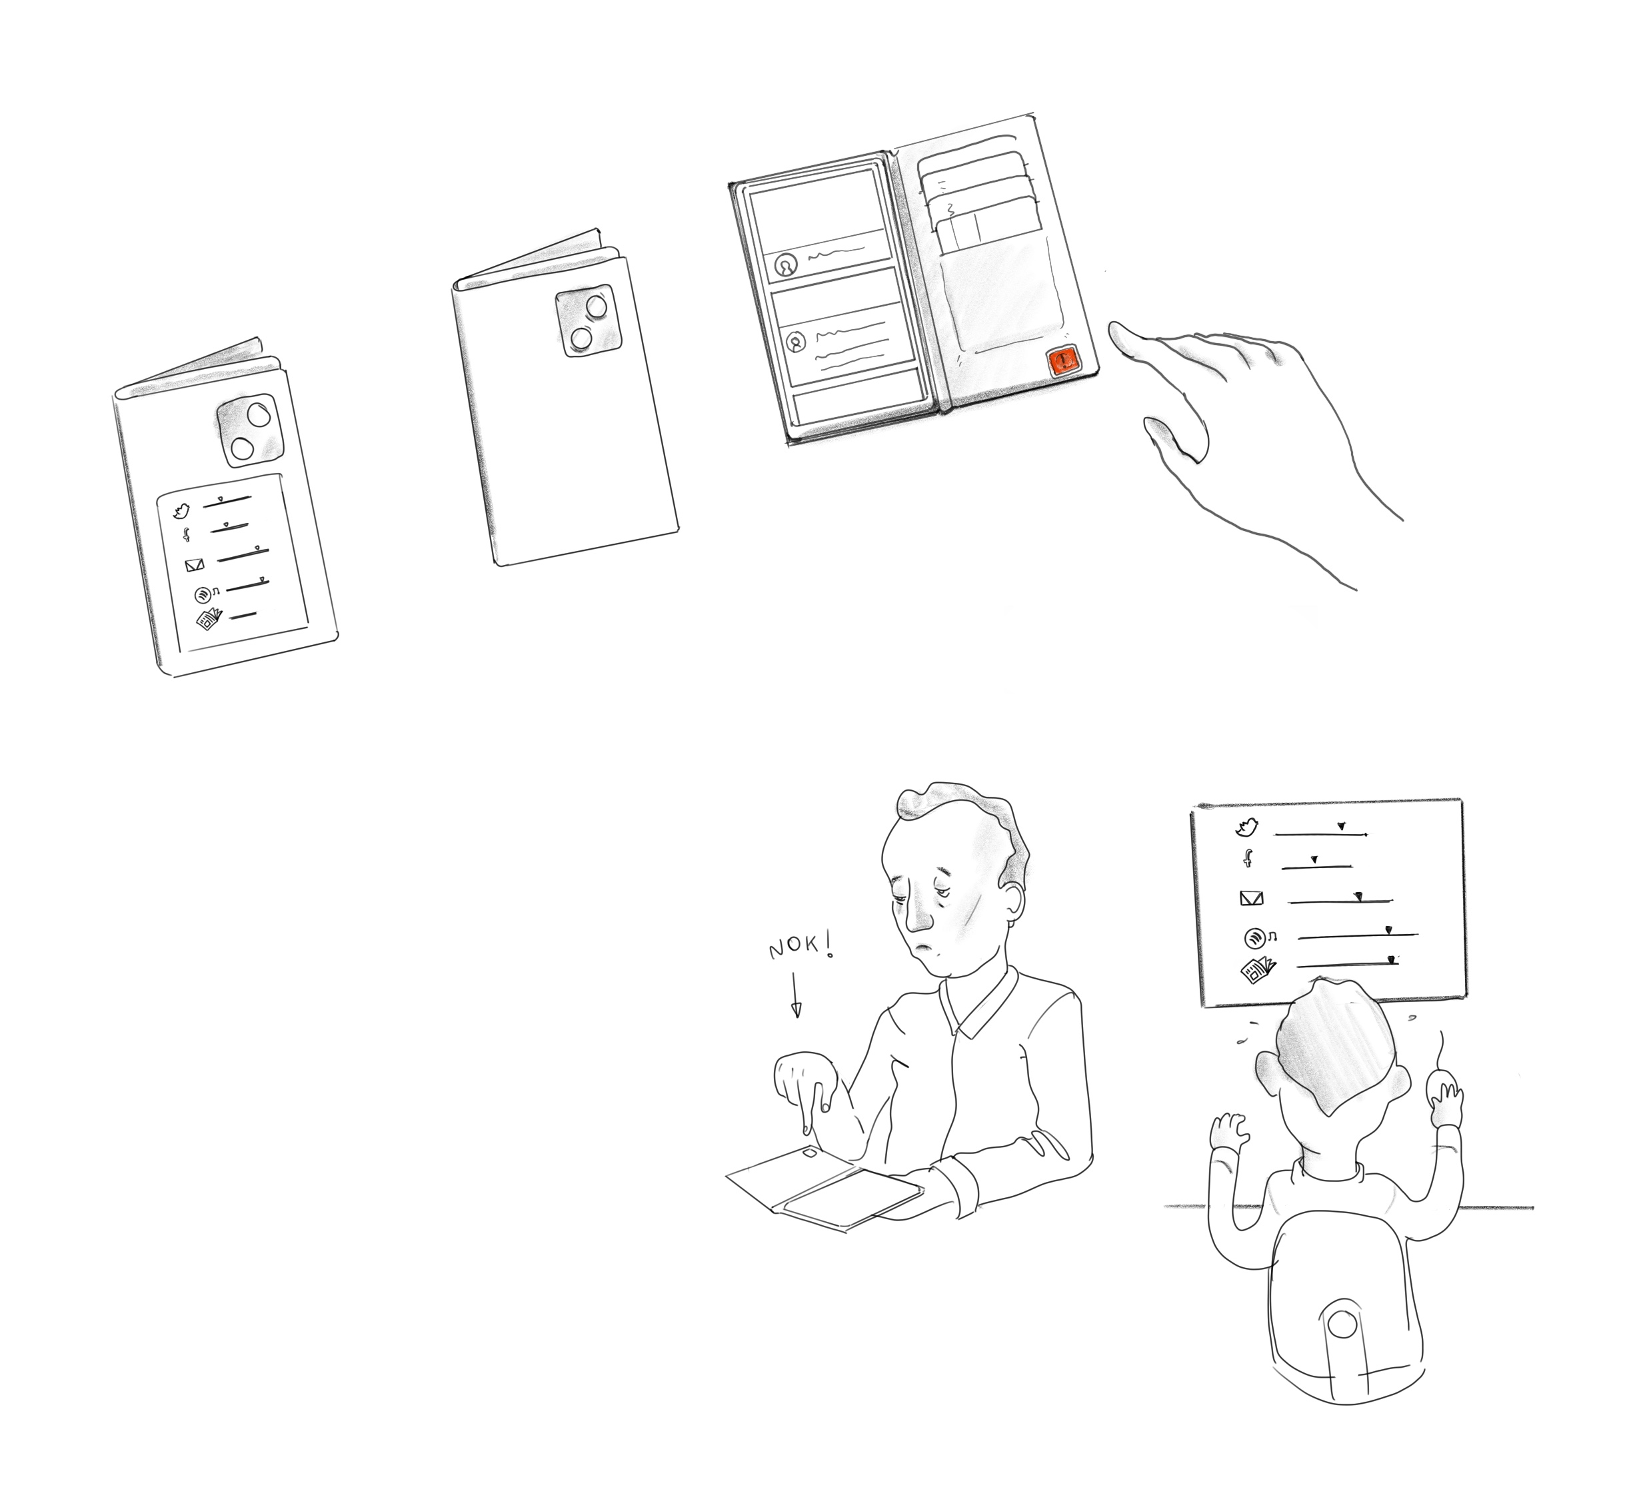
#7 Enough button
Help your personal AI learn your browsing habits and when to stop

Slide 36
Problem: It is hard to know when to take a break from your smartphone, or to know what material makes you happy or sad. You could use various site blocking or control apps, but which features should you really enable? Which sites should you really block or add friction to?
Solution: Add an "enough" button to your phone. It syncs with a VPN app on your phone, so that when you push the button, it knows which site you are at. You don't have to stop scrolling or browsing, but you use your own cognition to store a datapoint – the point where you start feeling overwhelmed. As you progress, your own AI assistant will learn which experiences overwhelm you and provide suggestions for taking control back.

Slide 38
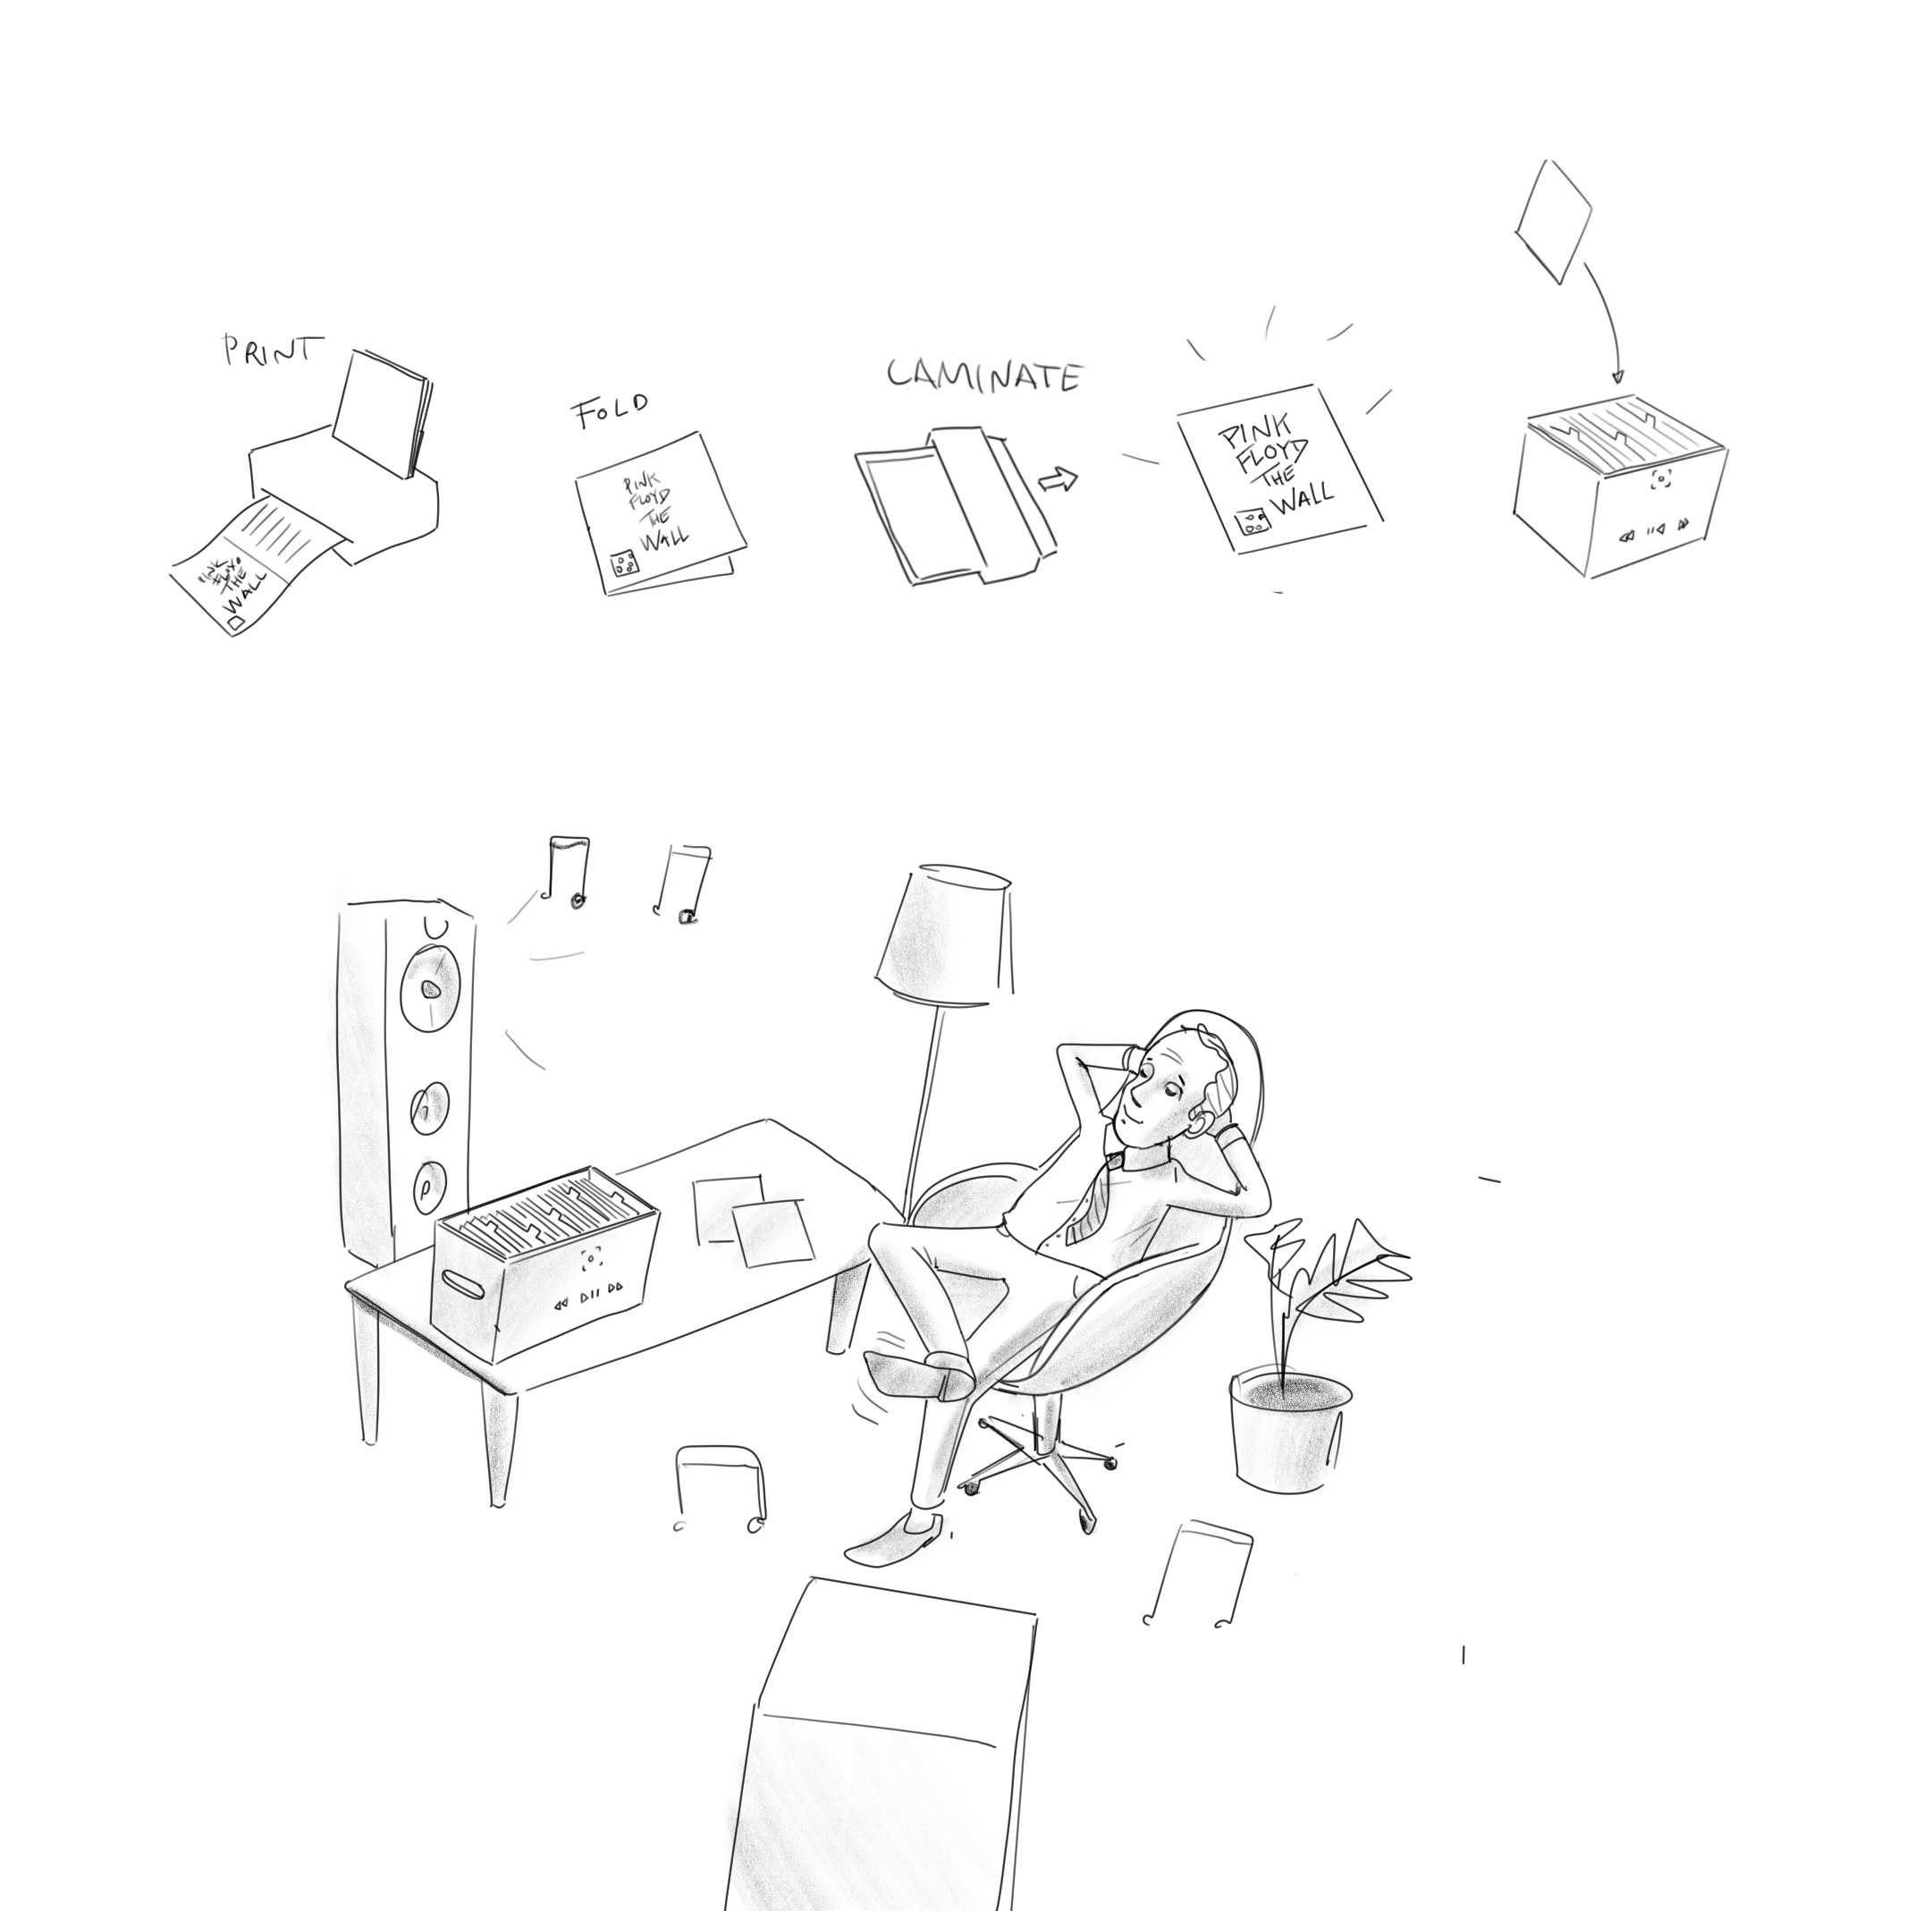
#8 Distractionless music
Stop searching infinite playlists and sample your own music again

Slide 39
Problem: We used to have CDs and records, which provided us with a finite, well cultivated set of listening experiences. Getting the records and putting them in a shelf, ready for playing was an important part of deciding what to listen to. These days, we have an infinite and overwhelming amount of music to select from. You could go back to records, but they are expensive…In addition, to use Spotify you would have to pick up your phone which could lead to all sorts of (self-) distraction)
Solution: Use Spotify of Tidal API to create an offline experience. Build a small PC or Raspberry Pi record-box solution with a small camera capable of detection QR codes. Then, print out the covers of your favourite covers with a QR code and simply "blip them" on outside of the box to play the album. All your selected favourite music at the cost of a streaming subscription.

Slide 41
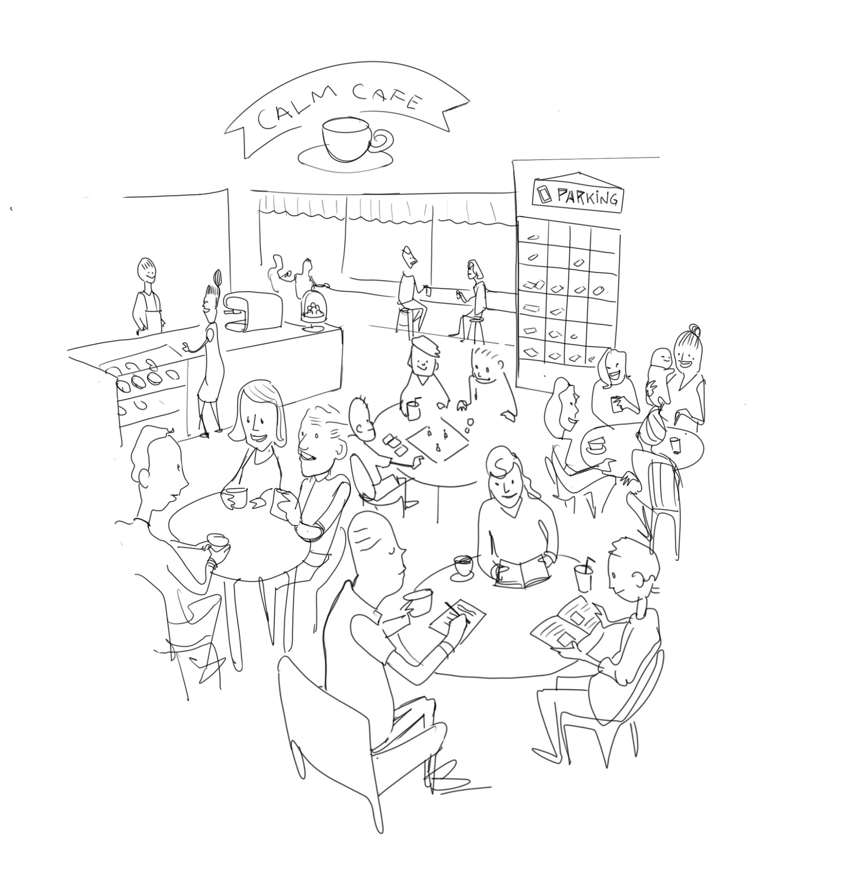
#9 Calm cafe
Spend time with your friends, leaving your phone without worry

Slide 42
Problem: Do you wish to meet up with friends for a real conversation while leaving your phone behind? It is not that easy. Someone could need to reach you or your phone. Yet, if you choose to bring your phone to be sure, there is always the temptation to pick it up and use it, changing the focus and intimacy of the conversation
Solution: Set up a public space, such as a café where you can leave your phone in the locker. Each locker cell has a light sensor. When the phone lights up, it sends to a signal to a wristband that you have picked up when checking the phone in. To keep the number of interrupts to a minimum, you set your phone to focus mode before checking it in, letting only most important calls or messages through.

Slide 43
Shelf for storing smartphones
Wristband detecting phone use – in focus mode

Slide 44
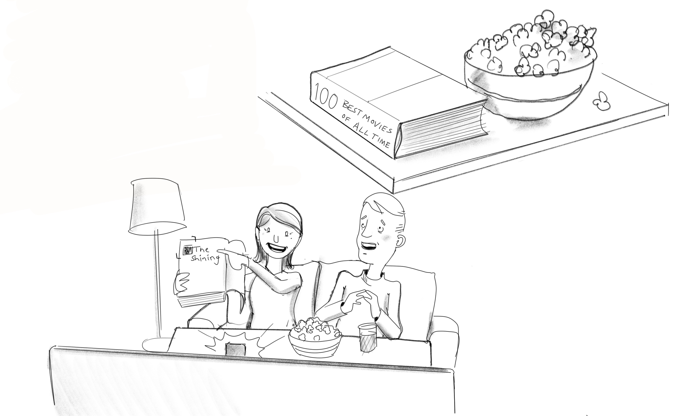
#10 The movie guide
Stop browsing the top choices pushed at you and start seeing great movies

Slide 45
Problem: Have you every tried to watch a movie on iTunes or Netflix and finding nothing. Tired of being recommended only a few titles that fit in the browsing menu of the top tier portals?
Solution: Return to a book-based solution, such as Time Outs "1000 Films to change your life". Each page has an in-depth description of the film and why you should watch it. The pages could be augmented by a QR-code that you can hold up towards the TV to start the moive, bypassing all the menus in the apps.
Details: Rather than providing an app that has to access iTunes or Netflix, you could hack an Apple remote control: Put it in a small box containing a speaker that you control. Now you can 'make' the box say "Hi Siri, play The Great Lebowski", and Siri will do the job for you.

Slide 46
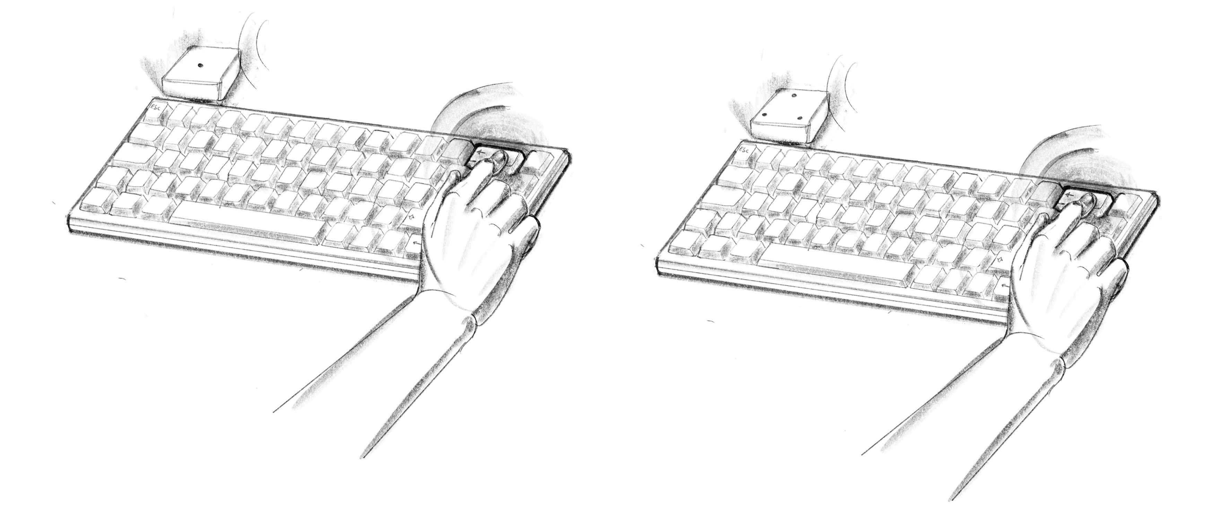
#11 Keyboard pressure and stress monitor
Learn to slow down when you're stressed out

Slide 47
Keyboard pressure & stress monitor
Problem: Sitting for a long time in front of a keyboard, you may start to punch faster and harder as stress levels increase, and being stressed you fail to detect that you should stop for a break
Solution: A monitoring system that detects the force of input and also frequently pushed keys like the delete and backspace buttons
A raspberry Pi with three microphones detecting position and force of a key being hit using relative time-of-flight difference and volume of sound.

Slide 48
Option B: use only a single microphone, and use a driver on the PC to detect which key is being pressed. The mic is then (only) used to detect the force of the key being pressed
Option A: use multiple mics to detect the position of the touch as well as the volume. This device requires no software protocol and works as a keyboard-independent device.
In either case, the algorithms used detect the speed, and the frequency of specific keys being hit. Patterns of interest are detected using machine learning. If for instance "Delete" is pressed frequently in combination with harder touches than normal, this might be a signal for a stressful work situation.

Slide 49
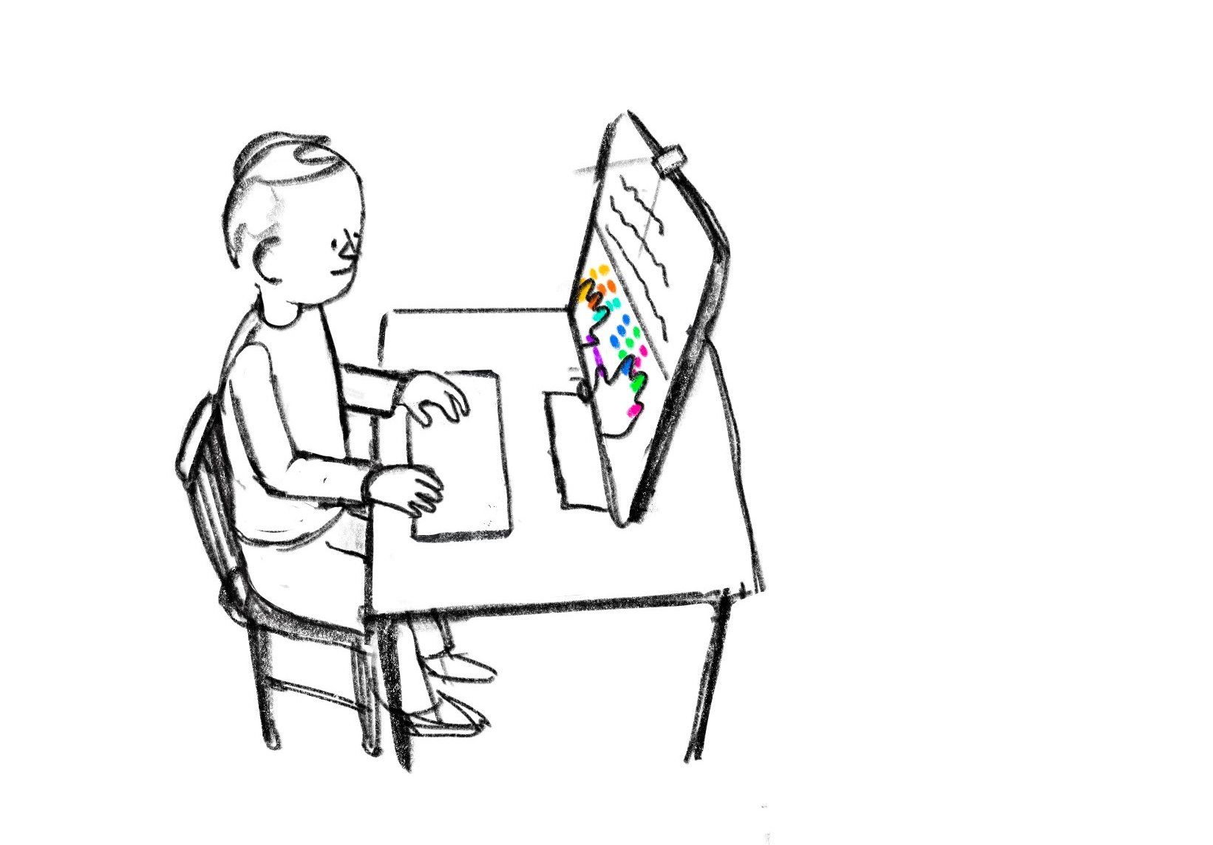
#12 Touch teacher
Learning touch the easy way

Slide 50
Touch teacher
Problem: Children and adults learning touch have little feedback on their performance. There is no easy way to verify which finger hit which key and whether the right finger was used.
Solution: Use a hand-pose tracker such as MediaPose to track the position of the fingers with a camera looking down on the keyboard
The fingers and the keyboard are shown on screen and each finger is coloured in the «Augmented reality» space and the keys to hit are marked in a corresponding colour. This helps the student locate the keys correctly while maintaining her gaze on the screen, without the need to look down.

Slide 51
A camera looking down on the keyboard & fingers
On the screen, each finger is given a specific color.
The keys of the keyboard are – in the augmented on-screen reality – also given a color.
The green on-screen finger goes to the green on-screen key etc
Computer software such as MediaPose, capable of locating the finger joints and segments in real-time, as a skeleton runs on the PC

Slide 52
#13 Smart home assistant
Minimize the interaction with the smart units of your home

Slide 53
Problem: Smart speakers like Amazon Echo and Google Home are neither robust enough to capture arbitrary voice commands nor are they open and democratic platforms that can be tailored to the individual’s needs. They also leak voice informations, habits and purchases.
Solution: «Under-engineering»: Build a keyboard with an integrated small screen featuring ChatBotOS that can give arbitrary commands to your home hi-fi, smart lights etc. Make sure the product looks appealing enough to be a decorative item in your house and use existing conversational interfaces such as KindlyAI

Slide 54
#14 Transparent phone
Get that sci-fi look while staying true to your attention resolutions

Slide 55
Problem: Today’s phones are rich and interactive but are bigger, bulkier and less beautiful than one could desire. They also tend to steal your attention.
Solution: Create a transparent phone made out of glass. The minimal design is an indicator of a person’s desire to stay in control of attention and time and at the same time be an individual concerned with design and appearance.
Use the lower part of a «glass phone» for minimal necessities such as battery and a small chip and chip-sim. The screen consist of a transparent layer of LEDs and a capacitive touch sensor. All screen rendering happens in the cloud and only the pixels are forwarded to the display, reducing computational power needs.

Slide 56
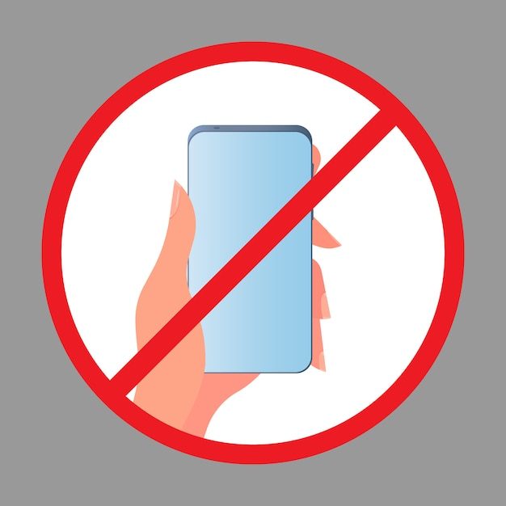
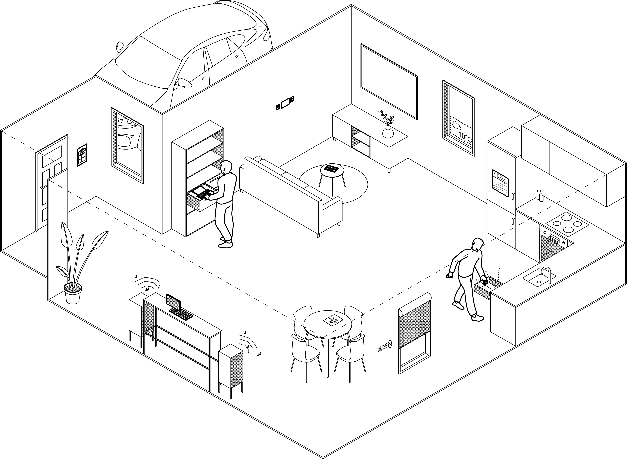
#15 The calm home alternative

Slide 57

The problem revisited
The problem: getting a break from your smartphone – and all its distractions - is becoming next to impossible. The way the OS and UI is designed, opening one app (such as setting a timer) ineviatably leads to looking at another app (such as Twitter), and so the cycle goes on via Reddit, BBC News, the kids activities app and Netflix. The net result? Lack of focus, connection, rest, sleep and increased exposure to commercial surveillance.
The alternative solution: Divide and conquer. When people try to use their phone less, they frequently buy a watch to prevent the temptation to pick up their phone . We can extend on this idea and move essential, phone-triggering functions away from the smartphone and into a physical space where they have more physical context. The remaining challenge? Powering all the small screens, buttons and actuators of the smartphone substitute system. This problem can be solved using RF-based or wireless optical charging - currently developed at SINTEF in the project InCharge - or in some situtions with and with appropriarte low power hardware design – indoor solar cells.

Slide 58
Distributed on-the-wall radio – buttons/wheels and screen separate
Transparent temperature display on window
Hidden smart home assistant, keyboard and chatbot-based (no smart speaker)
4
E-ink family calendar on fridge
1
8
Car control center
2
5
6
E-ink media selection tablet
3
9
7
A
In-drawer light
Cord-free media station with keyboard
Shade control
Projected or E-ink newspaper reader

Slide 59
Distributed on-the-wall radio – buttons/wheels and screen separate
Transparent temperature display on window
Hidden smart home assistant, keyboard and chatbot-based (no smart speaker)
4
E-ink family calendar on fridge
1
8
Car control center
2
5
6
E-ink media selection tablet
3
9
7
A
In-drawer light
Cord-free media station with keyboard
Shade control
Projected or E-ink newspaper reader
Together, these functions take away most reasons to pick up your phone at home – while letting your loved ones know what you are up to (unlike the situation today when you are clutching your phone)

Slide 60






Entirely new designs can be envisioned using wireless charging, because parts of a unit can be ‘exploded out’ from a unifying structure. Here, a radio has two dials separate from a screen in the middle.
Information can be (re-) placed into a physical context. The outside temperature can ‘live’ as a small screen on the window.
Controls can be placed at natural locations. The screen controlling the car can be on the way out into or in from the garage.
4
1
8
Low power portable screen can control information in a natural context. Here, the e-ink tablet is close to the TV and is used for selecting top channels and streaming services.
Compute can be put in the background where it doesn’t grab attention. In this example, a keyboard-driven chatbot computer lives in a drawer and can be used for arbitrary functions. Charging happens through the knob on the drawer, no need for cabling.
Information can be placed in places the family members visit habitually. An e-ink calender with wireless sync and updates is placed on the refridgerator.
5
6
2

Slide 61



Dedicated screens can be used for dedicated purposes and tied to specific locations. In this example, an e-ink newspaper reader lives at the dining table. The positioning capabilities of the wireless charging systems can be used to disable use beyond the dining table, so the paper doesn’t get lost.
Wireless charging can provide momentary lighting in locations where visibility is low. In this example, LED lights are placed inside the drawer, and are turned on when it is opened, or when there is motion inside the drawer, using proximity sensing. Charging happens through the knob of the drawer
Music and media streaming is a key driver for mobile usage at home. In this example, a tablet or phablet is used as the media hub, meaning you can leave your phone in your jacket. The bluetooh-connected keyboard also means you can search songs and media much faster than you could typing on a small touchscreen.
7
3
9

Slide 62
#16 Re-printable paper (with eInk)
Problem: Today’s screens benefit from multiple sources of data but have the downside of being easily over-used for scrolling, surfing, browsing and other non-creative activities.
Solution?: Use a re-printable material such as eInk to produce any document or booklet that you want to keep for a while
Details: Use raw eInk material and make a dedicated printer for it: Attach the surface electrode to one of the poles and move a dedicated counter-pole «plotter style» for each pixel you want to set

Slide 63


Techwell
A gemini-centre for humane digitalization. See techwell.no for more info

