Slide 1
Master studies at ITS
Kaja Mosserud-Haavardsholm
Administrative head of studies, ITS
kajaem@its.uio.no
Notes:
I’m Kaja, studied here before OJD even existed.

Slide 2
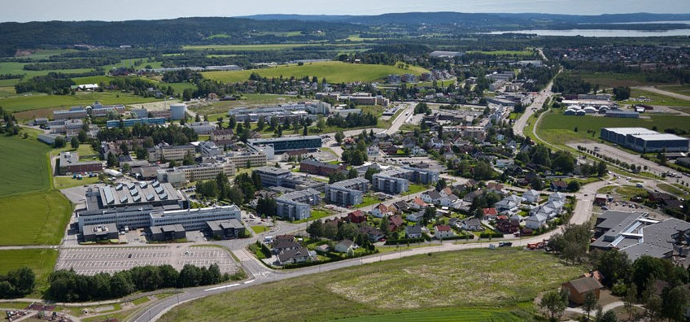
Department of Technology Systems, you say?
Based at Kjeller Science Park – where the Internet first came to Europe
Foundation (started by UiO and establishments at Kjeller) for 30 years; since 2017 a department at MN/UiO
About 12 full-time researchers
About 30 lecturers and supervisors with main positions in industry or research establishments
Notes:
«where the Internet first came to Europe» - literally, in our basement
UNIK – owned by Universities and research establishments
FFI - Norwegian Defence Research Establishment
IFE – Institute for energy technology
NORSAR
Justervesenet - Norwegian Metrology Service
NILU – Norwegian institute for air research
Telenor

Slide 3
Accociated organisations
Kjeller Science park, Lillestrøm
Kongsberg-gr.
Akershus Energi
Rainpower
NILU
IFE
Kjeller innovasjon
FFI
NORSAR
Oslo Met
FLO/Kjeller
AIM Norway
Juster-vesenet
Other partners companies of ITS:
Campus Blindern
Thales
ABB
Telenor

Slide 4
ITS
Purpose: Take the knowledge and research available in the science park, and insert it into the University
~40+ courses for Master and PhD students taught by researchers from Kjeller Science Park and other research establishments
Supervisors for Master’s and PhD theses
Notes:
ITS = Department of Technology Systems

Slide 5
Teachers and supervisors from:

Slide 6
Research areas and Master’s studies
Two sections and one Centre for research based innovation:
Energy Systems
Autonomous Systems and Sensor Technologies
CENSSS, Centre for Space Sensors and Systems (RIMFAX)
Three Master’s studies/programme options:
Renewable Energy Systems
I:Robotics: Cybernetics and Autonomous Systems
Space Systems

Slide 7
Courses at ITS
Autonomous Systems and Sensor Technologies
TEK4030 Control of manipulators and mobile robots
TEK4040 Mathematical modelling of dynamic system
TEK4050 Stochastic systems
TEK5010 Multi-agent systems
TEK5020 Pattern Recognition
TEK5030 Computer Vision
TEK5040 Deep learning for autonomous systems
TEK5600 Visualization of scientific data
Space Sensors and Systems
TEK4000 Systems Engineering
TEK4010 Optics and light
TEK4700 Space Systems
TEK4710 Space Sensors and Communications
TEK5050 Detection of Optical and Infrared Radiation
TEK5130 Satellite Communications
TEK5160 Radar remote sensing
TEK5710 Design of Small Satellites (2024)
TEK5720 Project in Space Systems (2024)
Security and Cyber Physical systems
TEK4500 Introduction to Cryptography
TEK5070 Wireless communications for autonomous and critical sensor systems
TEK5110 Building and Monitoring Communication Networks
TEK5510 Security in operating systems and software
TEK5520 Information security in industrial sensor and mobile systems
TEK5530 Measurable Security for the Internet of Things
TEK5550 Advanced topics in cryptology
Energy Systems
TEK5300 Renewable energy: science and technology
TEK5330 Solar Energy Systems
TEK5340 Energy systems analysis: Modelling, methods and scenarios
TEK5350 Energy Markets and Regulation
TEK5370 Grid, smartgrid og IoT
TEK5380 Prosjekt innen fornybar energi
TEK5390 Hydrogenteknologi
TEK5410 Energy Markets and Regulation - Modelling and Analysis
TEK5420 Norway’s Energy Transitions: Policy Directions and Challenges
TEK5440 Batteries: Technology and Systems
Photo by Christina @ wocintechchat.com on Unsplash
Notes:
All available on the UiO web page.

Slide 8
Courses at ITS
Autonomous Systems and Sensor Technologies
TEK4030 Control of manipulators and mobile robots
TEK4040 Mathematical modelling of dynamic system
TEK4050 Stochastic systems
TEK5010 Multi-agent systems
TEK5020 Pattern Recognition
TEK5030 Computer Vision
TEK5040 Deep learning for autonomous systems
TEK5600 Visualization of scientific data
Space Sensors and Systems
TEK4000 Systems Engineering
TEK4010 Optics and light
TEK4700 Space Systems
TEK4710 Space Sensors and Communications
TEK5050 Detection of Optical and Infrared Radiation
TEK5130 Satellite Communications
TEK5160 Radar remote sensing
TEK5710 Design of Small Satellites (2024)
TEK5720 Project in Space Systems (2024)
Security and Cyber Physical systems
TEK4500 Introduction to Cryptography
TEK5070 Wireless communications for autonomous and critical sensor systems
TEK5110 Building and Monitoring Communication Networks
TEK5510 Security in operating systems and software
TEK5520 Information security in industrial sensor and mobile systems
TEK5530 Measurable Security for the Internet of Things
TEK5550 Advanced topics in cryptology
Energy Systems
TEK5300 Renewable energy: science and technology
TEK5330 Solar Energy Systems
TEK5340 Energy systems analysis: Modelling, methods and scenarios
TEK5350 Energy Markets and Regulation
TEK5370 Grid, smartgrid og IoT
TEK5380 Prosjekt innen fornybar energi
TEK5390 Hydrogenteknologi
TEK5410 Energy Markets and Regulation - Modelling and Analysis
TEK5420 Norway’s Energy Transitions: Policy Directions and Challenges
TEK5440 Batteries: Technology and Systems
http://www.uio.no/studier/emner/matnat/its/
Photo by Christina @ wocintechchat.com on Unsplash
Notes:
All available on the UiO web page.

Slide 9
Courses at ITS
Autonomous Systems and Sensor Technologies
TEK4030 Control of manipulators and mobile robots
TEK4040 Mathematical modelling of dynamic system
TEK4050 Stochastic systems
TEK5010 Multi-agent systems
TEK5020 Pattern Recognition
TEK5030 Computer Vision
TEK5040 Deep learning for autonomous systems
TEK5600 Visualization of scientific data
Space Sensors and Systems
TEK4000 Systems Engineering
TEK4010 Optics and light
TEK4700 Space Systems
TEK4710 Space Sensors and Communications
TEK5050 Detection of Optical and Infrared Radiation
TEK5130 Satellite Communications
TEK5160 Radar remote sensing
TEK5710 Design of Small Satellites (2024)
TEK5720 Project in Space Systems (2024)
Security and Cyber Physical systems
TEK4500 Introduction to Cryptography
TEK5070 Wireless communications for autonomous and critical sensor systems
TEK5110 Building and Monitoring Communication Networks
TEK5510 Security in operating systems and software
TEK5520 Information security in industrial sensor and mobile systems
TEK5530 Measurable Security for the Internet of Things
TEK5550 Advanced topics in cryptology
Energy Systems
TEK5300 Renewable energy: science and technology
TEK5330 Solar Energy Systems
TEK5340 Energy systems analysis: Modelling, methods and scenarios
TEK5350 Energy Markets and Regulation
TEK5370 Grid, smartgrid og IoT
TEK5380 Prosjekt innen fornybar energi
TEK5390 Hydrogenteknologi
TEK5410 Energy Markets and Regulation - Modelling and Analysis
TEK5420 Norway’s Energy Transitions: Policy Directions and Challenges
TEK5440 Batteries: Technology and Systems
http://www.uio.no/studier/emner/matnat/its/
Photo by Christina @ wocintechchat.com on Unsplash
Notes:
All available on the UiO web page.

Slide 10
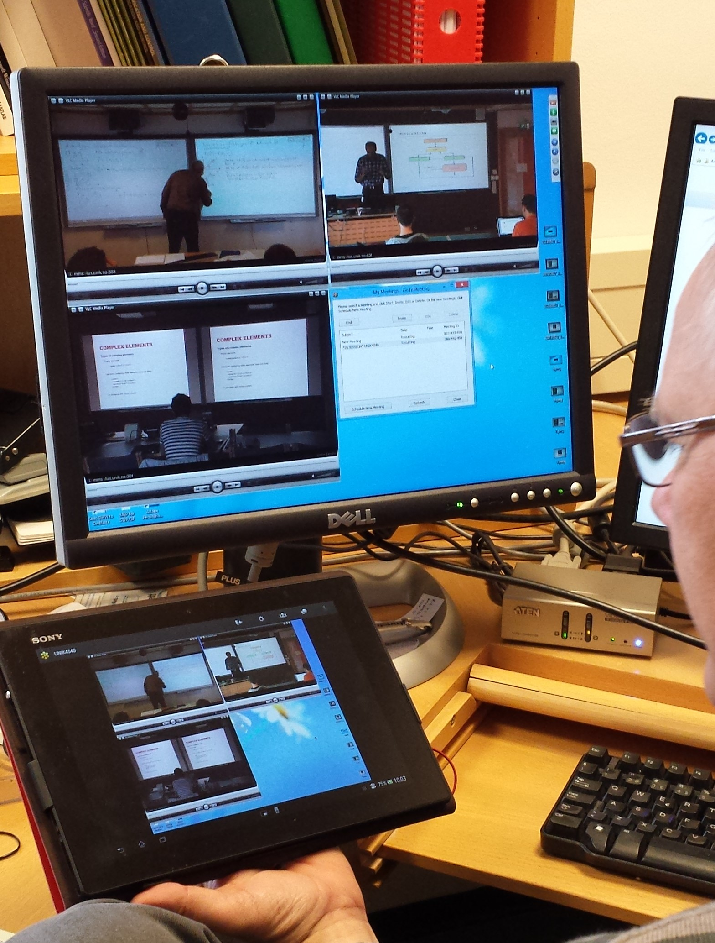
Attending courses at ITS
Two teaching sessions
09:15-12:00 /13:15-16:00
Free bus from Blindern (OJD – Informatics building) to and from each session
A lot of our courses are video transferred (streaming / recording / zoom)
Notes:
I usually add the percentage (80-90%), but now I give up. :o) Just ask your lecturer.

Slide 11
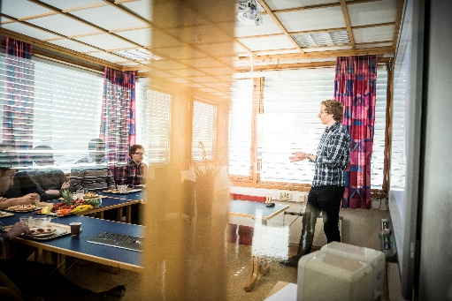
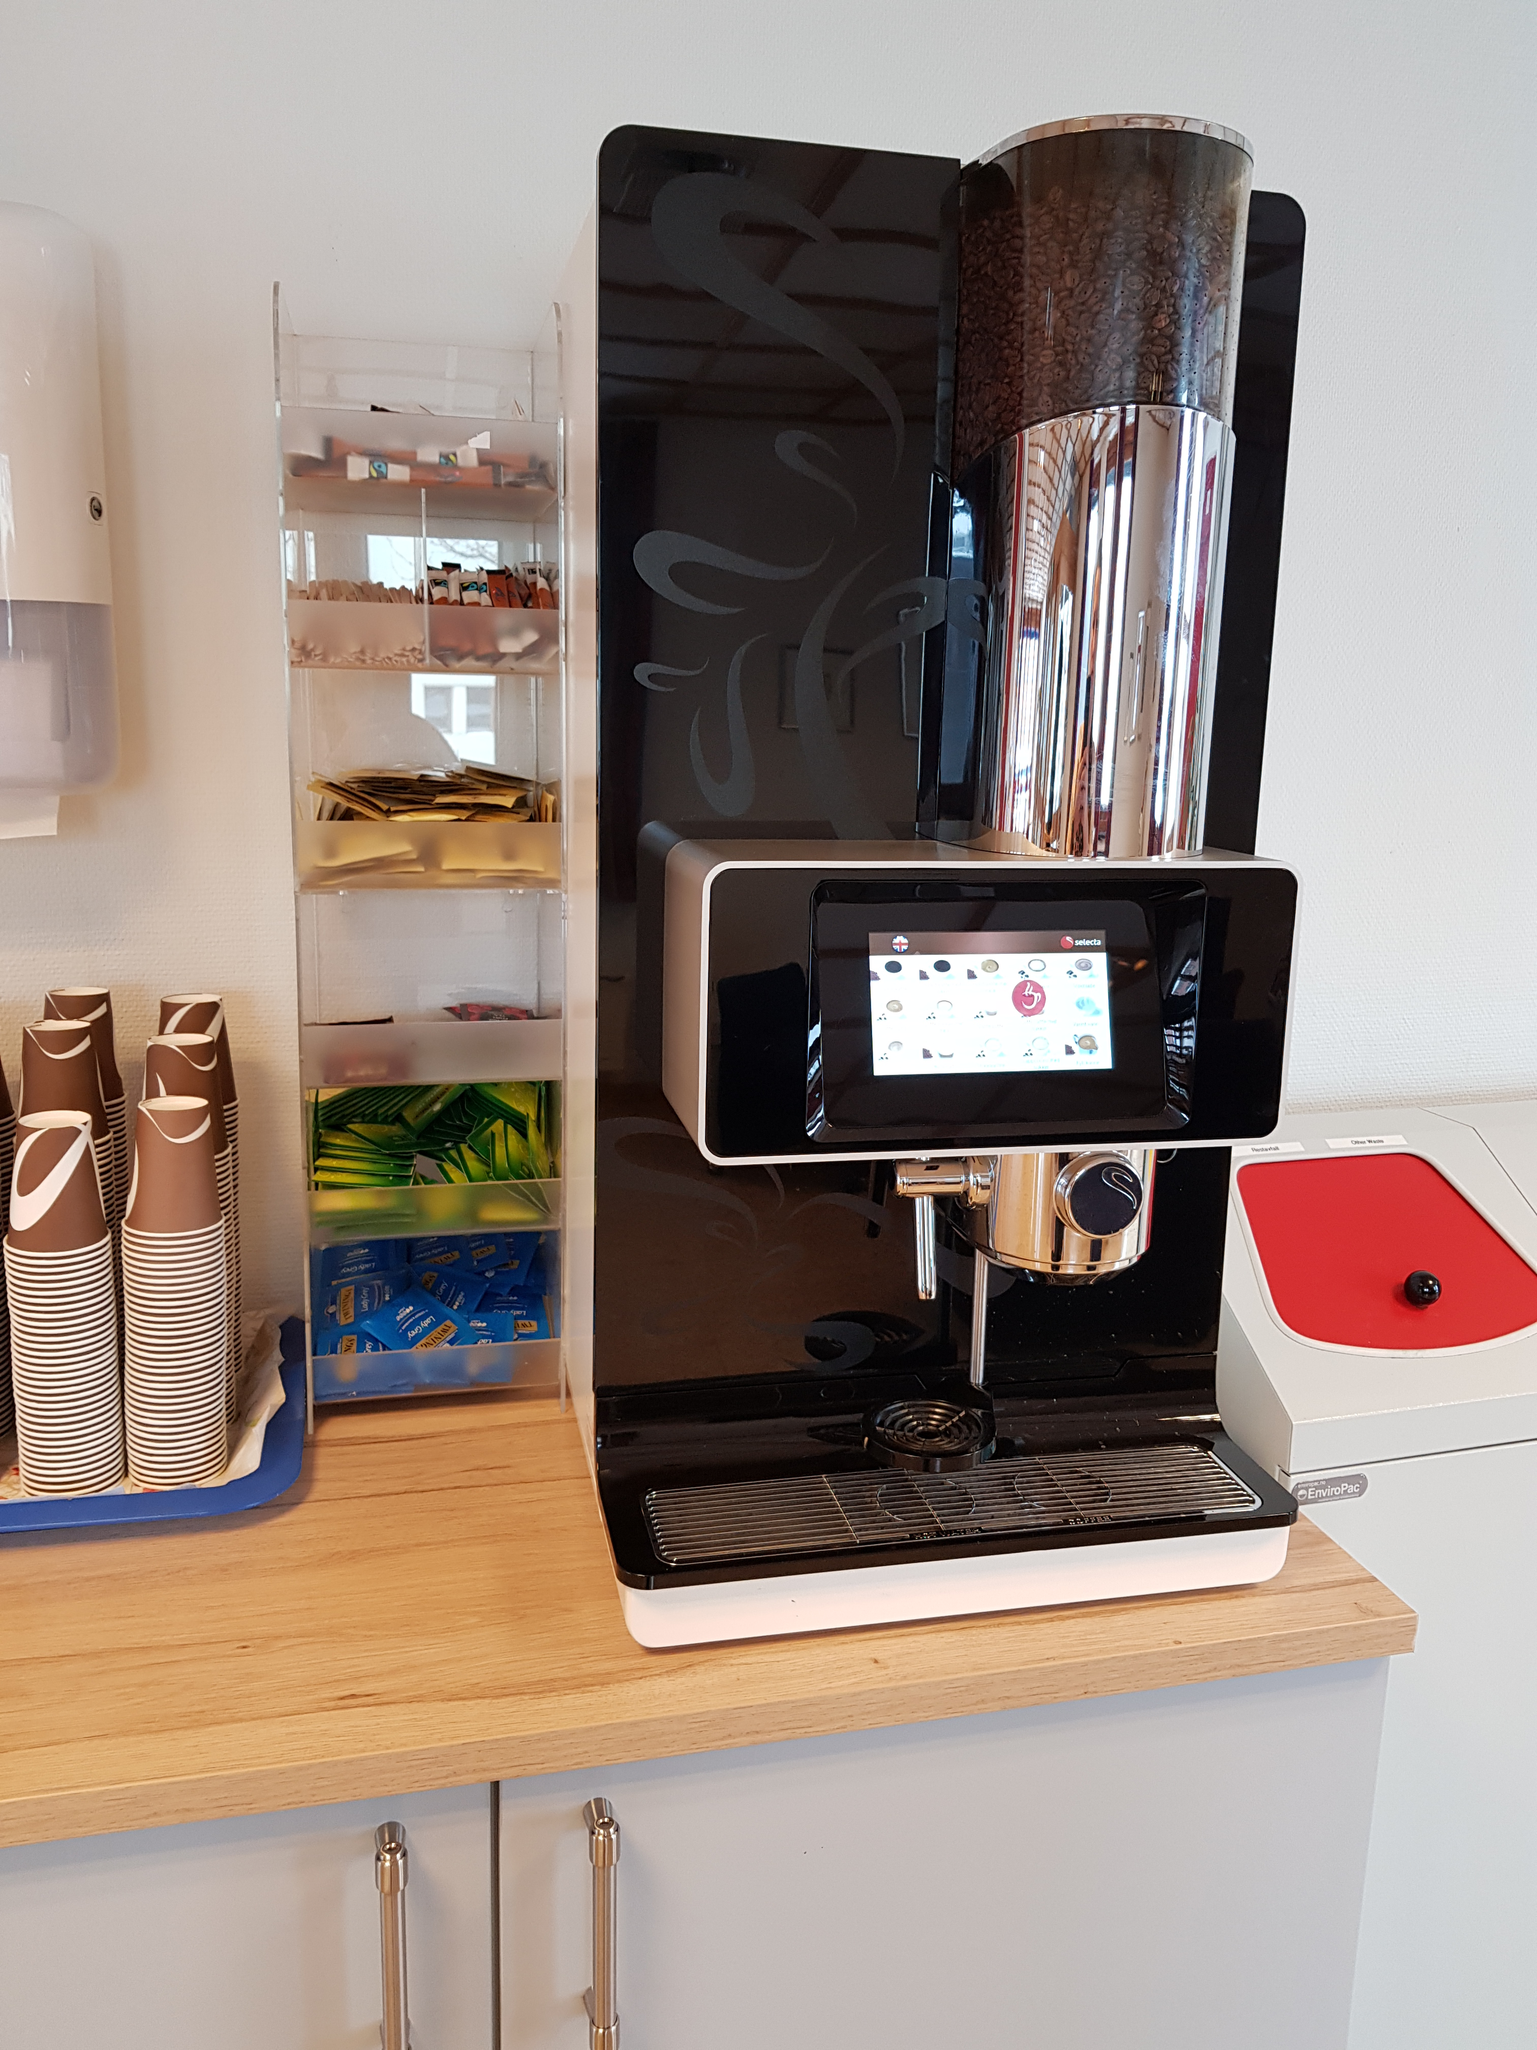
Contact
postmottak@its.uio.no / studieinfo@its.uio.no
department-of-technology- systems-uio
facebook.com/itsuio
www.mn.uio.no/its
WWW
Notes:
Or: come yell at me

Slide 12
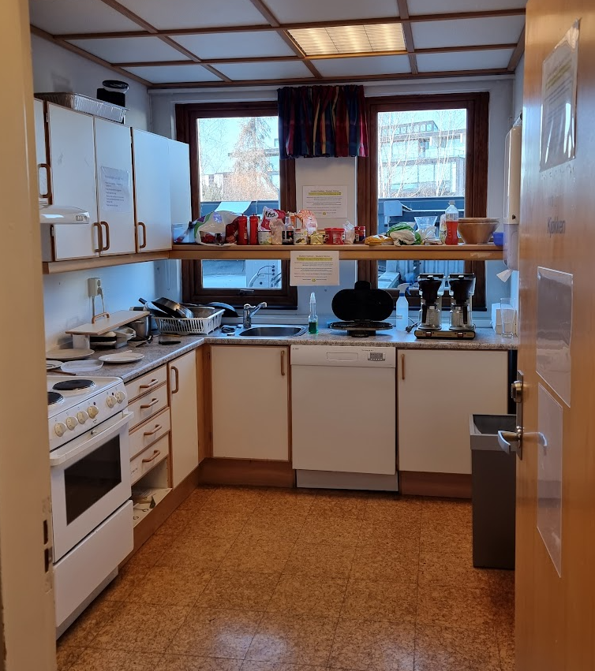
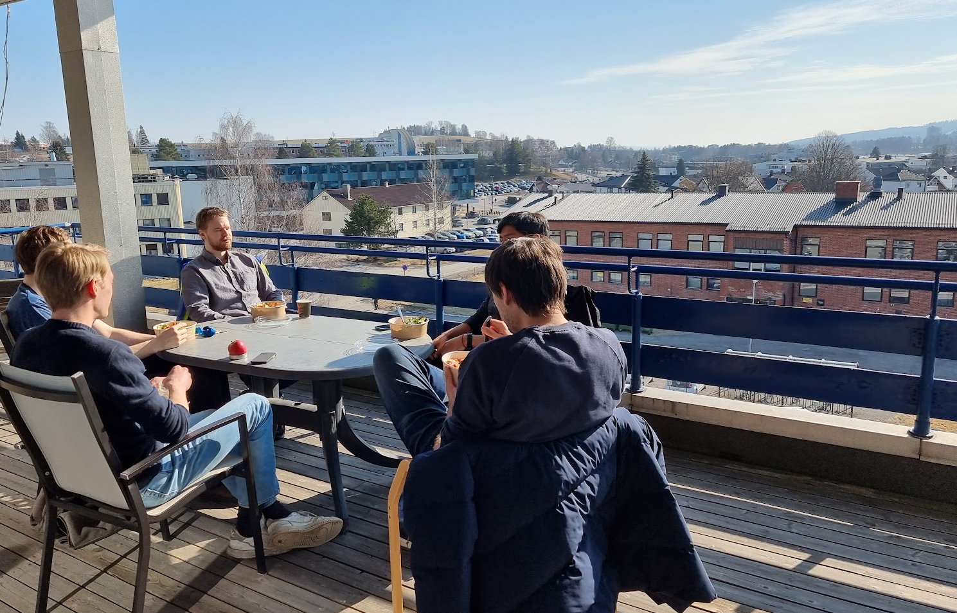
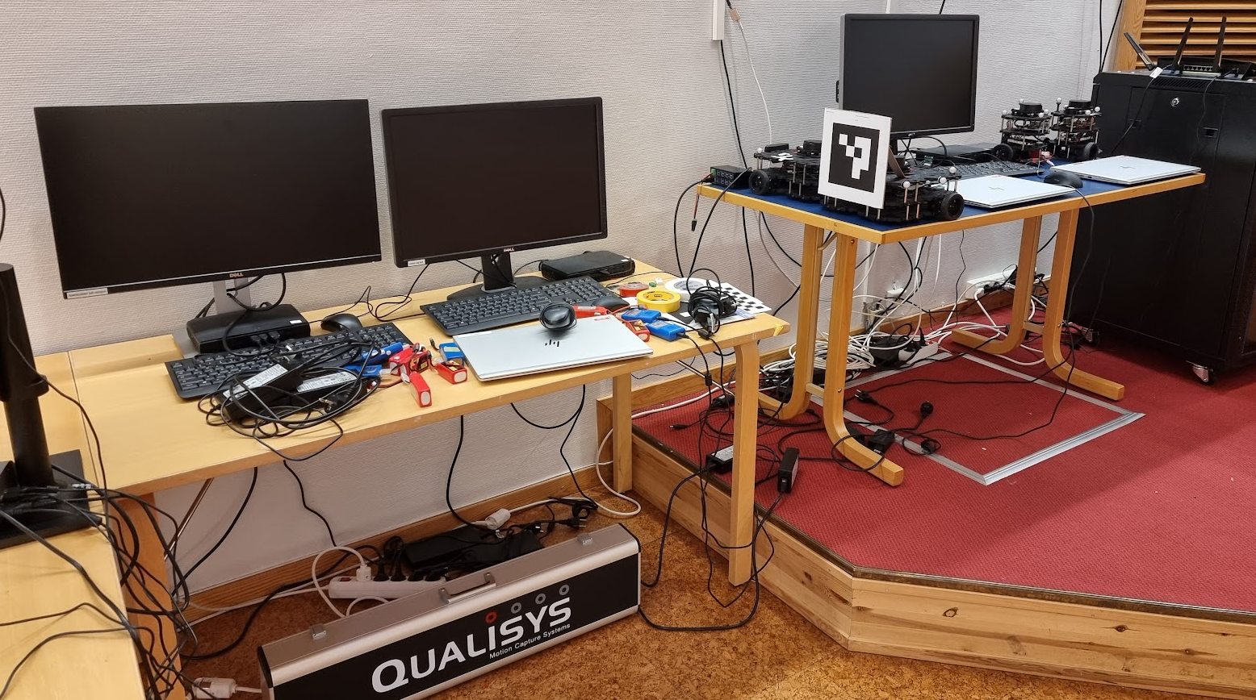
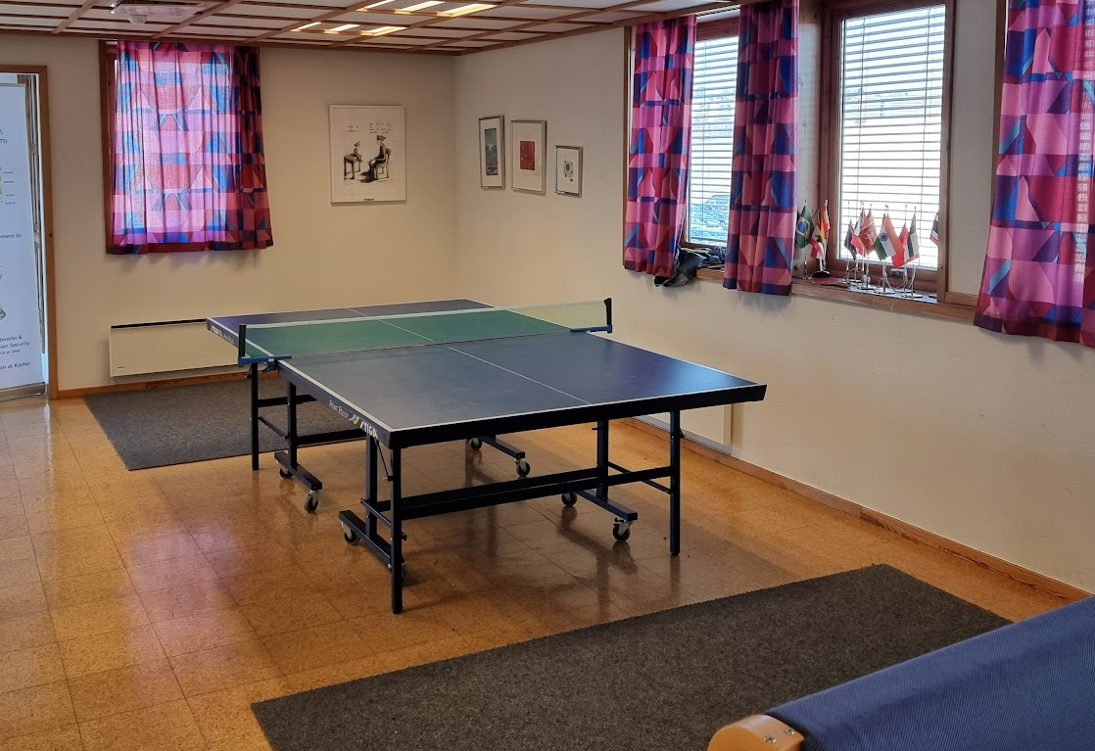
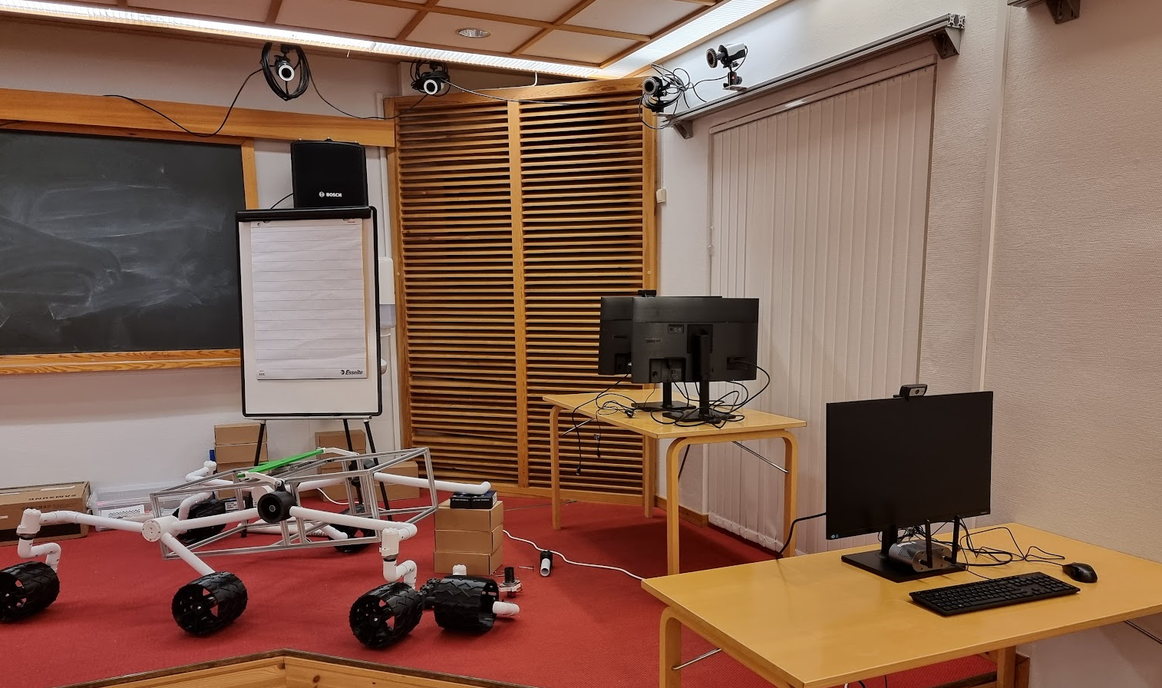
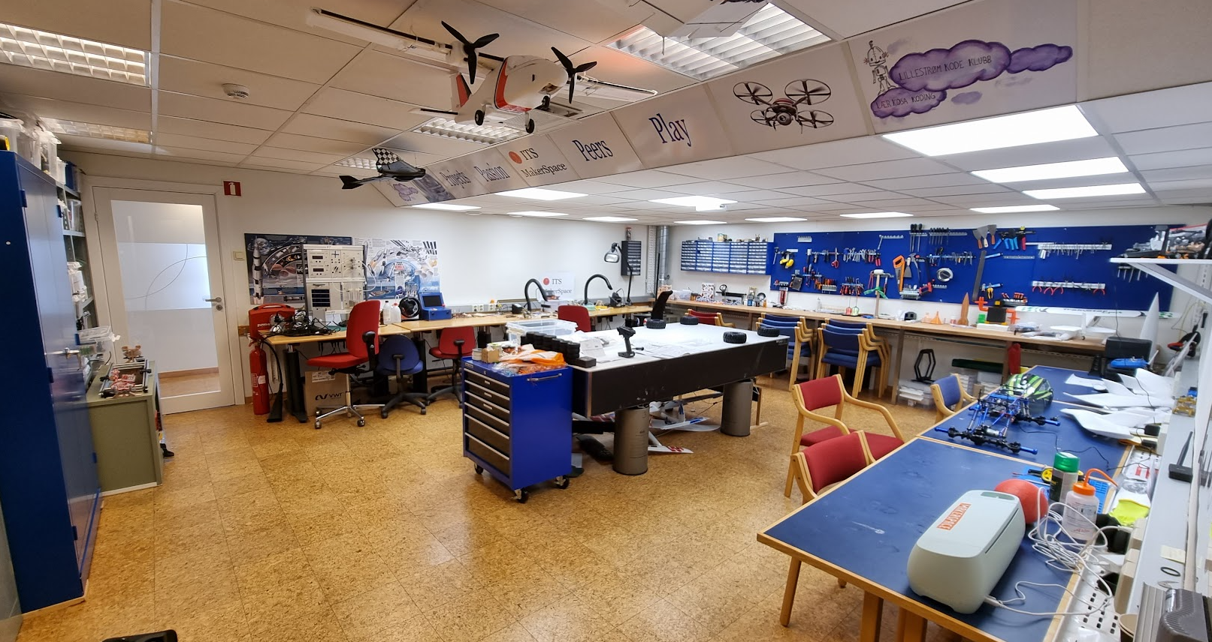
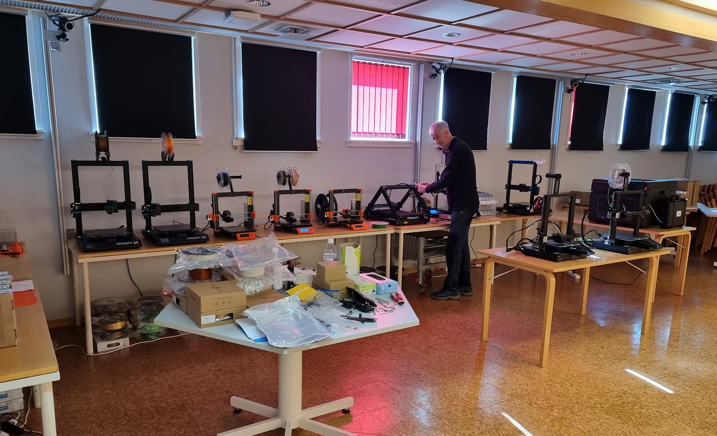
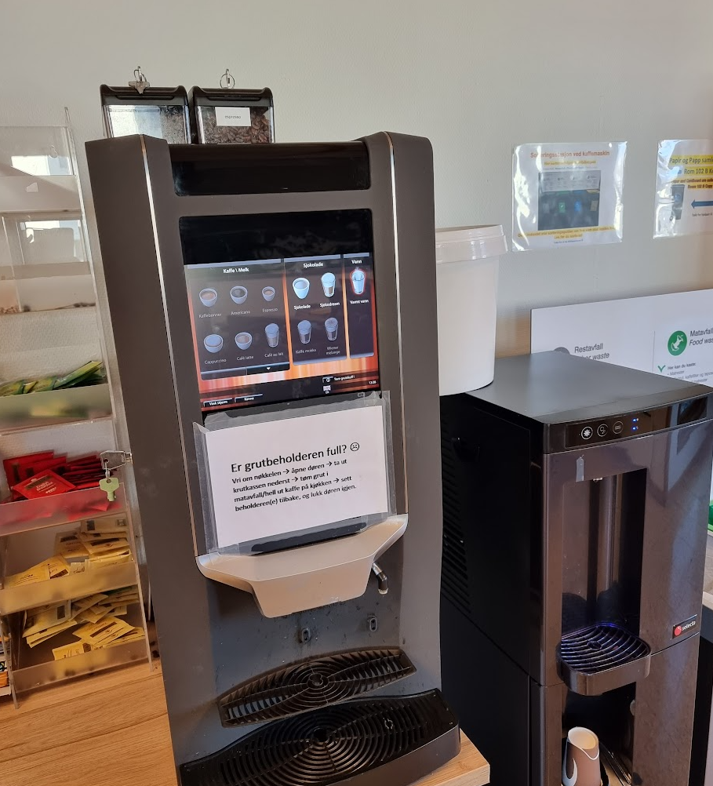
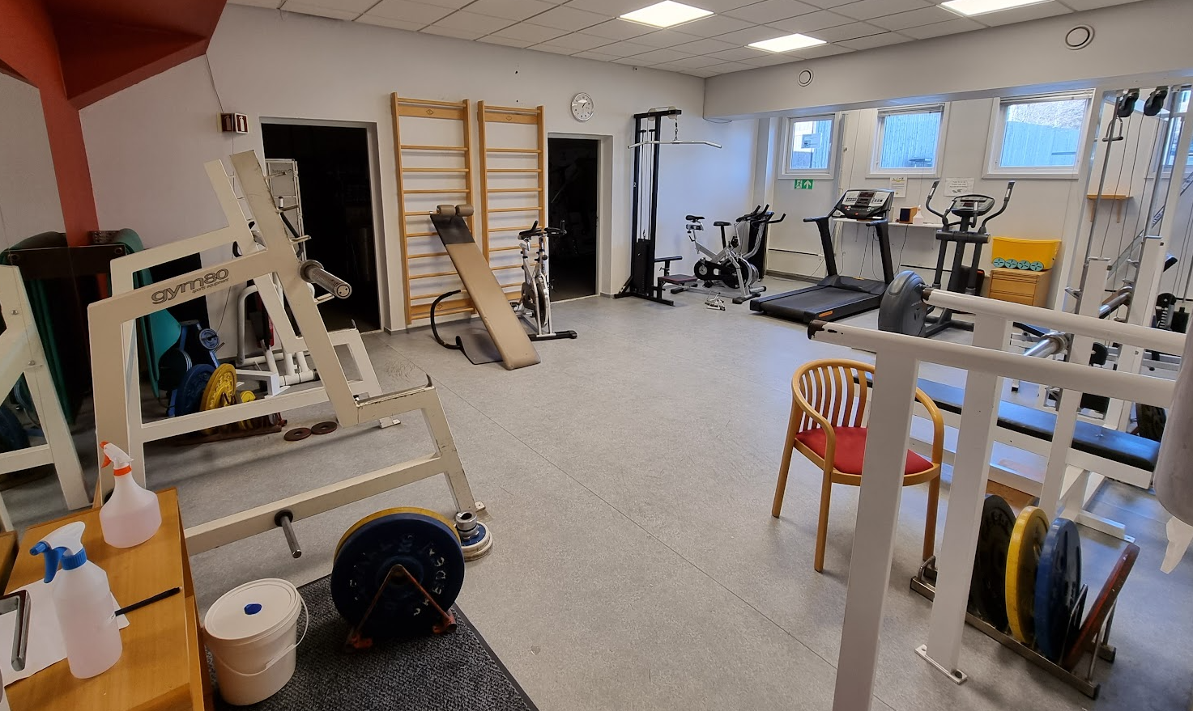
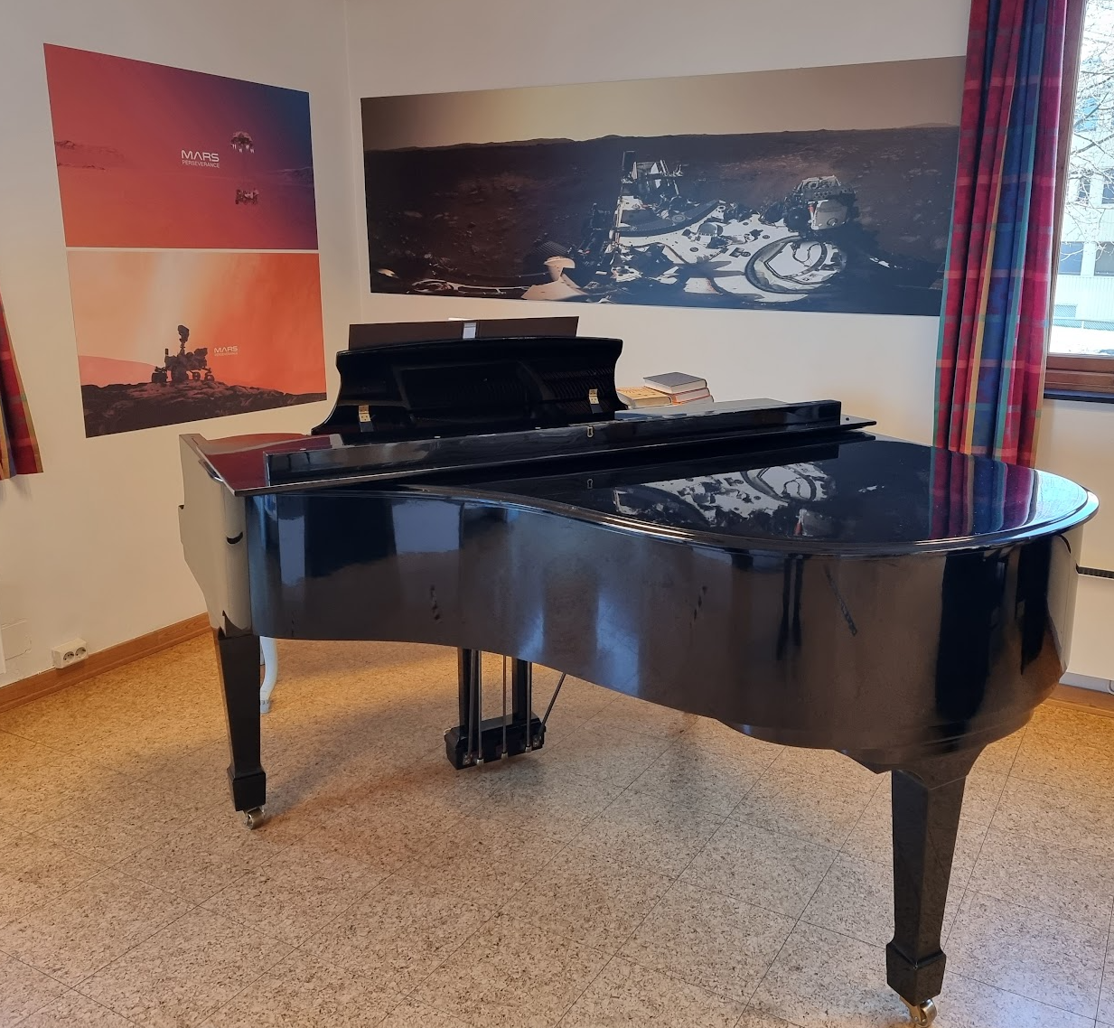
Student life at ITS

Slide 13
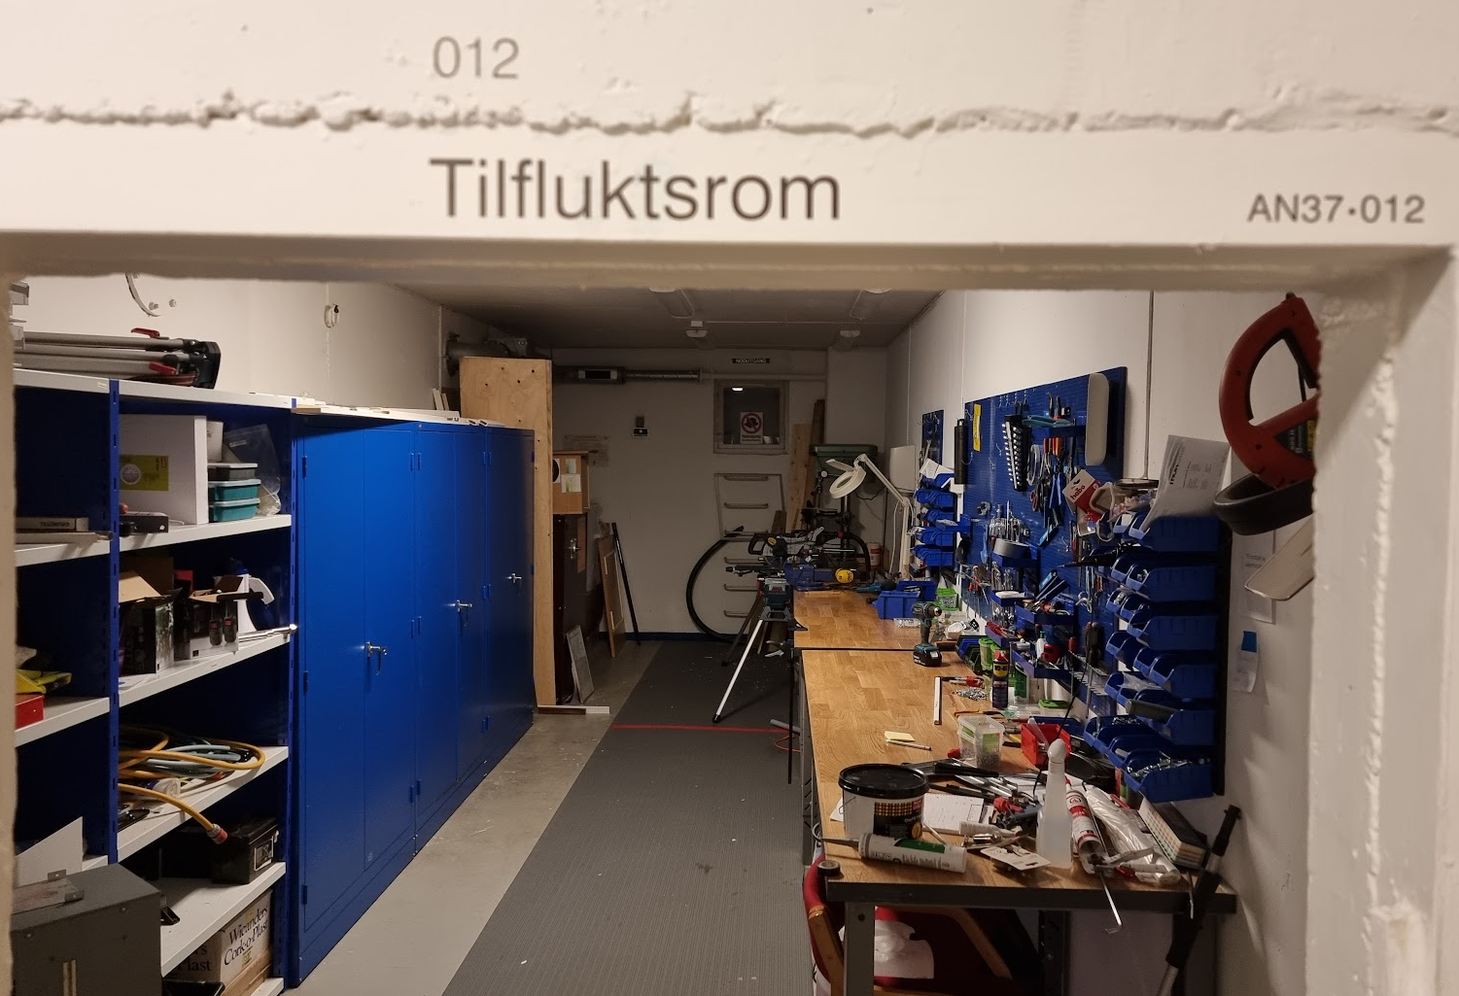
Notes:
Grovverksted / workshop in addition to shelter…

