Slide 1
Welcome as a master student at ITS!
Information from the study administration

Slide 2
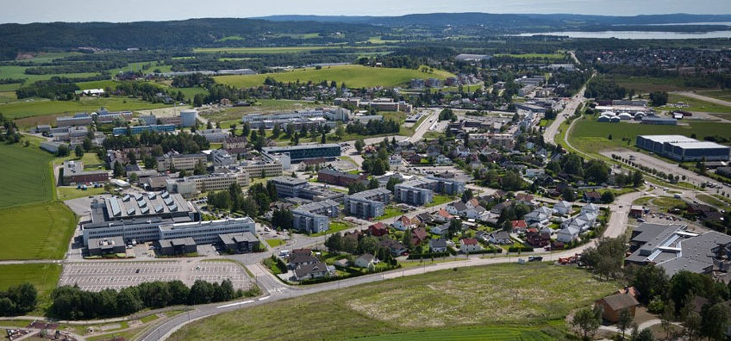
Program for the day
12:00 – Welcome!
12:15 – Information from the administration (the sometimes boring, but necessary stuff)
13:15 – Study specific information (splitting up in study programs for the more juicy stuff)
14:30 – Pizza!

Slide 3
Outline of presentation
Briefly about UiO for new students
Our department, ITS
Important things and practicalites for new master’s students

Slide 4
Outline of presentation
Briefly about UiO for new students
Our department, ITS
Important things and practicalites for new master’s students

Slide 5
Congratulation with a good choice of studyprogram
– our topics are very relevant for the future!
Renewable Energy Systems (master)
Cybernetics and Autonomous Systems (programme option – robotics and intelligent systems)
Space Systems (master)

Slide 6
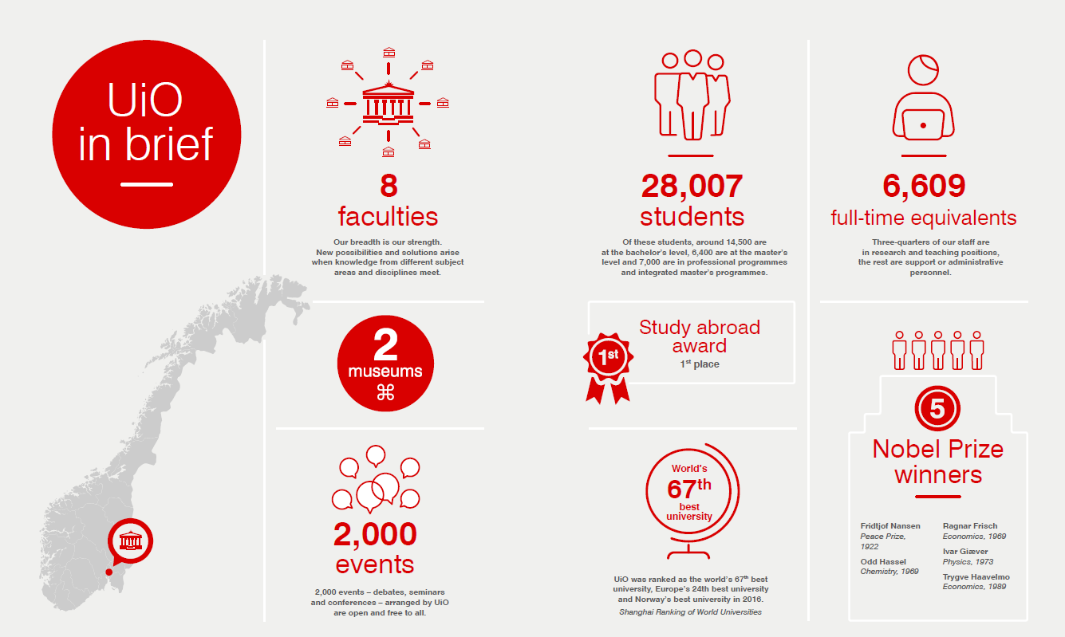

Slide 7
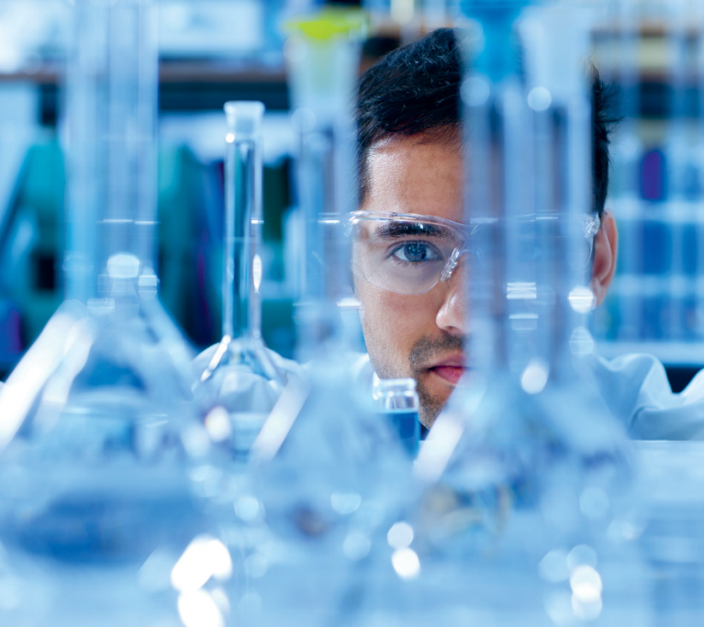
The Faculty of Mathematics and Natural Sciences
6000 students (bachelor, master)
50/50 natural sciences and technology courses
800 PhD-students
2000 employees
Turnover 1,9 billion NOK
40% of funding from external resources (EU & NFR & Industry)
200 active projects partners in industry and public sector
Extensive international activity
The Panorama strategy
The Guild network
Grant highlights
20 ERC-grants
4+4 Centre of excellences (SFF)
3+10 SFIs and FMEs
1 SFU
2 Nordic Centre of Excellence
25% of free NFR-research grants (FRIPRO)
3 of 3 NFR lighthouse projects (ICT)

Slide 8
Outline of presentation
Briefly about UiO for new students
Our department, ITS
Important things and practicalites for new master’s students

Slide 9
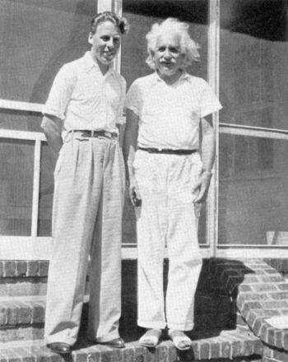
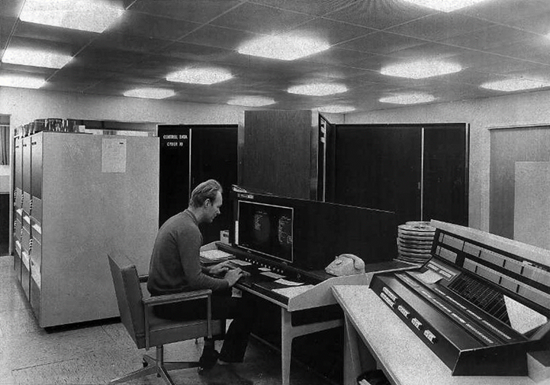
Kjeller history Norwegain defence research establishment NDRE/FFI Nuclear reseach at IFA
Gunnar Randers and Albert Einstein, 1940
Gunnar Randers vei 19

Slide 10
Accociated organisations
Kjeller Science park, Lillestrøm
Kongsberg-gr.
Akershus Energi
Rainpower
NILU
IFE
Kjeller innovasjon
FFI
NORSAR
Oslo Met
FLO/Kjeller
AIM Norway
Juster-vesenet
Other partners companies of ITS:
Campus Blindern
Thales
ABB
Telenor

Slide 11
ITS in numbers
2 research sections + 1 centre for research based innovation :
Energy Systems
Autonomous Systems and Sensor Technologies
Centre for Space Sensors and Systems (CENSSS)
~ 100 Master’s students
~ 30 PhD students
~ 30 associate researchers/lectureres
~ 10 full time researchers/lectureres

Slide 12
Outline of presentation
Briefly about UiO for new students
Our department, ITS
Important things and practicalites for new Master’s students

Slide 13
First semester as a new master student - what do I need to do?
Make sure to register on the Student Web and pay your semester fee by 1 September
Attend courses throughout the semester, and (hopefully) ace the exam
Find a supervisor (on your own, or on our presentations in later in the semester)
Hand in study plan agreement (by 1 December)

Slide 14
Practicalities
studentweb.uio.no
course registration
semester fee information
grades
when approved: study plan and supervisor information
Student ID card
access to buildings outside normal opening hours
access to UiO printers

Slide 15
Part-time and credit recognition
Part-time studies
50-100% progression possible
Find a good plan with your supervisor, and fill out your study plan agreement accordingly
Questions or problems? Ask us. ☺
Credits from other study higher education institutions you would like to use in your curriculum?
Apply for recognition through the Faculty of Natural Sciences (MN)
Add your courses to the study plan agreement

Slide 16
Attending courses at ITS
Two teaching sessions
09:15-12:00
13:15-16:00
Free bus from Blindern (OJD – Informatics building) to and from each session
Traditionally, most lectures are recorded and available for students

Slide 17
Student benefits at ITS
Free coffee
Student reading rooms
Gym room
Student kitchen
UNIKUM – your own student society
A really nice student administration! (conveniently located on the first floor)

Slide 18
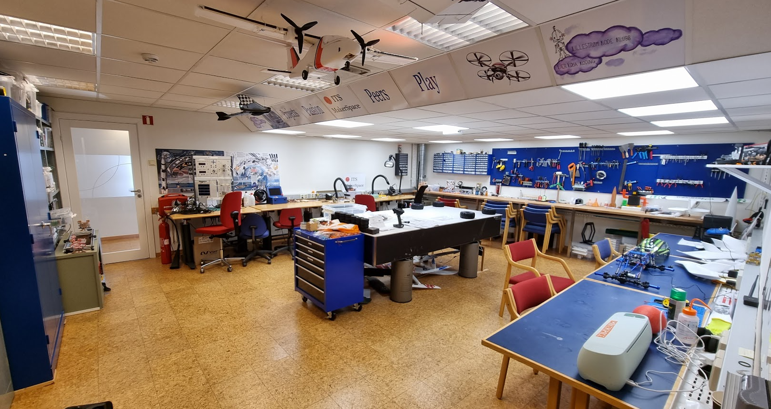
What happens on Friday?
Icebreaker with PhDs
Get to know Makerspace and labs
Hear from Portal Space
Meet our faculty over cake and coffee

Slide 19
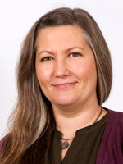
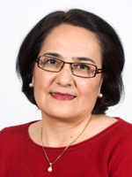
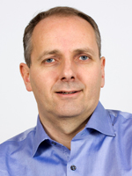
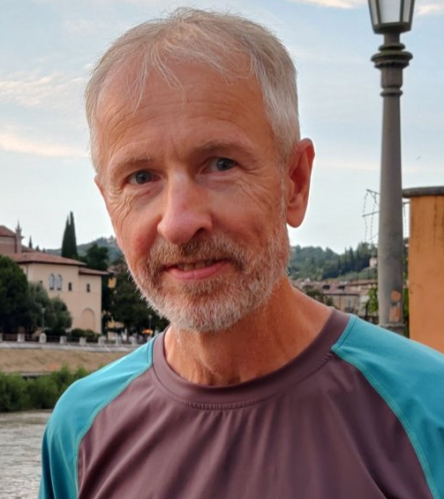
Who do I ask?
Study administration
Kaja Mosserud-Haavardsholm (especially study plans)
Tuhta Ismailova (especially exams)
IT and labs
Arild Hemstad
Pål Grønstad Solheim

Slide 20
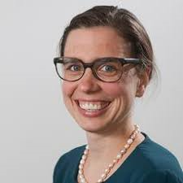
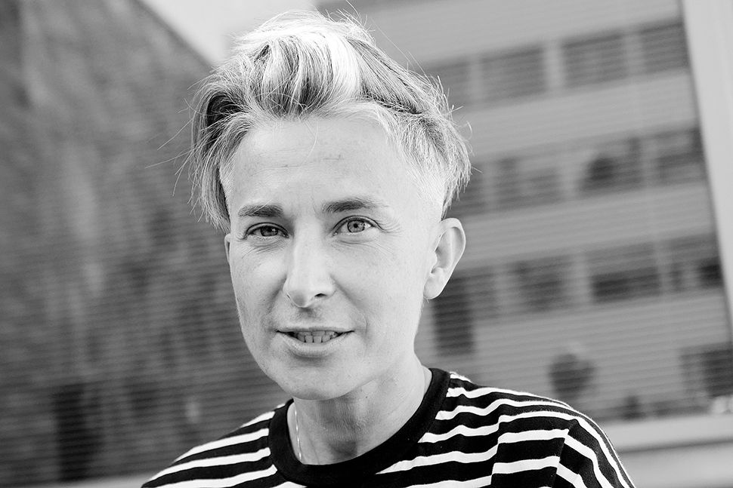
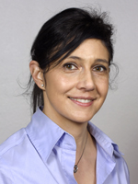
Renewable Energy Systems
Marianne Zeyringer
Matylda Guzik
Sabrina Sartori

Slide 21
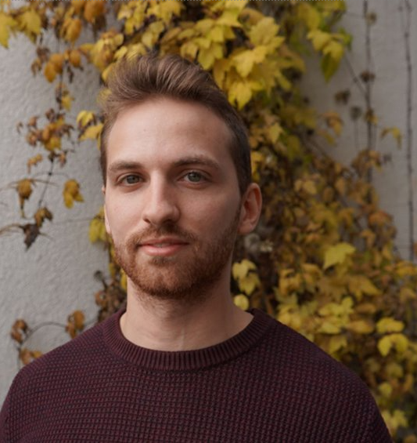
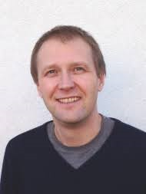
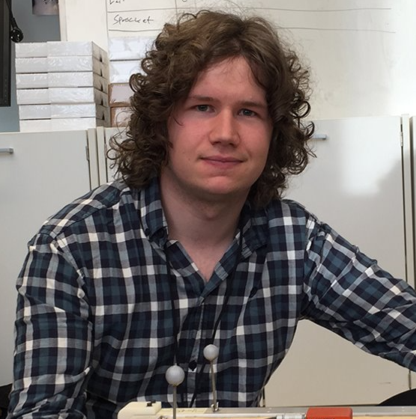
Cybernetics and Autonomous Systems
Ulysse Côté-Allard
Jonas Moen
Tønnes F. Nygaard

Slide 22
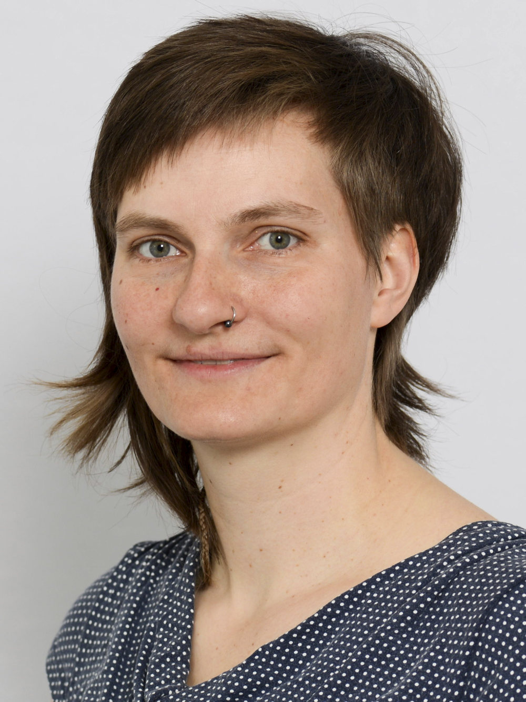
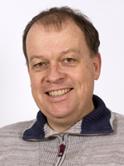
Space Systems
Anja Kohfeldt
Torbjørn Skauli

Slide 23
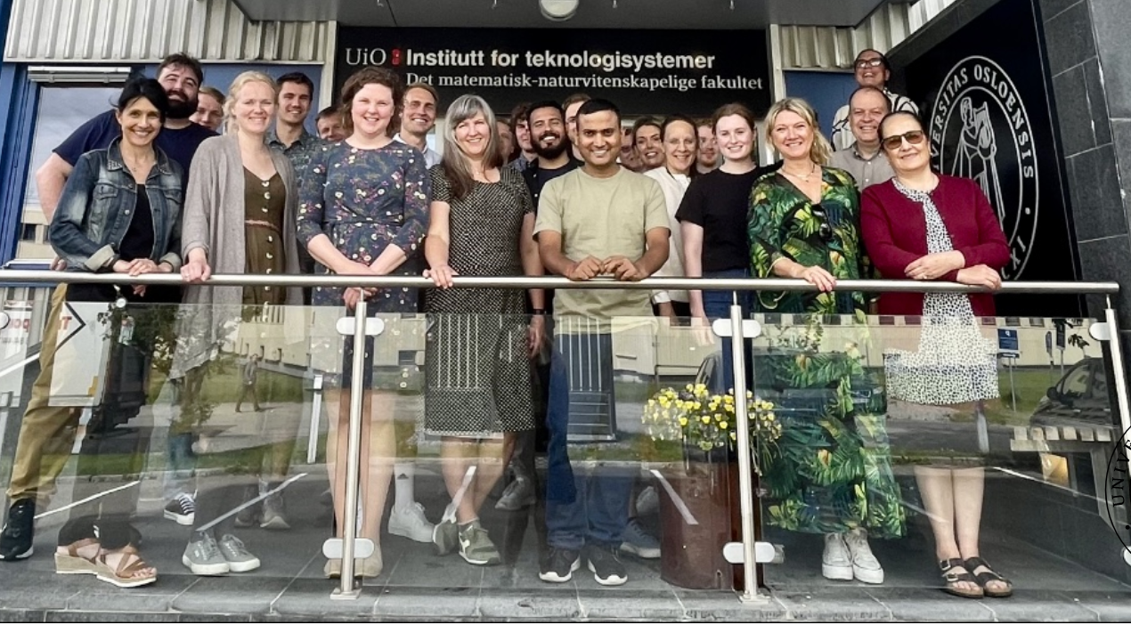
Remember:
We are all here to support you, but
YOU are the project manager of your
Master’s study and thesis!

Slide 24
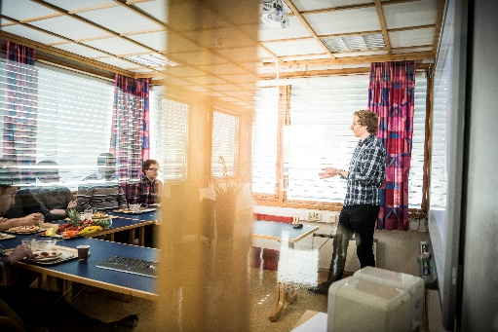
Contact
studieinfo@its.uio.no
facebook.com/itsuio
www.mn.uio.no/its
WWW
Notes:
Or: come yell at me

