Slide 1
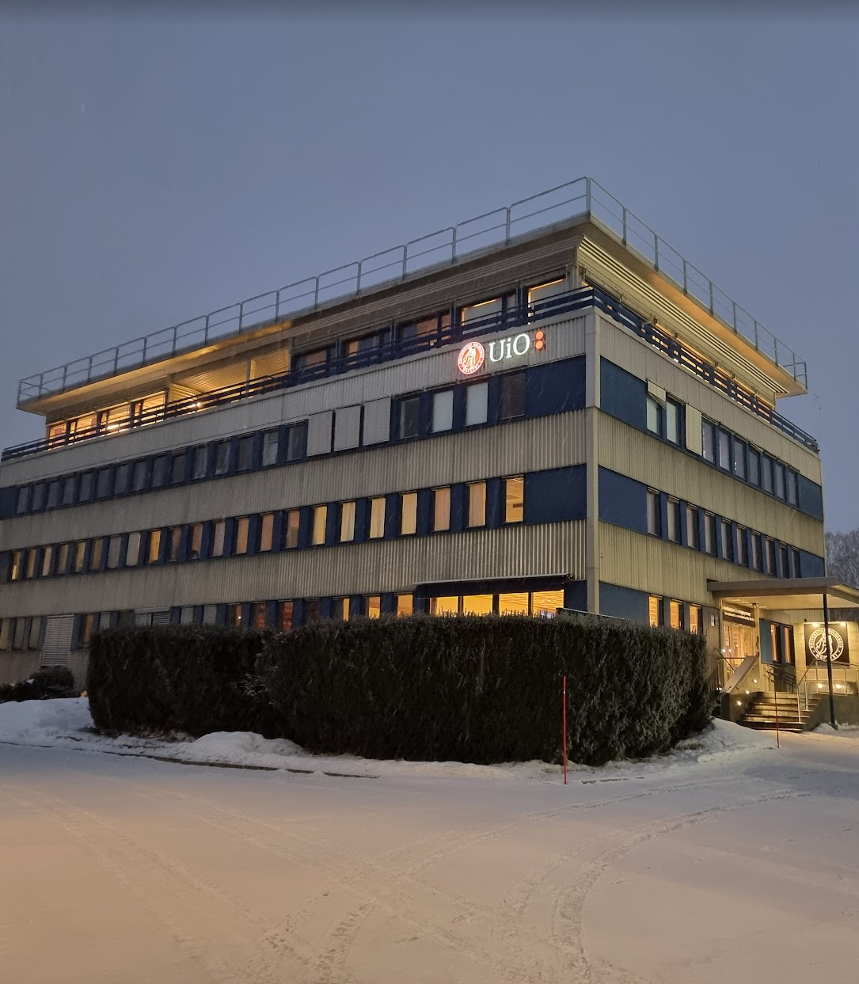
Faculty of Mathematics and Natural Sciences
Department of Technology Systems
ITS semester
kick-off 2024!

Slide 2
Program for today
12:15-14:30
12:15 – Pizza!
12:30 – Studadm
12:45 – SiO Health
13:30 – The Science Library
14:30 – Snacks in the Piano Room
(15:00 – Bus to Oslo)

Slide 3
Practical tidbits from the study administration
Deadlines for the semester:
  1 February:
    semester registration
    semester fee
    applications for special examination arrangements
  1 June: Delivering your essay – a preparation for your thesis
  Master thesis delivery spring 2024:
    Thursday 23 May – short thesis
    Wednesday 15 May – long thesis
    Week 24/25 (10-20 June) – presentation & examiniation
Study plan agreements: most, but not all, will have an approved plan by now. Changes are possible. :o)

