Slide 1
How to carry out experiments using MPMS
March 2012
Takeshi NAKAGAWA

Slide 2
Table of contents
starting up and shutting down
Mounting your sample
How to install sample to SQUID
Centering your sample
Status bar and Magnetic field Limit
Control centre

Slide 3
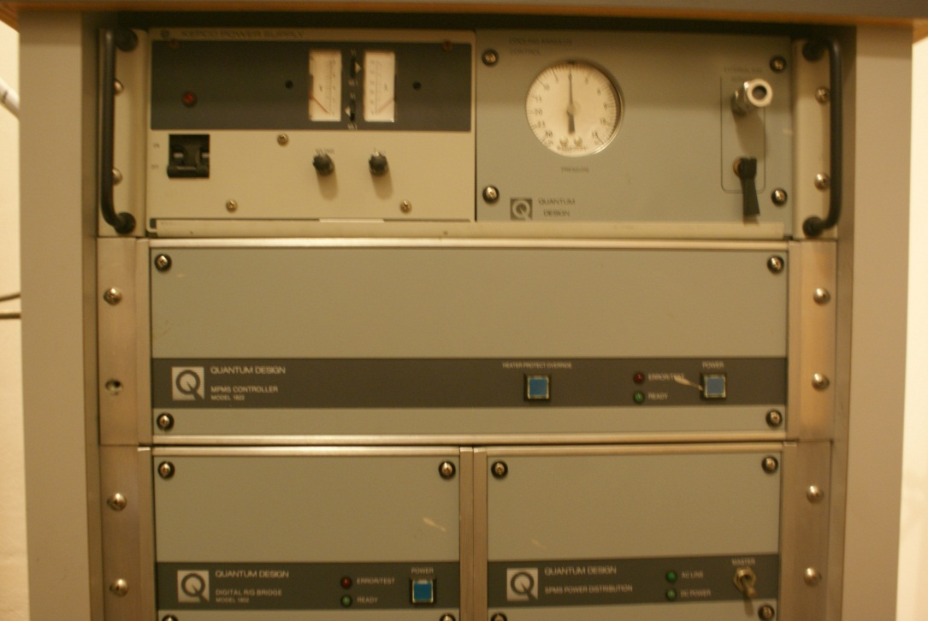
Shutting down the SQUID
Starting up the SQUID
Turn on the main power switch on the front panel of the PUD. (1b)Turn on the pump with the circuit breaker on the PDU rear panel.
Turn on the power to the Model 1802R/G and (2b) the Model 1822 MPMS controller.
Turn on the power to Magnetic field control system.
3
2b
2
1
1b
Close the MPMS Multi Vu software.
Turn off the power in reverse order

Slide 4
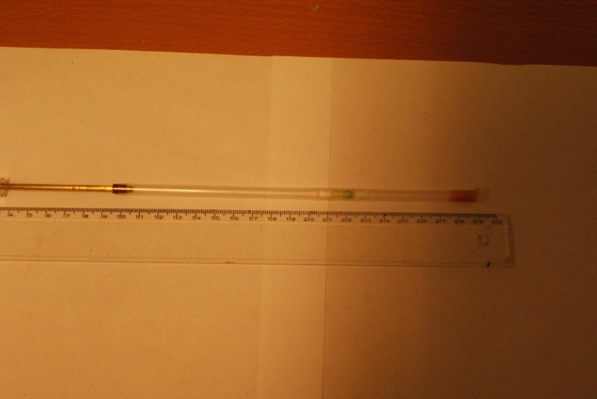
Sample mounting
Use Capsule and drinking straw:
for non-air sensitive sample and temp <50C (323K)
Place the sample in the short fat half of the capsule and find the weight of the powder. Then, press the longer thin half of the capsule upside down onto the sample.
Place this capsule into a drinking straw between 10 to 12cm from the top of straw.
Cut small segment of straw and place above and below the capsule. This is to avoid capsule moving up and down during measurements. Put some kapton tape at the bottom of straw to avoid dropping capsule out of straw.
Make some holes or slits on the top half of straw to allow air to be pumped out.
Top of straw
sample
bottom of straw with kapton tape

Slide 5
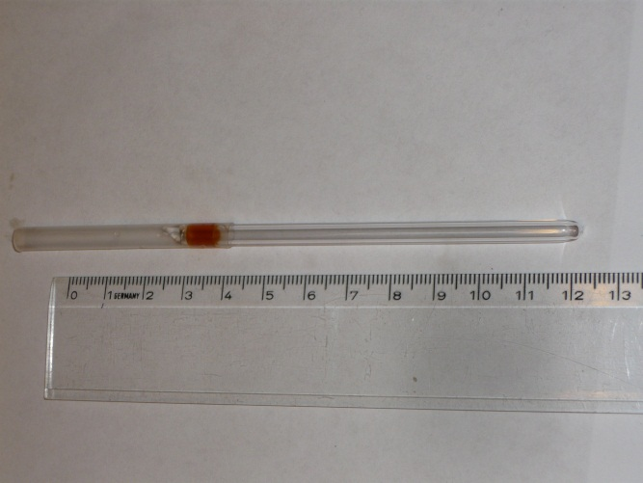
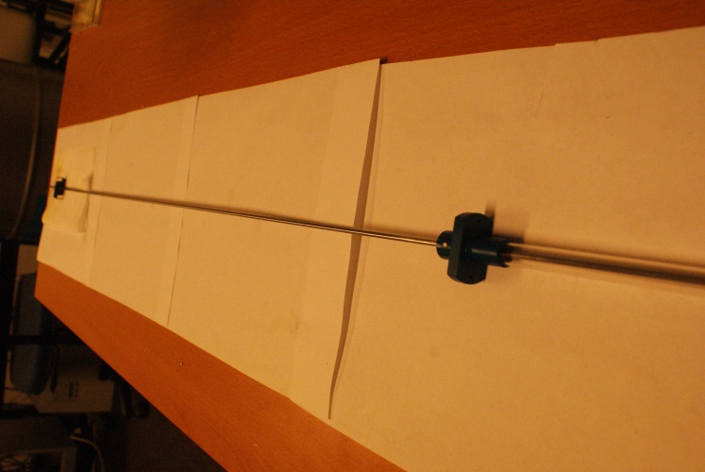
Sample mounting
Use Quartz tube:
for air sensitive sample and/or temp >50C (323K)
Place sample powder into the quartz tube using funnel to avoid powder touching wall of the tube.
Attach the tube to the vac-line for sealing under vacuum. Length of the tube should be ~10cm.
Attach the segment of straw at the top of straw, so that whole length will be around 12 to 13 cm. punch some holes on the straw part so that air can be pumped out.
N.B.: The sample holder rod is very easy to bend and damage irreparably. Do not use force when placing the straw on the rod. Do not use any pliers on the rod. Wear gloves when handling

Slide 6
Insert Sample into the instrument
N.B.: Any traces of Oxygen into the sample space could cause a serious damage to the instrument. Do not install sample if the temperature is not at RT and magnetic field must be zero.
Remove the blue air lock plug and insert the sample rod making sure white spot on slide seal assembly is facing you. Lock it with slide seal clamp.
Press purge airlock button to remove oxygen. (wait until green light lit, flush the space three times)
Turn the airlock lever clock wise to open airlock valve.
Lower the sample rod gently and slowly until black slide clamp on the rod engages the actuator shoe on top of the sample transport. Tighten the clip screws to secure the sample rod.

Slide 7
Centre the Sample
Use Multi Vu to center the sample in the SQUID pickup coil
Select Center > DC. The DC centering dialog box opens. First, Initialize Transport, and then set/change the parameter if needed.
Apply sufficient magnetic field, wait for stabilization, and then click on Full DC scan.
Perform “Adjust Position” by clicking “Adjust Automatically” until you get your signal at desired position.
Switch off magnetic field if necessary.

Slide 8
Multi Vu interface

Slide 9
Status Bar
Click here to change the field
Click here to change the temperature
N.B.: Check the He level every time before applying magnetic field. Do not change or apply Magnetic field when Temperature is not stable.
Magnetic field Limits at different He level:
100 – 50% : 0 – 5 T
40 – 50% : 0 – 1 T
30 – 40% : 0- 0.1 T
< 30% : not allowed

Slide 10
Control Centre
Define sample parameters
Edit sequence for your measurement. (See previously written sequences for detail)
Click here to run the selected sequence

