Slide 1

Introduction to
Classification and labelling of mixtures
Tuesday 21. aug. 2018
09:15 – 15.00
Seminar room, Berzelius, Chemistry building
Karoline Fægri og Svein Tveit, Skolelaboratoriet i kjemi

Slide 2
Competence aims
Enable students to:
use the CLP-definitions in classification and labelling of mixtures
describe hazard communication in the form of labelling
produce labels for 3 % NaOH, 15 % HCl, 9 % NH₃ and 2 % CuSO₄
Notes:
Downstreams user?

Slide 3
Outline
Background information on CLP
Definitions and rules used in classification and labelling with CLP
Exercise 1 & 2
More definitions and rules
Exercise 3
Even more definitions and rules
Exercise 4
How do we label chemicals at the university
Optional exercise 5 – solve during the day.

Slide 4
Breaks
10.10 – 10.30
11.30 – 12.15 – lunch

Slide 5
Outline
Background information on CLP
Definitions and rules used in classification and labelling with CLP
Exercise 1 & 2
More definitions and rules
Exercise 3
Even more definitions and rules
Exercise 4
How do we label chemicals at the university
Optional exercise 5 – solve during the day.

Slide 6
Why is it important to classify and label chemicals?

Slide 7



HSE/HMS – authorities in Norway
 | Nature of hazards | Resposible authorities for HSE-laws and regulations
Health Helse | Health | Norwegian Labour Inspection Authority Arbeidstilsynet
Safety Sikkerhet | Physical | Norwegian Directorate for Civil Protection Direktoratet for samfunnssikkerhet og beredskap (DSB)
Environment Miljø | Environment | Norwegian Environment Agency Miljødirektoratet

Slide 8


About Regulation (EC) No 1272/2008 (CLP)
GHS | Global Harmonized System for classification and labelling of chemicals FNs globalt harmoniserte system for klassifisering og merking av kjemikalier
ECHA | European CHemicals Agency, responsible for implementing GHS in EU by establishing and updating an inventory for GHS substances Det europeiske kjemikaliebyrået ECHA har ansvar for å etablere og holde oppdatert et register over stoffers fareklassifisering og -merking.

Slide 9


About Regulation (EC) No 1272/2008 (CLP)
REACH | Regulation (EC) No 1907/2006 Registration, registrering Evaluation, vurdering Authorisation and Restriction, godkjenning og begrensning CHemicals, kjemikalier
CLP | Regulation (EC) No 1272/2008 Classification. klassifisering Labelling, merking Packaging of Substances and Mixtures, og emballering av stoffer og stoffblandinger

Slide 10

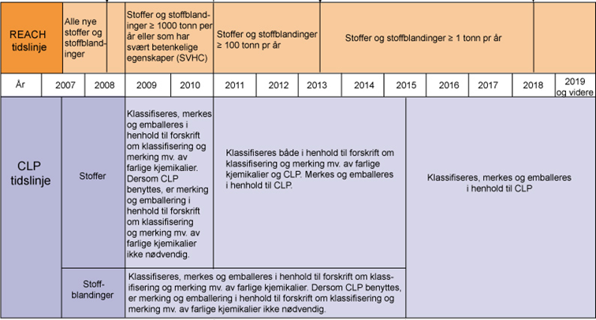
Timeline for implementing CLP
only CLP after
1. juni 2017
16. June 2012
CLP in Norway
1. December 2010
CLP in EU
Old labels and CLP until
1. June 2015
Kilde: http://www.miljodirektoratet.no/Global/dokumenter/tema/kjemikaler/reach_clp_tidslinje_800.jpg (august 2014)
Notes:
Forskrift om klassifisering, merking og emballering av stoffer og stoffblandinger (CLP) ble innført 16. juni 2012. Denne forskriften erstatter Forskrift om klassifisering, merking mv. av farlige kjemikalier (Merkeforskriften).
Skal sikre samme merking for lagring, omsetning og transport, over hele verden.

Slide 11
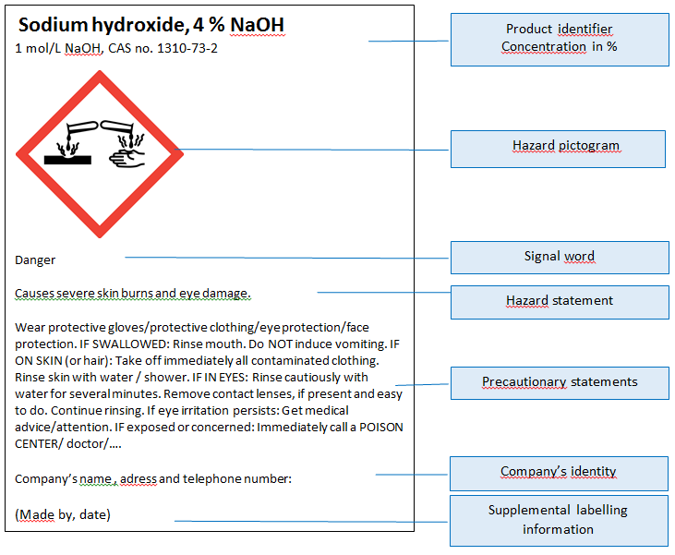
Hazard communication
Product identifier
Hazard pictogram
Signal word
Hazard statement
Precautionary
statement
Company identity

Slide 12
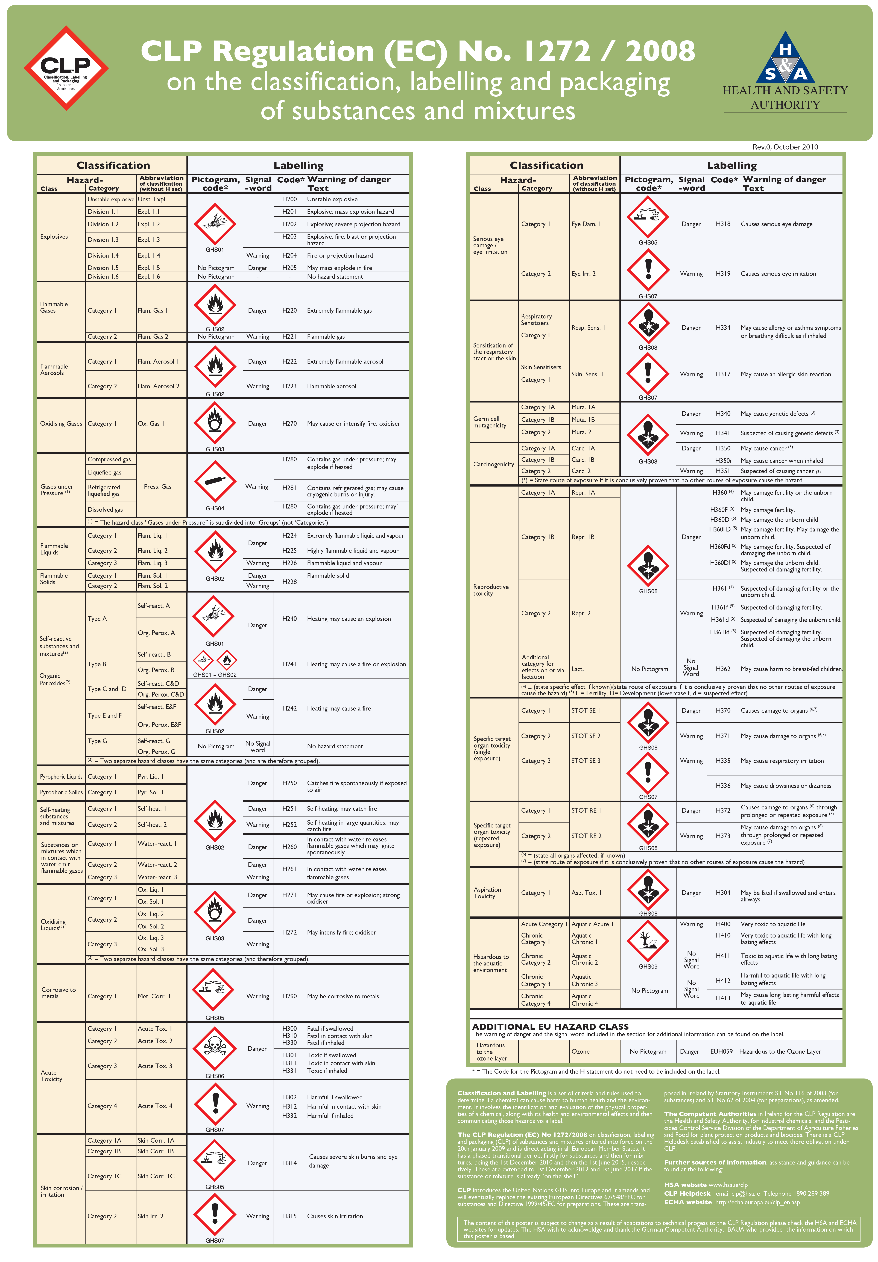
Guidance on Labelling and Packaging in accordance with Regulation (EC) No 1272/2008
The poster
English:
CLP Regulation
Norwegian:
Klassifisering og merking i CLP

Slide 13
Product identifier
Name and identification number given in the Classification and Labelling Inventory
if not included in C&L Inventory
CAS number and IUPAC name

Slide 14

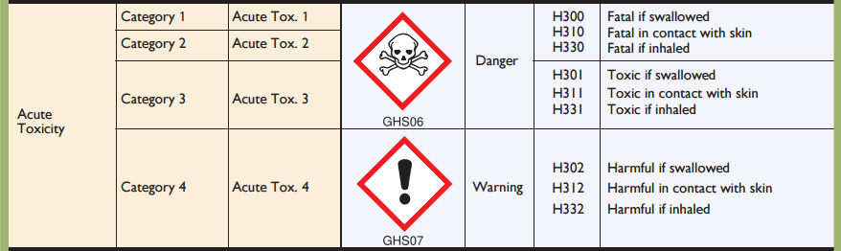
Hazard classes and categories

Slide 15
Hazard pictograms
Physical
Health
Environment

Slide 16
Signal words and hazard statements

Slide 17
Groups of hazard and precautionary statements
Code | hazard statements | Code | precautionary statements
H200-H299 | Physical | P100-P199 | General
H300-H399 | Health | P200-P299 | Prevention
H400-H499 | Environment | P300-P399 | Response
 |  | P400-P499 | Storage
 |  | P500-P599 | Disposal
EUH | only in the EU

Slide 18
Exercises - CLP
Label for 3 % NaOH in 1 L bottle
Booklet with exercises and relevant links can be found here:
https://www.mn.uio.no/kjemi/forskning/grupper/skole/kurs/tidligere-kurs/2018/klassifisering-og-merking/index.html

Slide 19
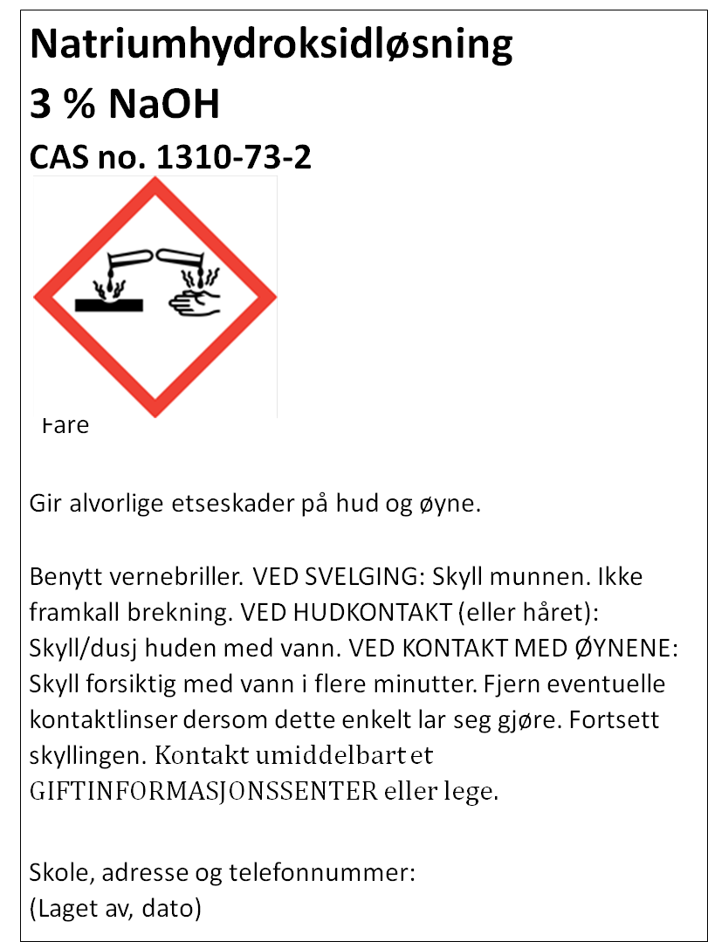
Fare

Slide 21
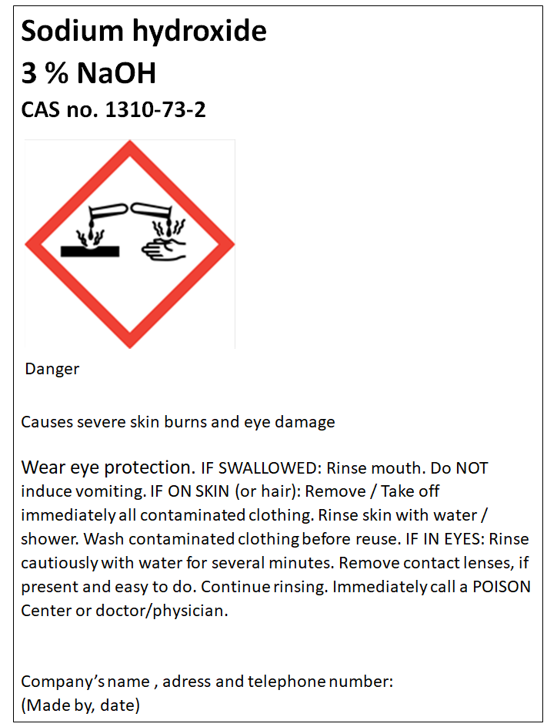

Slide 23
Exercises - CLP
2. Label for 15 % HCl in 1 L bottle

Slide 24
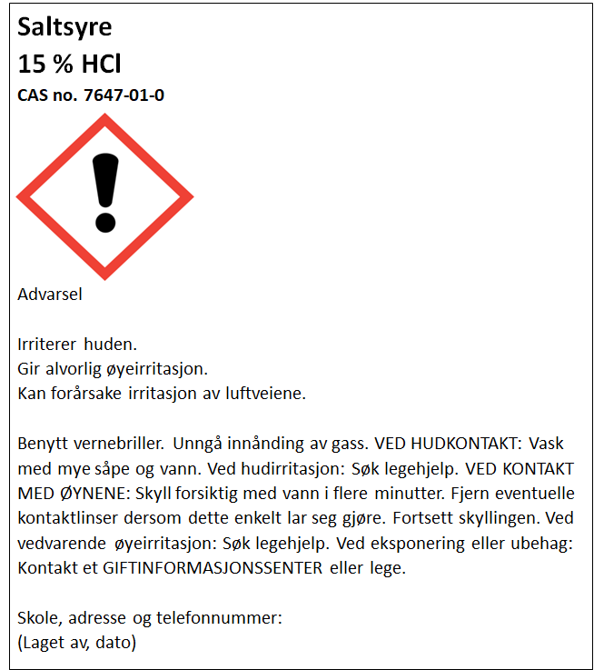

Slide 26
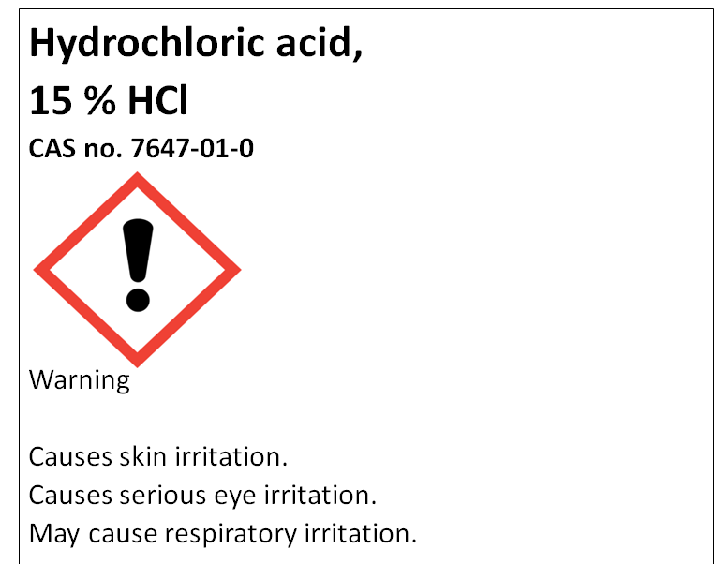

Slide 27
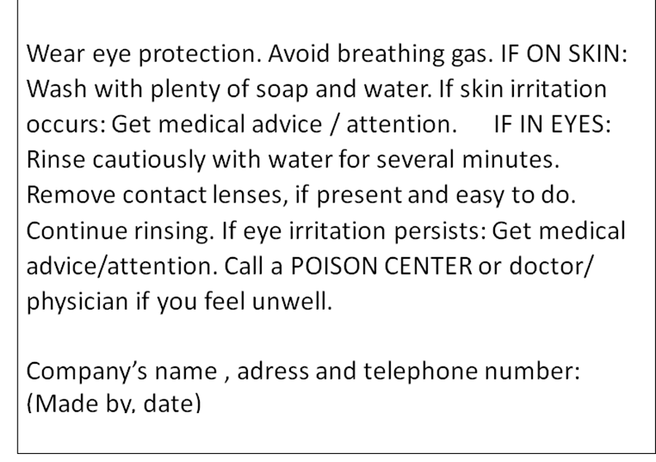

Slide 28

Labelling with only hazard pictogram and signal word
Exeptions for some hazard classes where the contents do not exceed 125 mL (see page 5 in booklet with exercises)
Hydrochloric acid,
15 % HCl
Warning
Company’s name , adress and telephone number:
(Made by, date)
Saltsyre
15 % HCl
Advarsel
Skole, adresse og telefonnummer:
(Laget av, dato)

Slide 29
Concentration limits
Specific concentration limits and Generic concentration limits

Slide 30
Classification for acute or chronic aquatic hazard
L(E)C₅₀ from SDS
Product name Ammonia
SECTION 12: Ecological information
12.1. Toxicity
Acute aquatic, fish: Value: x mg/l, Method of testing: LC50 (Not ionized freshwater), Duration: 96h
Acute aquatic, Daphnia: Value: y mg/m³, Method of testing: LC50 (Freshwater), Duration: 96 h

Slide 31
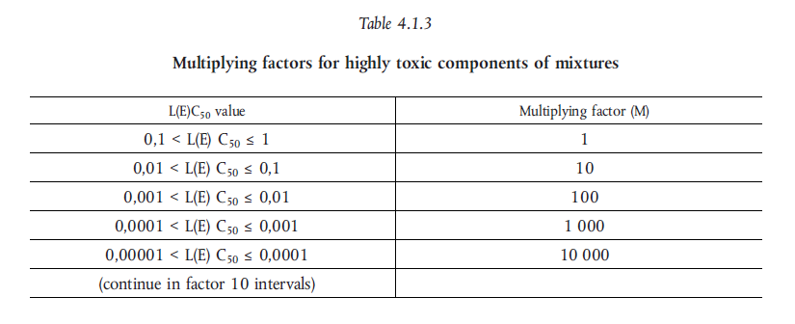
M - factor

Slide 32
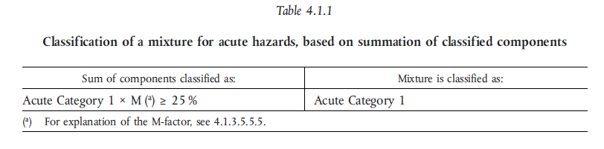
Classification – Aquatic acute

Slide 33
Exercises - CLP
3. Label for 9 % NH₃ in 1L bottle

Slide 34
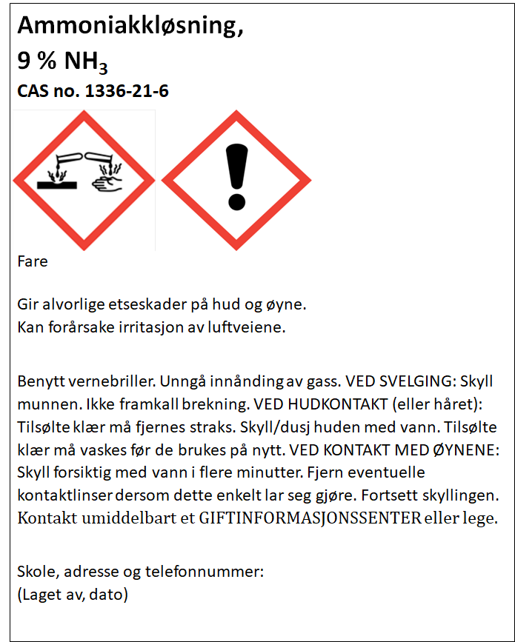

Slide 36
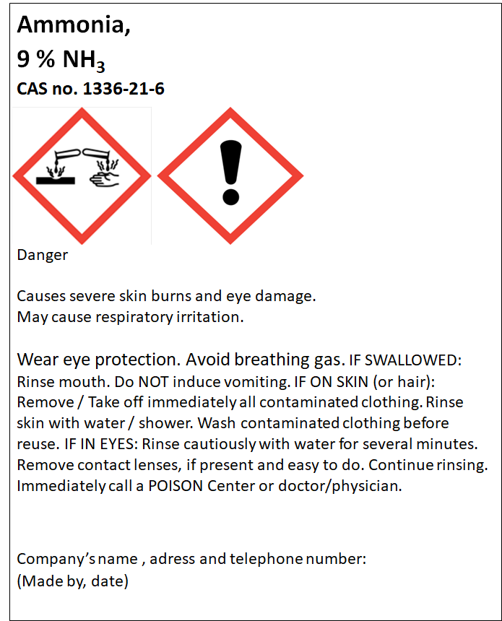

Slide 38
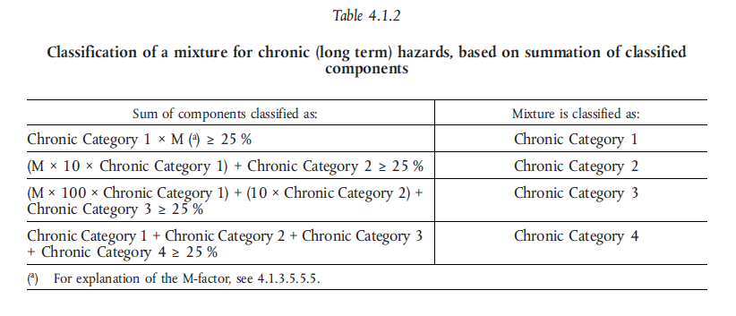
Classification – Aquatic chronic

Slide 39


Classification – Acute toxicity
ATE = Acute toxicity estimate

Slide 40
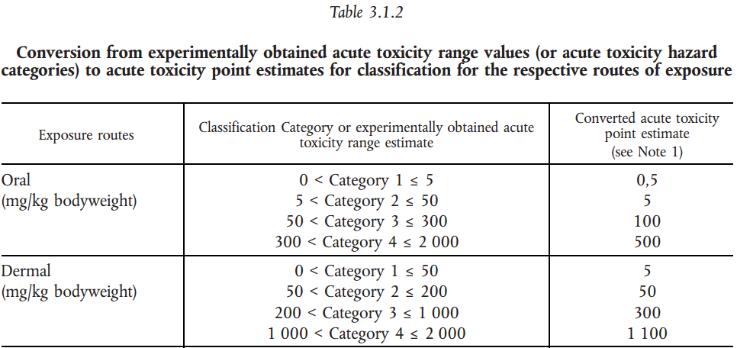

Acute toxicity
Example
A 5 % solution of a substance classified as acute tox. 3 – oral exposure
$${ATE}_{mix}=\frac{100∗{ATE}_{i}}{c_{i}}=\frac{100∗100}{5}=2000$$

Slide 41
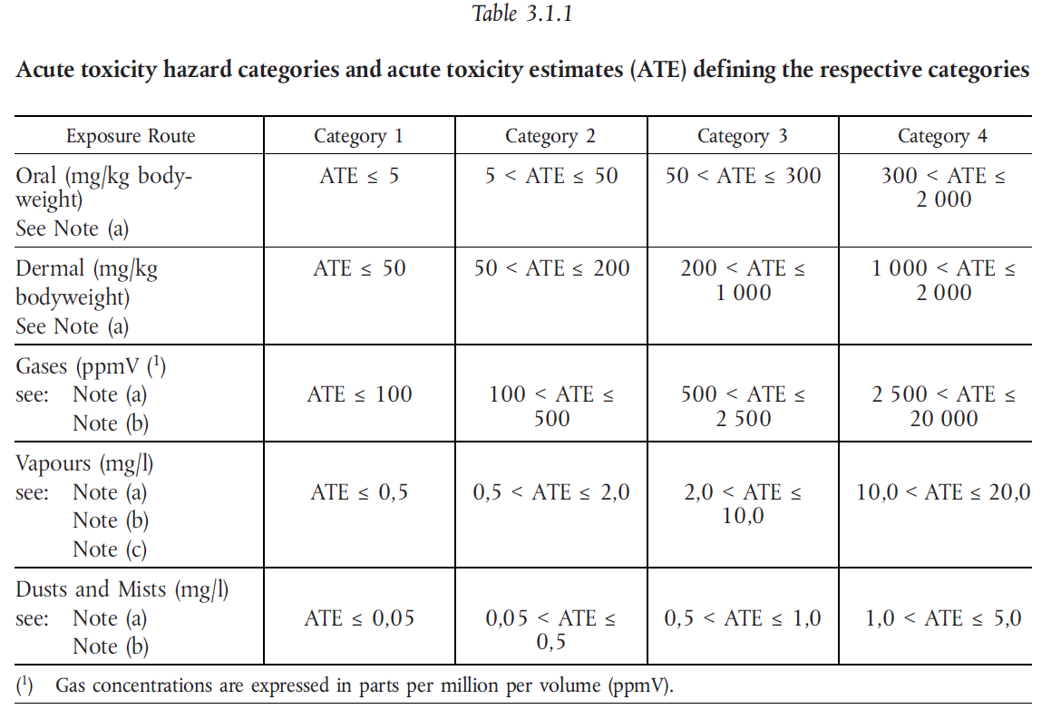

Slide 42
Acute toxicity
Example
A 5 % solution of a substance classified as acute tox. 3 – oral exposure
$${ATE}_{mix}=\frac{100∗{ATE}_{i}}{c_{i}}=\frac{100∗100}{5}=2000$$

Slide 43
Exercises - CLP
4. Label for 2 % CuSO₄ in 1 L bottle

Slide 44

Kobber(II)sulfatløsning,
2 % CuSO₄
CAS no. 7758-98-7
Giftig, med langtidsvirkning, for liv i vann.
Unngå utslipp til miljøet. Samle opp spill
Skole, adresse og telefonnummer:
(Laget av, dato)

Slide 45
copper(II)sulphate ,
2 % CuSO₄
CAS no. 7758-98-7
Toxic to aquatic life with long lasting effects.
Avoid release to the environment. Collect spillage.
Company’s name , adress and telephone number:
(Made by, date)

Slide 46
Labelling with only hazard pictogram and signal word
Exeptions for some hazard classes where the contents do not exceed 125 mL (see page 5 in the booklet with exercises).
Kobber(II)sulfatløsning,
2 % CuSO₄
Skole, adresse og telefonnummer:
(Laget av, dato)
copper(II)sulphate
2 % CuSO₄
Company’s name , adress and telephone number:
(Made by, date)

Slide 47
Exercise - CLP (optional)
5. Wich concentration of a nickel(II)sulfate solution is the lowest that will trigger any classification of the solution as hazardous according to the CLP regulation?
(see next slide)

Slide 48
Hazard class | To determine the classification of the mixture | Concentration limit for the mixture to be classified as hazardous
Acute Tox. 4;H302 | Oral | 25 %
Skin irrit. 2;H315 | Specific concentration limit C ≥ 20 % | 20 %
Skin Sens. 1;H317 | Specific concentration limit C ≥ 0,01 % | 0,01 %
Acute Tox. 4;H332 | Dust/mist | 30 %
Resp. Sens. 1;H334 | Generic concentration limit C ≥ 1,0 % - table 3.4.3 in the CLP regulation | 1 %
Muta. 2;H341 | Generic concentration limit C ≥ 1,0 % - table 3.5.2 in the CLP regulation | 1 %
Carc. 1A;H350i | Generic concentration limit C ≥ 0,1 % - table 3.6.2 in the CLP regulation | 0,1 %
Repr. 1B;H360D | Generisk konsentrasjonsgrense C ≥ 0,3 % - table 3.7.2 in the CLP regulation | 0,3 %
STOT RE 1;H372 | Specific concentration limit C ≥ 1 % | 1 %
STOT RE 2;H373 | Specific concentration limit 0,1 % ≤ C ≤ 1% | 0,1 %
Aquatic Acute 1 | ˂ 25 % ∙ 1(M) ˂ 25 % | 25 %
Aquatic Chronic 1 | ˂ 0,25 % ∙ 1 (M) ∙ 100 ˂ 25 % | 0,25 %

Slide 49
Harmonised classification
Harmonised classification (as provided in Annex VI to CLP), must always be used by a manufacturer
Harmonised classification normally applies to those properties of the highest concern
Where some, but not all hazard classes or differentiations within hazard classes have been harmonised, the remainder should be self-classified to complete the classification
Guidance on the Application of the CLP Criteria

Slide 50
Leads to different classification for the same mixture
Ammonia 25 % (Avantor)
Skin corrosion 1B
Aquatic acute, 1
STOT, SE, 3
Serious eyedamage, 1
Aquatic chronic, 2
Ammonia 25 % (Merck)
Skin corrosion, 1B
Aquatic acute, 1
STOT, SE, 3
Corrosive to metals, 1

Slide 51
CLP in scientific research
This Regulation (CLP) shall not apply to the following:
substances and mixtures for scientific research and development, which are not placed on the market, provided they are used under controlled conditions in accordance with Community workplace and environmental legislation.
http://eur-lex.europa.eu/LexUriServ/LexUriServ.do?uri=OJ:L:2008:353:0001:1355:en:PDF
Title 1, Article 1, 2d

Slide 52
How to label mixtures in your science lab
Mixtures that are to be use the same day do not require any labelling
Mixtures that are left over night requires a minimum labelling of:
  Name and molar concentration
  Hazard pictograms
  Hazard statements
  Highly relevant precautionairy statements

Slide 53
Evaluation
Plus, minus, delta

