Slide 1



Modeling and simulation of deformable porous media
Jan Martin Nordbotten
Department of Mathematics, University of Bergen, Norway
Department of Civil and Environmental Engineering, Princeton University, USA
VISTA – Norwegian Academy of Sciences and Letters and Statoil ASA

Slide 2
Overview
Motivating examples and Biot’s equations
Hybrid variational finite volume discretization
Applications

Slide 3
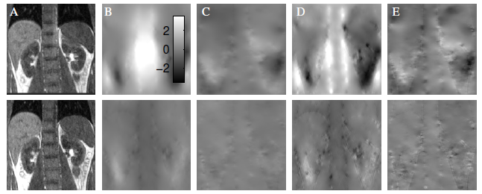
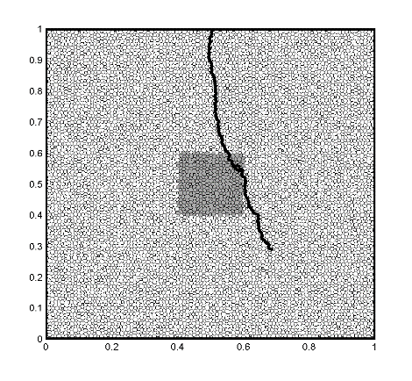
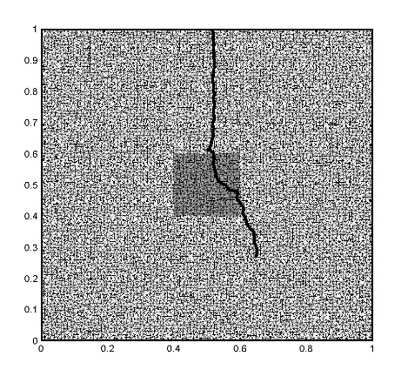
Motivating examples
Soil Desiccation
Image processing
K. DeCarlo
E. Hodneland
Multi-phase flow in porous materials
Fractured/ing rock
F. Doster

Slide 4
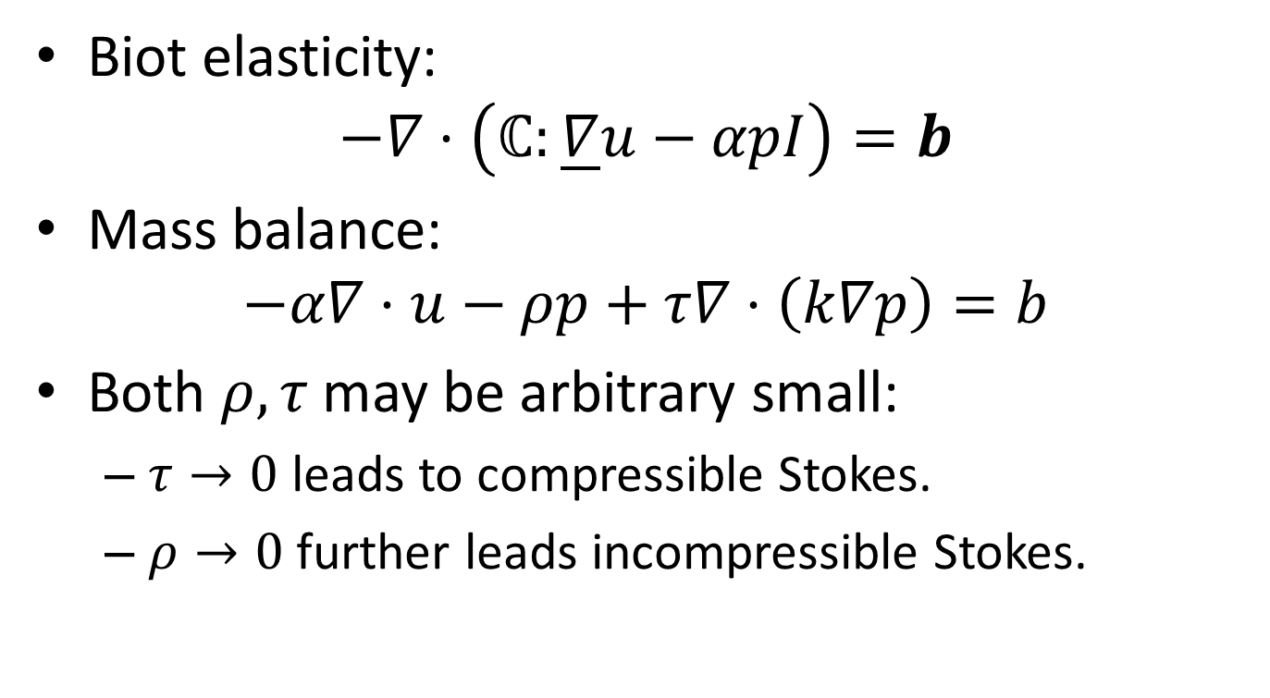
Linearized Biot equations
Biot elasticity:
$−∇⋅\left(ℂ:\underline{∇}u−αpI\right)=b$
Mass balance:
$−α∇⋅u−ρp+τ∇⋅\left(k∇p\right)=b$
Both $ρ, τ$ may be arbitrary small:
  $τ→0$ leads to compressible Stokes.
  $ρ→0$ further leads incompressible Stokes.

Slide 5
Qualities of «good» discretizations
Minimum number of degrees of freedom.
Weak limitations on admissible grids.
Stable in all physically relevant limits.
Preserves physical conservation principles.
Handles jumps in coefficients accurately.
Supported by rigorous analysis.

Slide 6
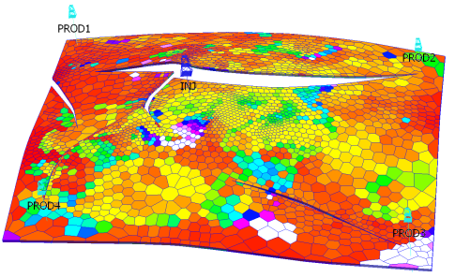
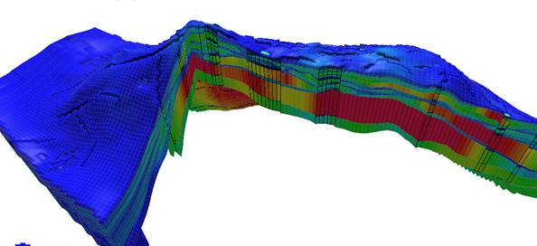
Engineering preference for grids
Unstructured grids minimize grid orientation effects for flow equations.
High aspect ratio grids adapt to geological heterogenity.

Slide 7
A resolution of these properties
Cell-centered co-located displacement and pressure variables.
Finite volume structure balancing mass and momentum.
Constitutive laws approximated by multipoint flux and stress approximations.
Analysis via links to discrete functional framework and discontinuous Galerkin.

Slide 8

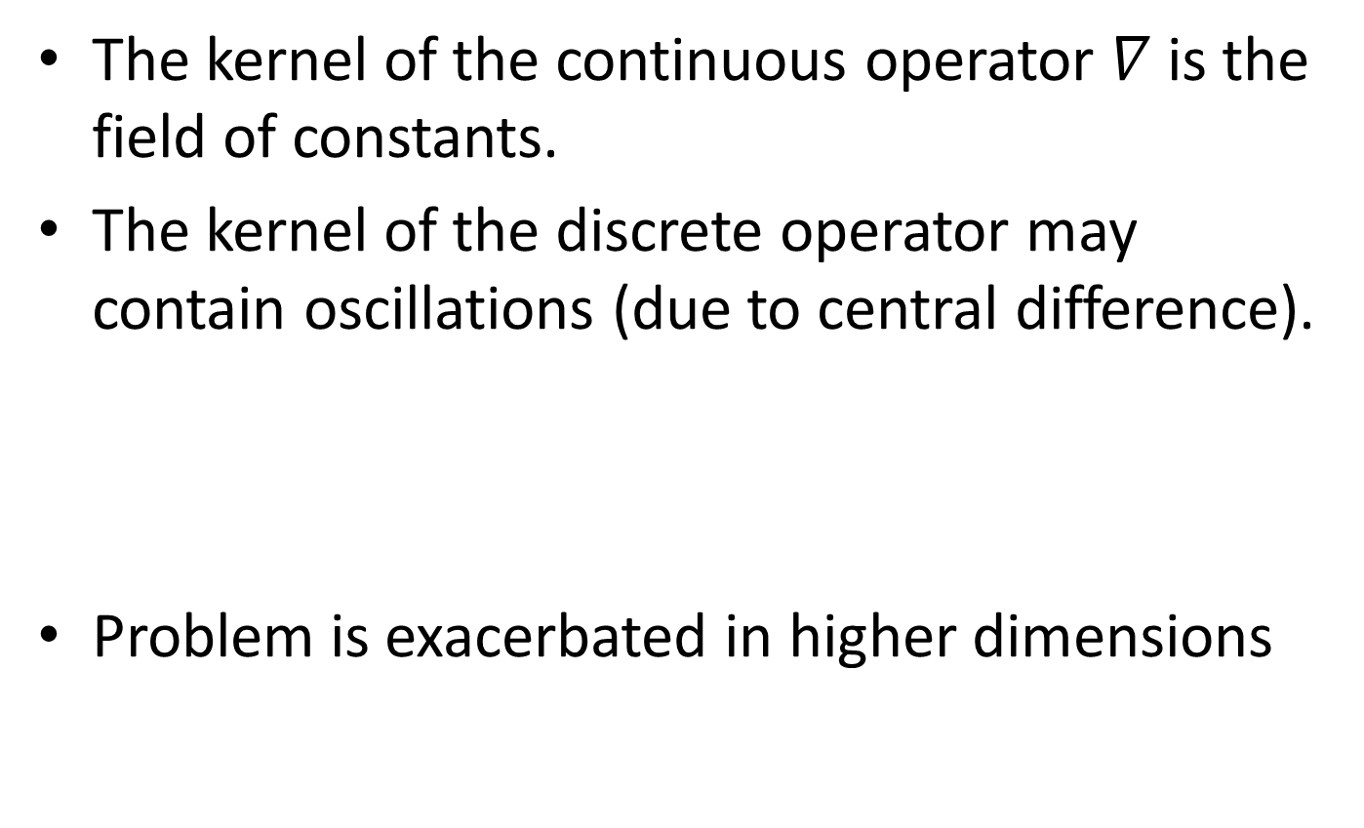



Common challenge
The kernel of the continuous operator $∇$ is the field of constants.
The kernel of the discrete operator may contain oscillations (due to central difference).
Problem is exacerbated in higher dimensions
$$u$$
$$\frac{du}{dx}$$
$$x$$
$$x$$

Slide 9
Implication
Straight-forward discretizations with co-located equal-order elements are in general not robust.

Slide 10
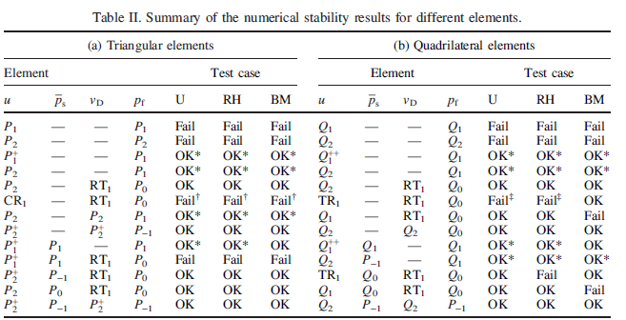
Standard finite elements
Haga, Osnes, Langtangen, 2012.

Slide 11
Standard solutions
Staggered variables (e.g. RT0 + P0 for flow).
Enriched spaces (e.g. MINI + P1 for Biot).
Macro-elements (elasticity, ...)
Artificial stabilization (Brezzi-Pitkaranta, Gaspar, etc.)
Bubbles/VMS (Hughes, Quarteroni, Zikatanov...)
Here: Coupled discretization can be related to many of the preceding ideas.

Slide 12
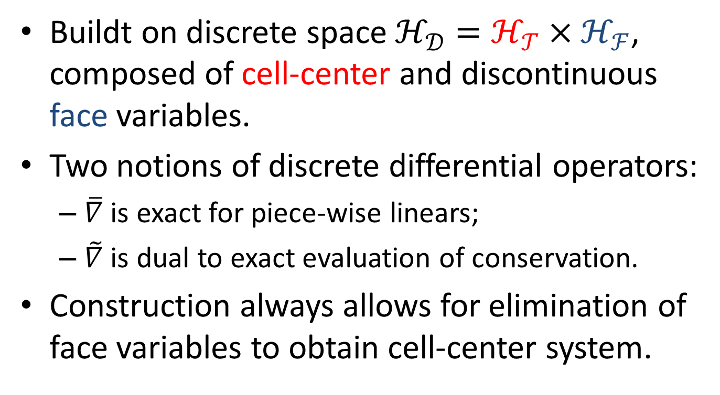
Hybrid variational FV
Buildt on discrete space $ℋ_{𝒟}=ℋ_{𝒯}×ℋ_{ℱ}$, composed of cell-center and discontinuous face variables.
Two notions of discrete differential operators:
  $\overline{∇}$ is exact for piece-wise linears;
  $\tilde{∇}$ is dual to exact evaluation of conservation.
Construction always allows for elimination of face variables to obtain cell-center system.

Slide 13
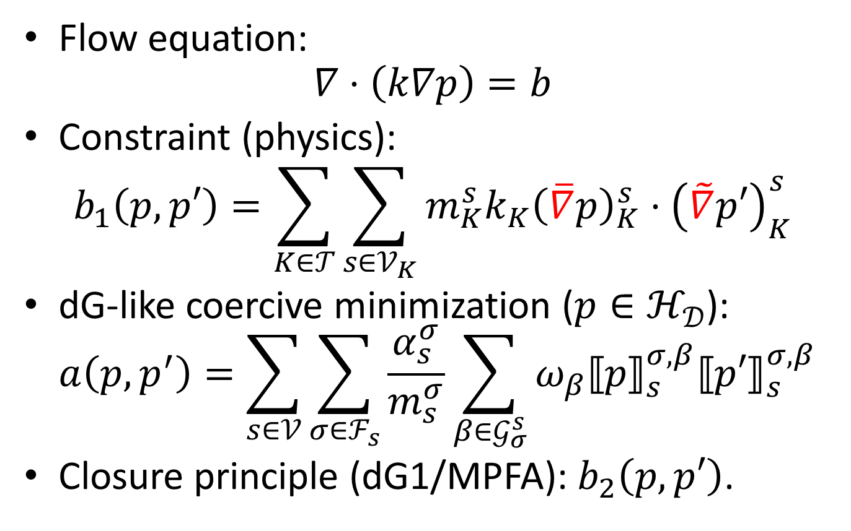
Review: HVFV (MPFA)
Flow equation:
$∇⋅\left(k∇p\right)=b$
Constraint (physics):
$b_{1}\left(p,p′\right)=\sum_{K∈𝒯}{\sum_{s∈𝒱_{K}}{m_{K}^{s}k_{K}{\left(\overline{∇}p\right)}_{K}^{s}⋅{\left(\tilde{∇}p′\right)}_{K}^{s}}}$
dG-like coercive minimization (${p∈ℋ}_{𝒟}$):
$a\left(p,p^{′}\right)=\sum_{s∈𝒱}{\sum_{σ∈ℱ_{s}}{\frac{α_{s}^{σ}}{m_{s}^{σ}}\sum_{β∈𝒢_{σ}^{s}}{ω_{β}{⟦p⟧}_{s}^{σ,β}{⟦p′⟧}_{s}^{σ,β}}}}$
Closure principle (dG1/MPFA): $b_{2}\left(p,p′\right)$.

Slide 14





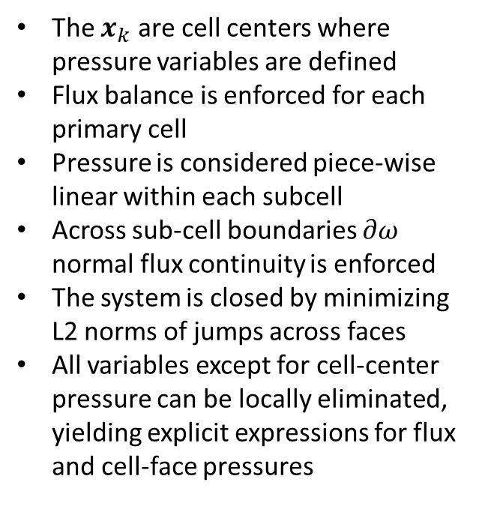




Interpretation
The $x_{k}$ are cell centers where pressure variables are defined
Flux balance is enforced for each primary cell
Pressure is considered piece-wise linear within each subcell
Across sub-cell boundaries $∂ω$ normal flux continuity is enforced
The system is closed by minimizing L2 norms of jumps across faces
All variables except for cell-center pressure can be locally eliminated, yielding explicit expressions for flux and cell-face pressures
$$x_{4}$$
$$x_{3}$$
$$i$$
$${∂ω}_{1,2,i}$$
$$x_{2}$$
$$x_{1}$$
$${∂ω}_{1,2,j}$$
$$j$$
$$x_{5}$$

Slide 15
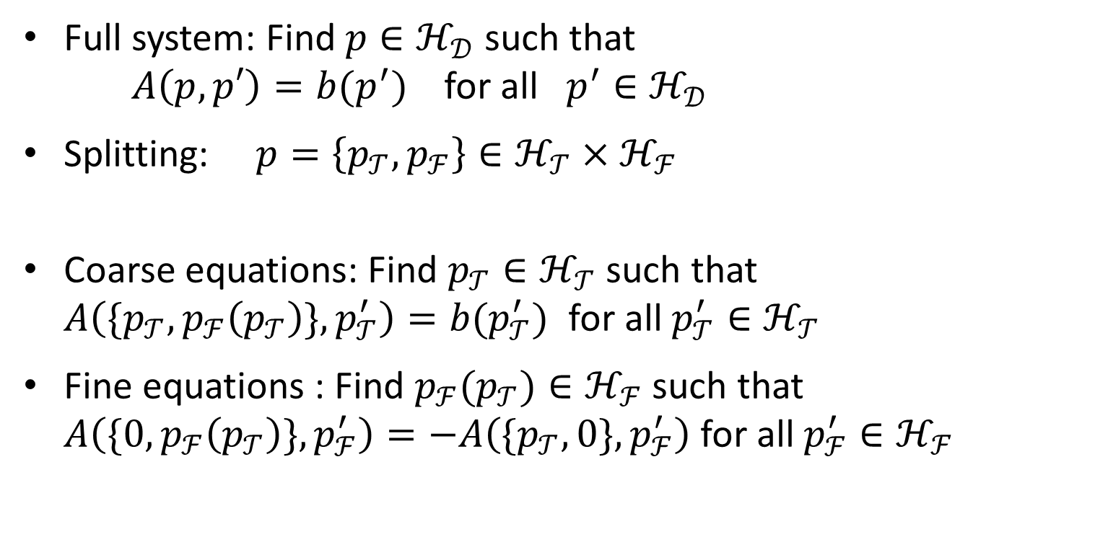
VMS re-formulation
Full system: Find ${p∈ℋ}_{𝒟}$ such that
$A\left(p,p′\right)=b(p^{′})$ for all ${p^{′}∈ℋ}_{𝒟}$
Splitting: $p=\left\{p_{𝒯},p_{ℱ}\right\}∈ℋ_{𝒯}×ℋ_{ℱ}$
Coarse equations: Find ${p_{𝒯}∈ℋ}_{𝒯}$ such that
$A\left(\{p_{𝒯},p_{ℱ}\left(p_{𝒯}\right)\},p_{𝒯}^{′}\right)=b(p_{𝒯}^{′})$ for all ${p_{𝒯}^{′}∈ℋ}_{𝒯}$
Fine equations : Find ${p_{ℱ}(p_{𝒯})∈ℋ}_{ℱ}$ such that
$A\left(\{0,p_{ℱ}\left(p_{𝒯}\right)\},p_{ℱ}^{′}\right)=−A\left(\{p_{𝒯},0\},p_{ℱ}^{′}\right)$ for all ${p_{ℱ}^{′}∈ℋ}_{ℱ}$

Slide 16
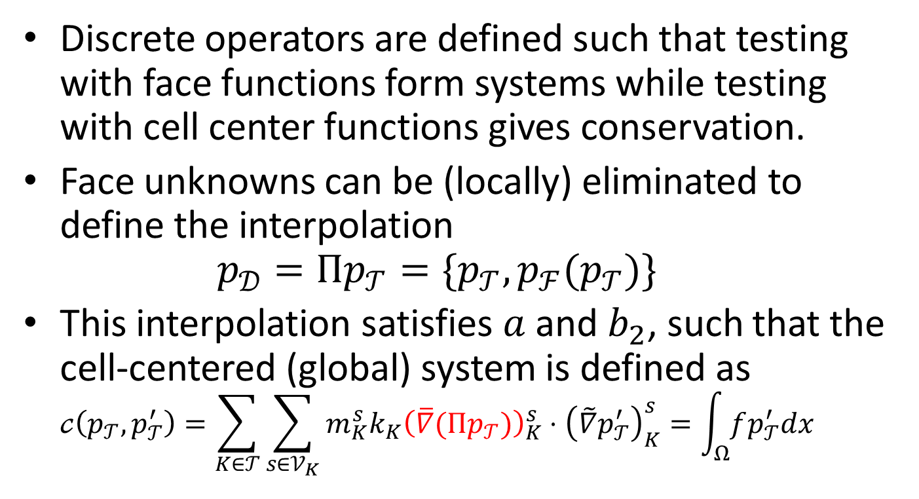
Elimination of face unknowns
Discrete operators are defined such that testing with face functions form systems while testing with cell center functions gives conservation.
Face unknowns can be (locally) eliminated to define the interpolation
$p_{𝒟}=Πp_{𝒯}=\{p_{𝒯},p_{ℱ}(p_{𝒯})\}$
This interpolation satisfies $a$ and $b_{2}$, such that the cell-centered (global) system is defined as
$𝒸\left(p_{𝒯},p_{𝒯}^{′}\right)=\sum_{K∈𝒯}{\sum_{s∈𝒱_{K}}{m_{K}^{s}k_{K}{\left(\overline{∇}(Πp_{𝒯})\right)}_{K}^{s}⋅{\left(\tilde{∇}p_{𝒯}^{′}\right)}_{K}^{s}}}=\int_{Ω}{fp_{𝒯}^{′}dx}$

Slide 17
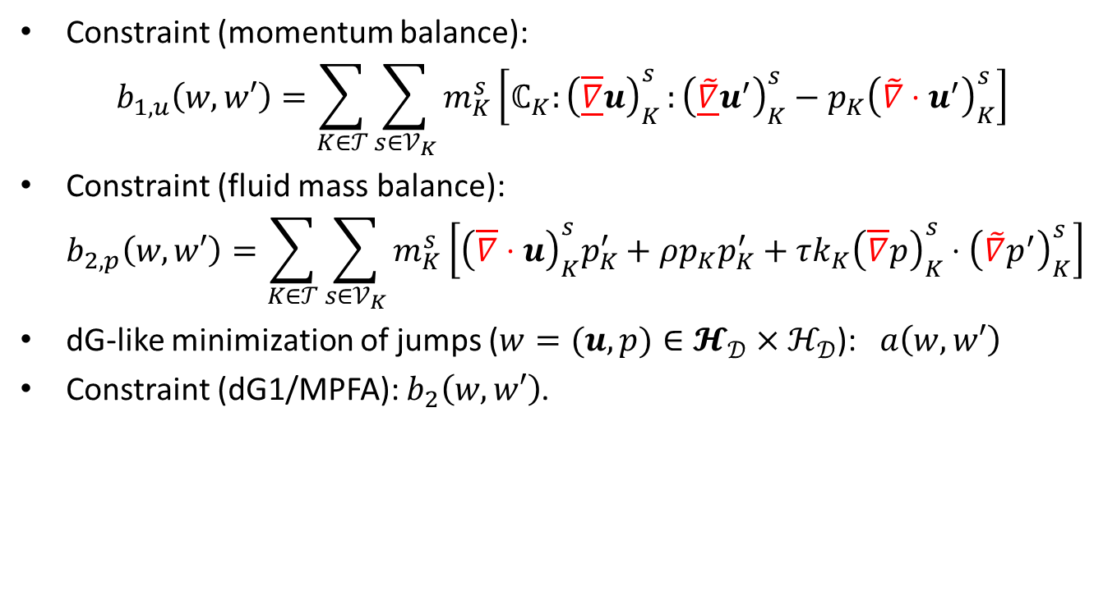
HVFV for Biot
Constraint (momentum balance):
$b_{1,u}\left(w,w′\right)=\sum_{K∈𝒯}{\sum_{s∈𝒱_{K}}{m_{K}^{s}\left[ℂ_{K}{:\left(\underline{\overline{∇}}u\right)}_{K}^{s}:{\left(\underline{\tilde{∇}}u^{′}\right)}_{K}^{s}−p_{K}{\left(\tilde{∇}⋅u^{′}\right)}_{K}^{s}\right]}}$
Constraint (fluid mass balance):
$b_{2,p}\left(w,w′\right)=\sum_{K∈𝒯}{\sum_{s∈𝒱_{K}}{m_{K}^{s}\left[{\left(\overline{∇}⋅u\right)}_{K}^{s}p_{K}^{′}+ρp_{K}p_{K}^{′}+τk_{K}{\left(\overline{∇}p\right)}_{K}^{s}⋅{\left(\tilde{∇}p^{′}\right)}_{K}^{s}\right]}}$
dG-like minimization of jumps ($w=(u,p)∈𝓗_{𝒟}×ℋ_{𝒟}$): $a\left(w,w′\right)$
Constraint (dG1/MPFA): $b_{2}\left(w,w′\right)$.

Slide 18
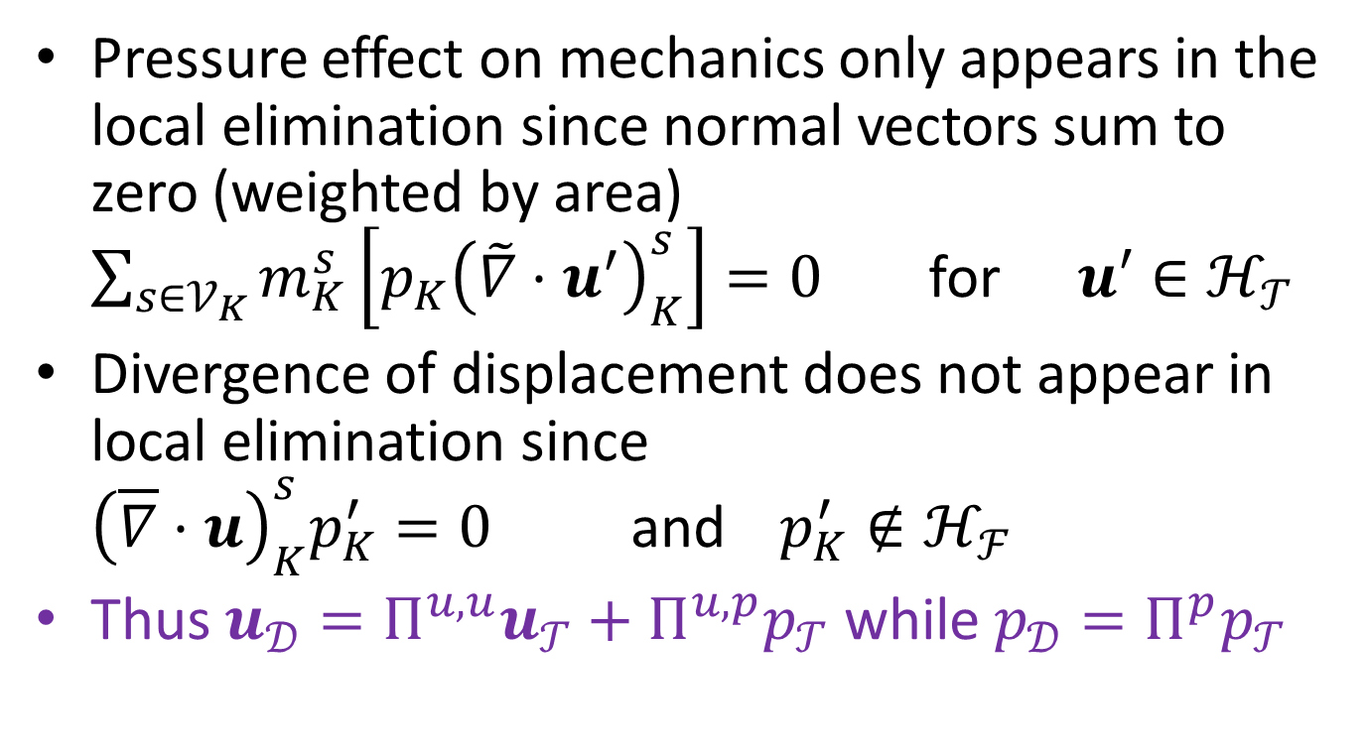
Important details
Pressure effect on mechanics only appears in the local elimination since normal vectors sum to zero (weighted by area)
$\sum_{s∈𝒱_{K}}{m_{K}^{s}\left[p_{K}{\left(\tilde{∇}⋅u^{′}\right)}_{K}^{s}\right]}=0$ for ${u′∈ℋ}_{𝒯}$
Divergence of displacement does not appear in local elimination since
${\left(\overline{∇}⋅u\right)}_{K}^{s}p_{K}^{′}=0$ and ${p_{K}^{′}∉ℋ}_{ℱ}$
Thus $u_{𝒟}=Π^{u,u}u_{𝒯}+Π^{u,p}p_{𝒯}$ while $p_{𝒟}=Π^{p}p_{𝒯}$

Slide 19
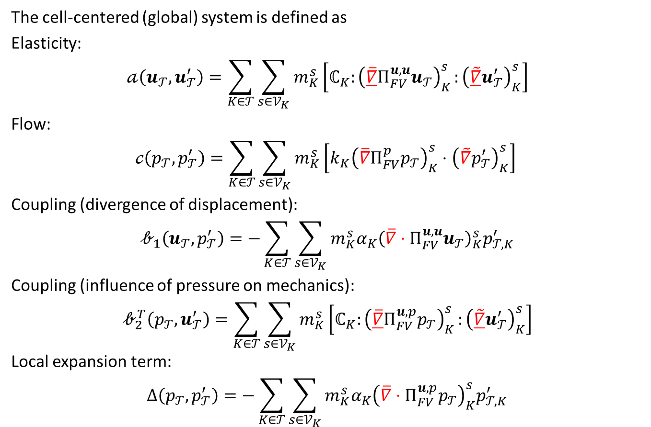
Elimination of face unknowns
The cell-centered (global) system is defined as
Elasticity:
$$𝒶\left(u_{𝒯},u_{𝒯}^{′}\right)=\sum_{K∈𝒯}{\sum_{s∈𝒱_{K}}{m_{K}^{s}\left[ℂ_{K}{:\left(\underline{\overline{∇}}Π_{FV}^{u,u}u_{𝒯}\right)}_{K}^{s}:{\left(\underline{\tilde{∇}}u_{𝒯}^{′}\right)}_{K}^{s}\right]}}$$
Flow:
$$𝒸\left(p_{𝒯},p_{𝒯}^{′}\right)=\sum_{K∈𝒯}{\sum_{s∈𝒱_{K}}{m_{K}^{s}\left[k_{K}{\left(\overline{∇}Π_{FV}^{p}p_{𝒯}\right)}_{K}^{s}⋅{\left(\tilde{∇}p_{𝒯}^{′}\right)}_{K}^{s}\right]}}$$
Coupling (divergence of displacement):
$$𝒷_{1}\left(u_{𝒯},p_{𝒯}^{′}\right)=−\sum_{K∈𝒯}{\sum_{s∈𝒱_{K}}{m_{K}^{s}α_{K}{\left(\overline{∇}⋅Π_{FV}^{u,u}u_{𝒯}\right)}_{K}^{s}p_{𝒯,K}^{′}}}$$
Coupling (influence of pressure on mechanics):
$$𝒷_{2}^{T}\left(p_{𝒯},u_{𝒯}^{′}\right)=\sum_{K∈𝒯}{\sum_{s∈𝒱_{K}}{m_{K}^{s}\left[ℂ_{K}{:\left(\underline{\overline{∇}}Π_{FV}^{u,p}p_{𝒯}\right)}_{K}^{s}:{\left(\underline{\tilde{∇}}u_{𝒯}^{′}\right)}_{K}^{s}\right]}}$$
Local expansion term:
$$Δ\left(p_{𝒯},p_{𝒯}^{′}\right)=−\sum_{K∈𝒯}{\sum_{s∈𝒱_{K}}{m_{K}^{s}α_{K}{\left(\overline{∇}⋅Π_{FV}^{u,p}p_{𝒯}\right)}_{K}^{s}p_{𝒯,K}^{′}}}$$

Slide 20
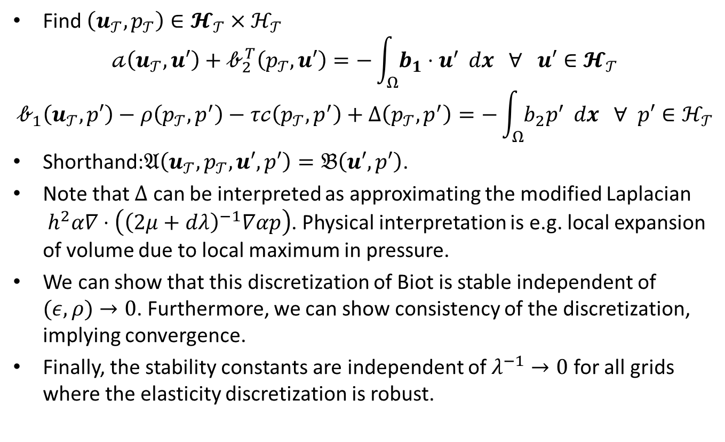
Global Biot system
Find $\left(u_{𝒯},p_{𝒯}\right)∈𝓗_{𝒯}×ℋ_{𝒯}$
$$𝒶\left(u_{𝒯},u′\right)+𝒷_{2}^{T}\left(p_{𝒯},u′\right)=−\int_{Ω}{b_{1}⋅u^{′}} dx ∀ u′∈𝓗_{𝒯}$$
$$𝒷_{1}\left(u_{𝒯},p′\right)−ρ\left(p_{𝒯},p^{′}\right)−τ𝒸\left(p_{𝒯},p^{′}\right)+Δ\left(p_{𝒯},p^{′}\right)=−\int_{Ω}{b_{2}p^{′}} dx ∀ p′∈ℋ_{𝒯}$$
Shorthand:$𝔄\left(u_{𝒯},p_{𝒯},u′,p′\right)=𝔅\left(u′,p′\right)$.
Note that $Δ$ can be interpreted as approximating the modified Laplacian
$h^{2}α∇⋅\left({\left(2μ+dλ\right)}^{−1}∇αp\right)$. Physical interpretation is e.g. local expansion of volume due to local maximum in pressure.
We can show that this discretization of Biot is stable independent of
$(ε,ρ)→0$. Furthermore, we can show consistency of the discretization, implying convergence.
Finally, the stability constants are independent of $λ^{−1}→0$ for all grids where the elasticity discretization is robust.

Slide 21
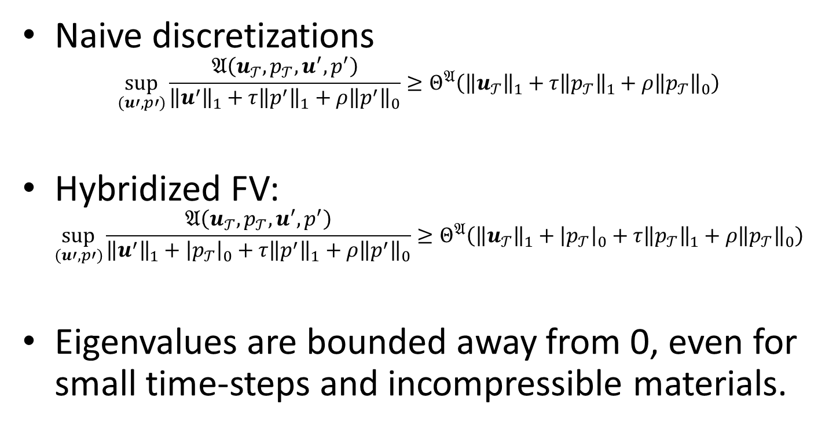
Main result
Naive discretizations
$\sup_{(u′,p′)}{\frac{𝔄\left(u_{𝒯},p_{𝒯},u^{′},p^{′}\right)}{{\left\|u^{′}\right\|}_{1}+τ{\left\|p^{′}\right\|}_{1}+ρ{\left\|p^{′}\right\|}_{0}}≥Θ^{𝔄}\left({\left\|u_{𝒯}\right\|}_{1}+τ{\left\|p_{𝒯}\right\|}_{1}+ρ{\left\|p_{𝒯}\right\|}_{0}\right)}$
Hybridized FV:
$\sup_{(u′,p′)}{\frac{𝔄\left(u_{𝒯},p_{𝒯},u^{′},p^{′}\right)}{{\left\|u^{′}\right\|}_{1}+{\left|p_{𝒯}\right|}_{0}+τ{\left\|p^{′}\right\|}_{1}+ρ{\left\|p^{′}\right\|}_{0}}≥Θ^{𝔄}\left({\left\|u_{𝒯}\right\|}_{1}+{\left|p_{𝒯}\right|}_{0}+τ{\left\|p_{𝒯}\right\|}_{1}+ρ{\left\|p_{𝒯}\right\|}_{0}\right)}$
Eigenvalues are bounded away from 0, even for small time-steps and incompressible materials.

Slide 22
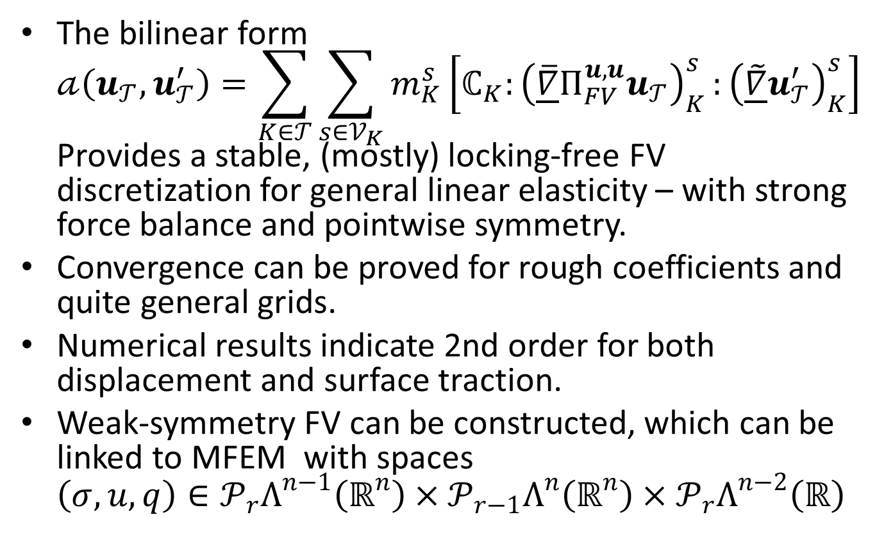
Comment on elasticity
The bilinear form
$𝒶\left(u_{𝒯},u_{𝒯}^{′}\right)=\sum_{K∈𝒯}{\sum_{s∈𝒱_{K}}{m_{K}^{s}\left[ℂ_{K}{:\left(\underline{\overline{∇}}Π_{FV}^{u,u}u_{𝒯}\right)}_{K}^{s}:{\left(\underline{\tilde{∇}}u_{𝒯}^{′}\right)}_{K}^{s}\right]}}$
Provides a stable, (mostly) locking-free FV discretization for general linear elasticity – with strong force balance and pointwise symmetry.
Convergence can be proved for rough coefficients and quite general grids.
Numerical results indicate 2nd order for both displacement and surface traction.
Weak-symmetry FV can be constructed, which can be linked to MFEM with spaces
$\left(σ, u,q\right)∈𝒫_{r}Λ^{n−1}\left(ℝ^{n}\right)×𝒫_{r−1}Λ^{n}\left(ℝ^{n}\right)×𝒫_{r}Λ^{n−2}\left(ℝ\right)$

Slide 23

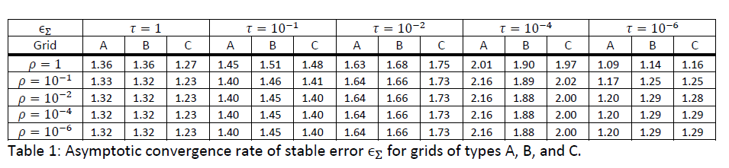
Numerical verification: Convergence

Slide 24
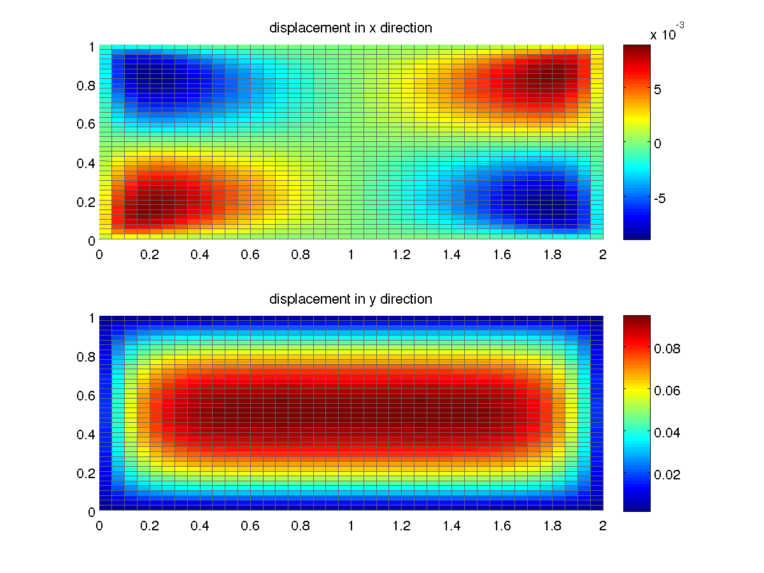
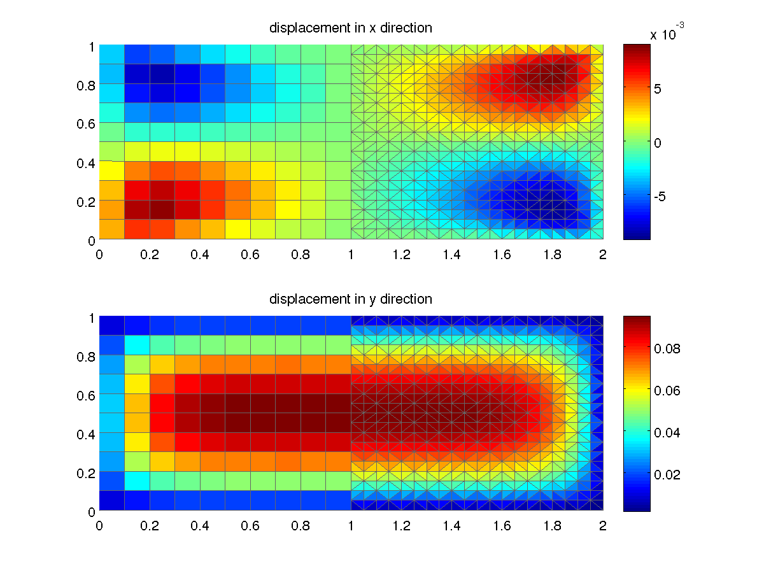
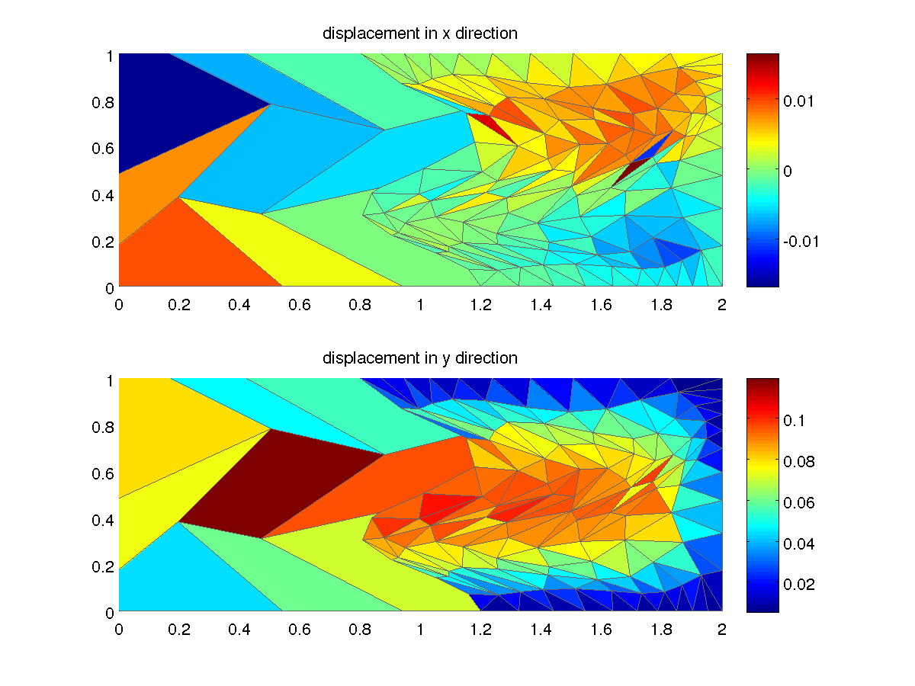
Validations: Rough grids (elasticity)

Slide 25
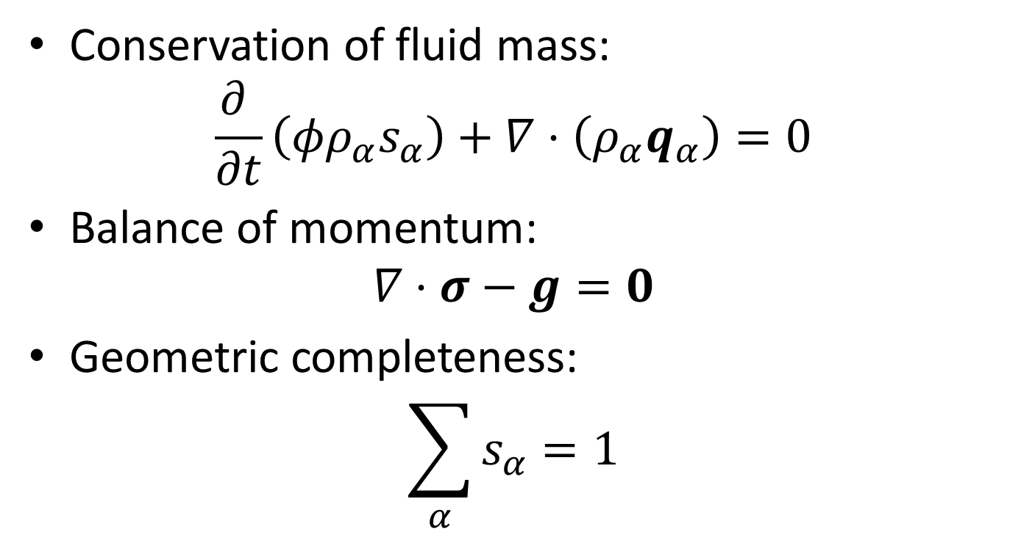
Applications: Governing equations
Conservation of fluid mass:
$\frac{∂ }{∂t}\left(φρ_{α}s_{α}\right)+∇⋅\left(ρ_{α}q_{α}\right)=0$
Balance of momentum:
$∇⋅σ−g=0$
Geometric completeness:
$\sum_{α}{s_{α}}=1$

Slide 26
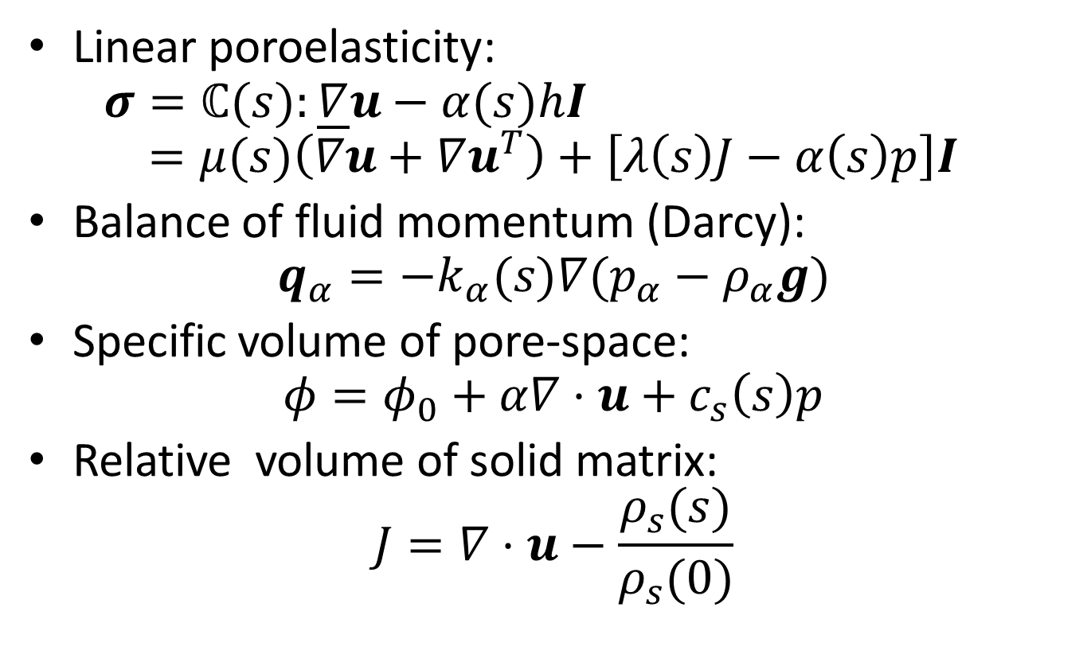
Constitutive laws
Linear poroelasticity:
$σ=ℂ(s):\underline{∇}u−α(s)hI$
$=μ(s)\left(∇u+∇u^{T}\right)+\left[λ\left(s\right)J−α\left(s\right)p\right]I$
Balance of fluid momentum (Darcy):
$q_{α}=−k_{α}(s)∇(p_{α}−ρ_{α}g)$
Specific volume of pore-space:
$φ=φ_{0}+α∇⋅u+c_{s}\left(s\right)p$
Relative volume of solid matrix:
$J=∇⋅u−\frac{ρ_{s}(s)}{ρ_{s}(0)}$

Slide 27
Application: CO2 storage
Non-linear multi-component system of conservation equations for two fluids.
Linear elasticity.
System resolved using generalized ImPEM with Full Pressure Coupling (FPS).
Key Idea: Pressure and displacement solved fully coupled and implicitly, mass transport explicitly.
Joint work with Florian Doster.

Slide 28
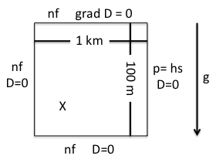
Rise of injected CO2
Sketch of setup
CO2 saturation
X component
Z component
3 cm
6 cm
0 cm
0 cm
- 1 cm
- 4 cm

Slide 29
Application: Soil fracturing
Non-linear, saturation-dependent soil (clay) properties, including significant shrinking.
Heterogeneous soil saturation introduces mechanical stresses.
Tensile soil failure and fracture evolution according to Griffith’s criterium.
Field data with bioturbation: Elephants (external load) and termites (soil cohesion).
Joint work with Keita DeCarlo and Kelly Caylor.

Slide 30
Preliminary results

Slide 31
Conclusions
We have presented a hybrid variational FV framework and formulated a cell-centered discretization for Biot. The formulation builds on previous work for Darcy flow (MPFA) and elasticity (MPSA)
The discretization has the advantages that it:
  Is locally mass and momentum conservative
  Can be applied to arbitrary grids
  Has explicitly provides local expressions for flux and traction
  Has co-located variables allowing for minimum degrees of freedom
  Is stable without relying on any arbitrary stabilization parameters
The discretization has been applied to a wide range of grids and problems in 2D and 3D to verify the practical applicability.
Ongoing work on finite volume methods with weak symmetry – both in the HVFV framework and MFEM with quadrature.

Slide 32
Some references
Nordbotten, J. M. (2014), Finite volume hydro-mechanical simulation of porous media, Water Resources Research, 50(5), 4279-4394, doi:10.1002/2013WR015179.
Nordbotten, J. M. (2014), Cell-centered finite volume methods for deformable porous media, International Journal for Numerical Methods in Engineering, 100(6), 399-418, doi:10.1002/nme.4734.
Nordbotten, J. M., Convergence of a cell-centered finite volume method for linear elasticity, preprint: http://arxiv.org/abs/1503.05040.
Nordbotten, J. M., Stable cell-centered finite volume discretization for Biot’s equations, submitted.

