Slide 1











Infiltrated Double Perovskite Electrodes for Proton Conducting Steam Electrolysers
Einar Vøllestad¹, Ragnar Strandbakke¹, Marie-Laure Fontaine² and Truls Norby¹
1: University of Oslo, Department of Chemistry
2: SINTEF Materials and Chemistry

Slide 2
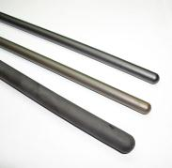
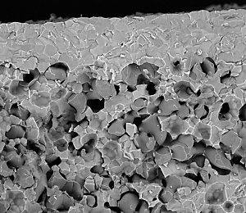
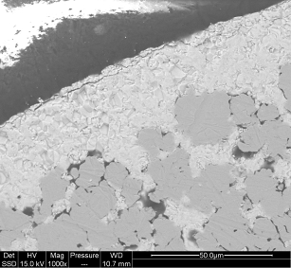
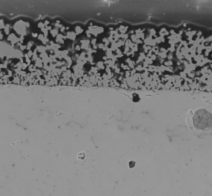
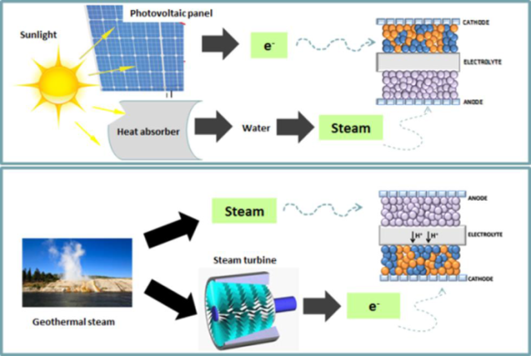
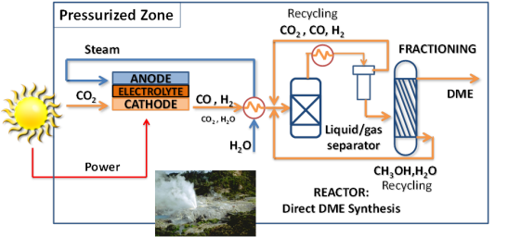





High temperature electrolyser with novel proton ceramic tubular modules (2014-2017)
Fabrication of BZY-based segmented-in-series tubular electrolyser cells
Multi-tube module development
H₂ production from steam and electricity
DME/Ethanol production from steam, CO₂ and electricity
20 µm
50 µm
U
4e⁻
4H⁺
2H₂O
2H₂O
3/2O₂
Development of mixed proton-electron conducting anodes
2H₂
O²⁻
4H⁺
O₂
100 µm
CO₂
CO+2H₂

Slide 3

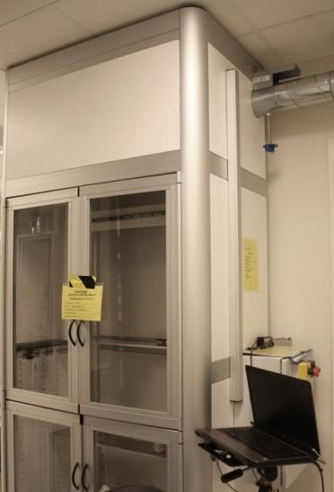
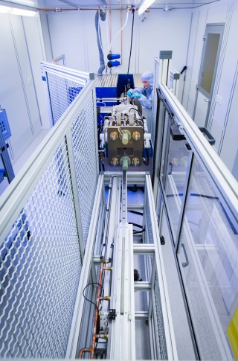
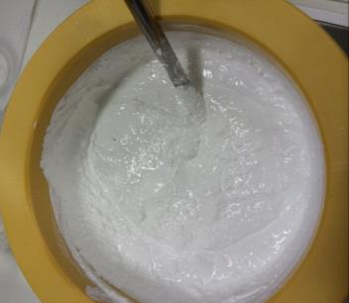
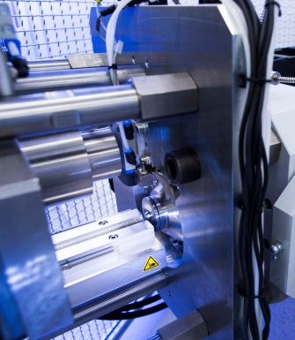

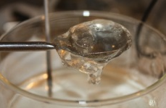
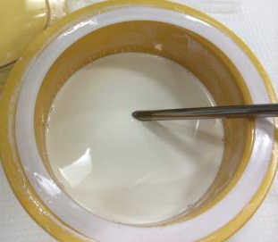
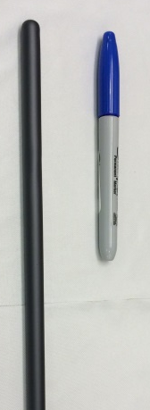
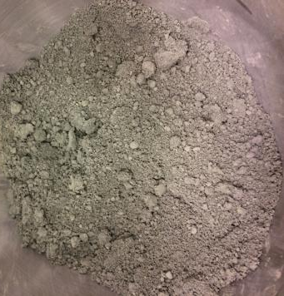
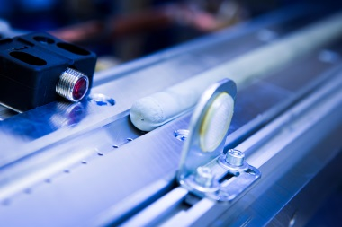
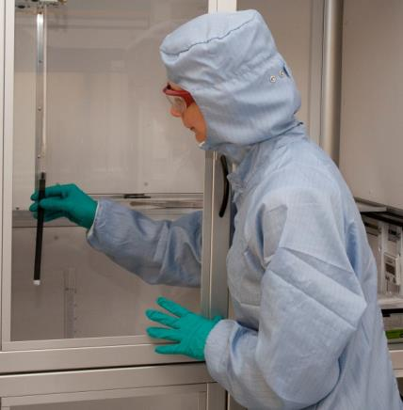
Solid state reactive sintering for BZCY based cell production
SONATE 100 m² clean room
Pastes and suspensions using BaSO₄, CeO₂, Y₂O₃, ZrO₂
Extrusion of fuel electrode
Electrolyte deposition
Co-sintering
Drying in air
Drying in air
Wet milling of SSRS based precursors
10-25 cm long tubes
Automatic dip-coater
Max 1m long tube
Dip-coating suspensions
NiO based paste
40-ton extruder with automatic capping, cutting and air transport belt

Slide 4
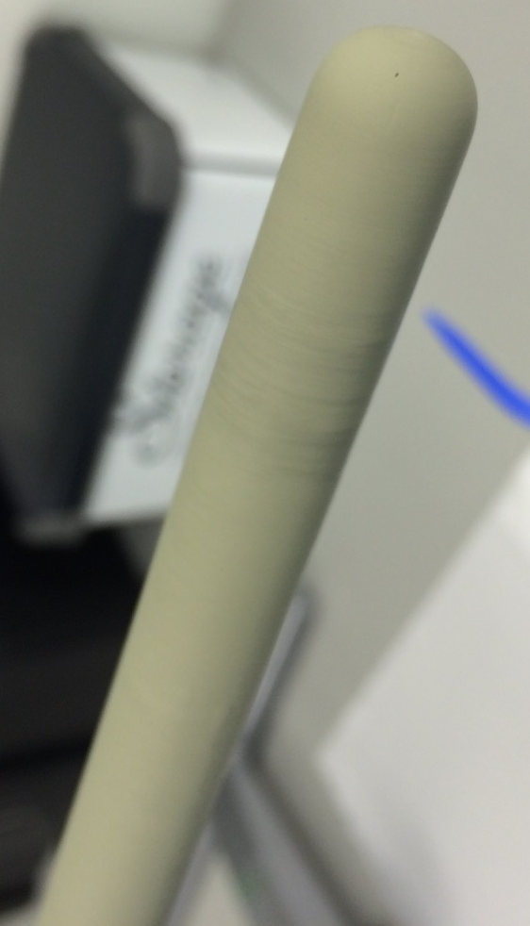
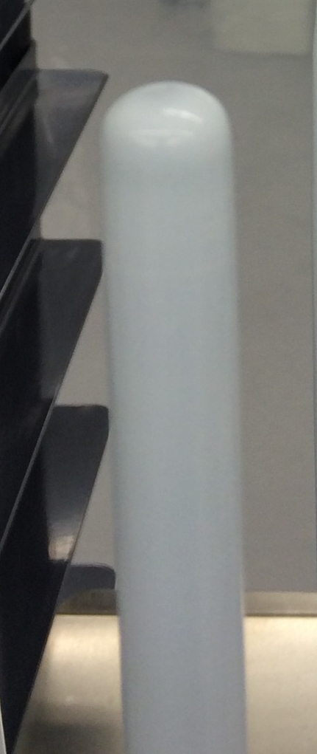
BZCY72 // BZCY72-NiO
Half-cells
Sintering @
1550°C – 24h
100 microns
40 microns
BZCY (2% Ce; 10% Y) // BZCY72-NiO
BZCY72-NiO green tube before and after dip-coating in water based suspension
100 microns
40 microns
Dense electrolyte @ 1550°C – 24 h
1610°C – 6 h

Slide 5
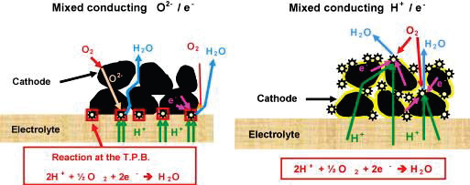
Development of O₂-H₂O electrode, current collector and interconnect materials
100 µm

Slide 6
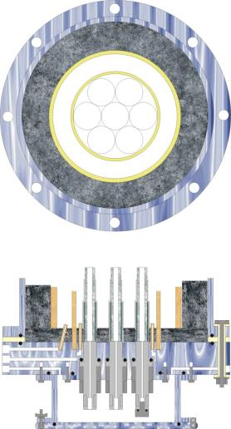
Multi-tube module
Design and build module for multi-tubular testing
  7-10 tubes pr module
  Replaceable individual tubes
  Monitoring of individual tubes
Balance of Plant modelling
  Heat, flow, mass and charge balances
Goal: Test unit for 1kW electrochemical energy conversion

Slide 7

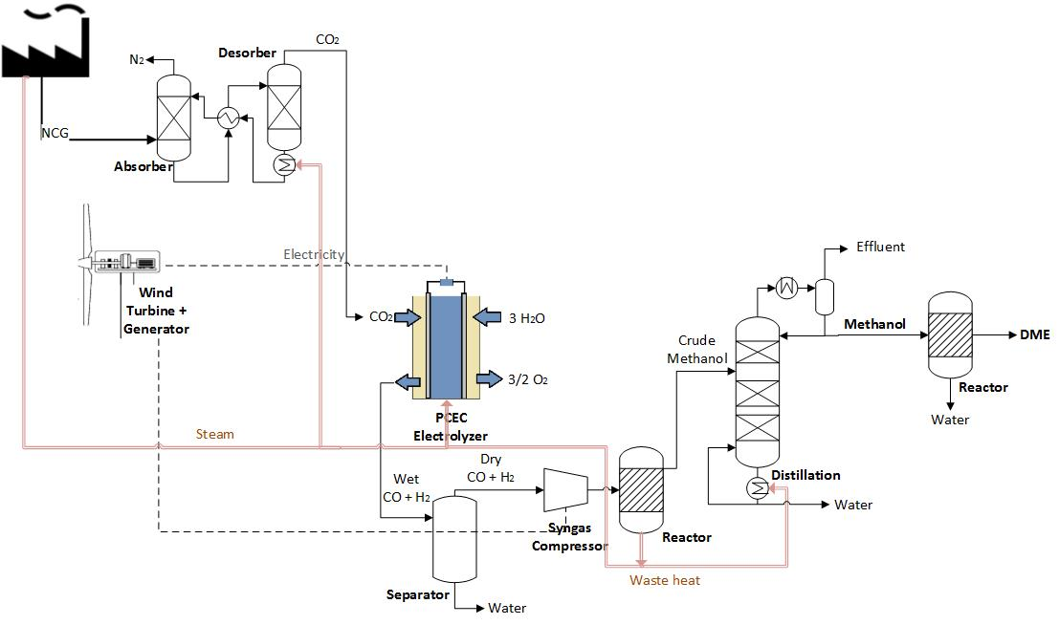
Techno-economic evaluation of PCEC integrated with renewable energy sources
H₂ production from steam and electricity
DME/Ethanol production from steam, CO₂ and electricity

Slide 8
Key differences between SOEC and PCEC
- advantages and challenges
Solid Oxide Electrolyser Cell
  Well proven technology
    Scalable production
    High current densities at thermo-neutral voltage
  Long term stability challenges
    Delamination of O₂-electrode
    Oxidation of H₂-electrode at OCV
  High temperatures
Proton Ceramic Electrolyser Cell
  Less mature technology
    Fabrication and processing challenges
  Produces dry, pressurized H₂ directly
  Potentially intermediate temperatures
    Slower degradation
    Slow O₂-electrode kinetics
U
4e⁻
SOEC
2H₂O
2O²⁻
600-800°C
O₂
2H₂
U
4e⁻
PCEC
4H⁺
2H₂O
2H₂
400-700°C
O₂

Slide 9
O₂-electrodes for PCECs involve multiple species
Ideal H⁺ conductor
Ideal
PCEC anode
Typical H⁺ conductor
Typical
PCEC anode
e⁻
e⁻
4e⁻
4e⁻
2O²⁻
2O²⁻
O₂
4H⁺
4H⁺
O₂
4e⁻
4H⁺
O₂
2H₂O
2H₂O

Slide 10
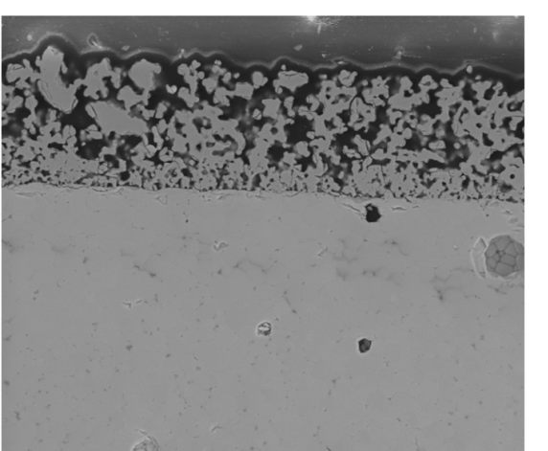
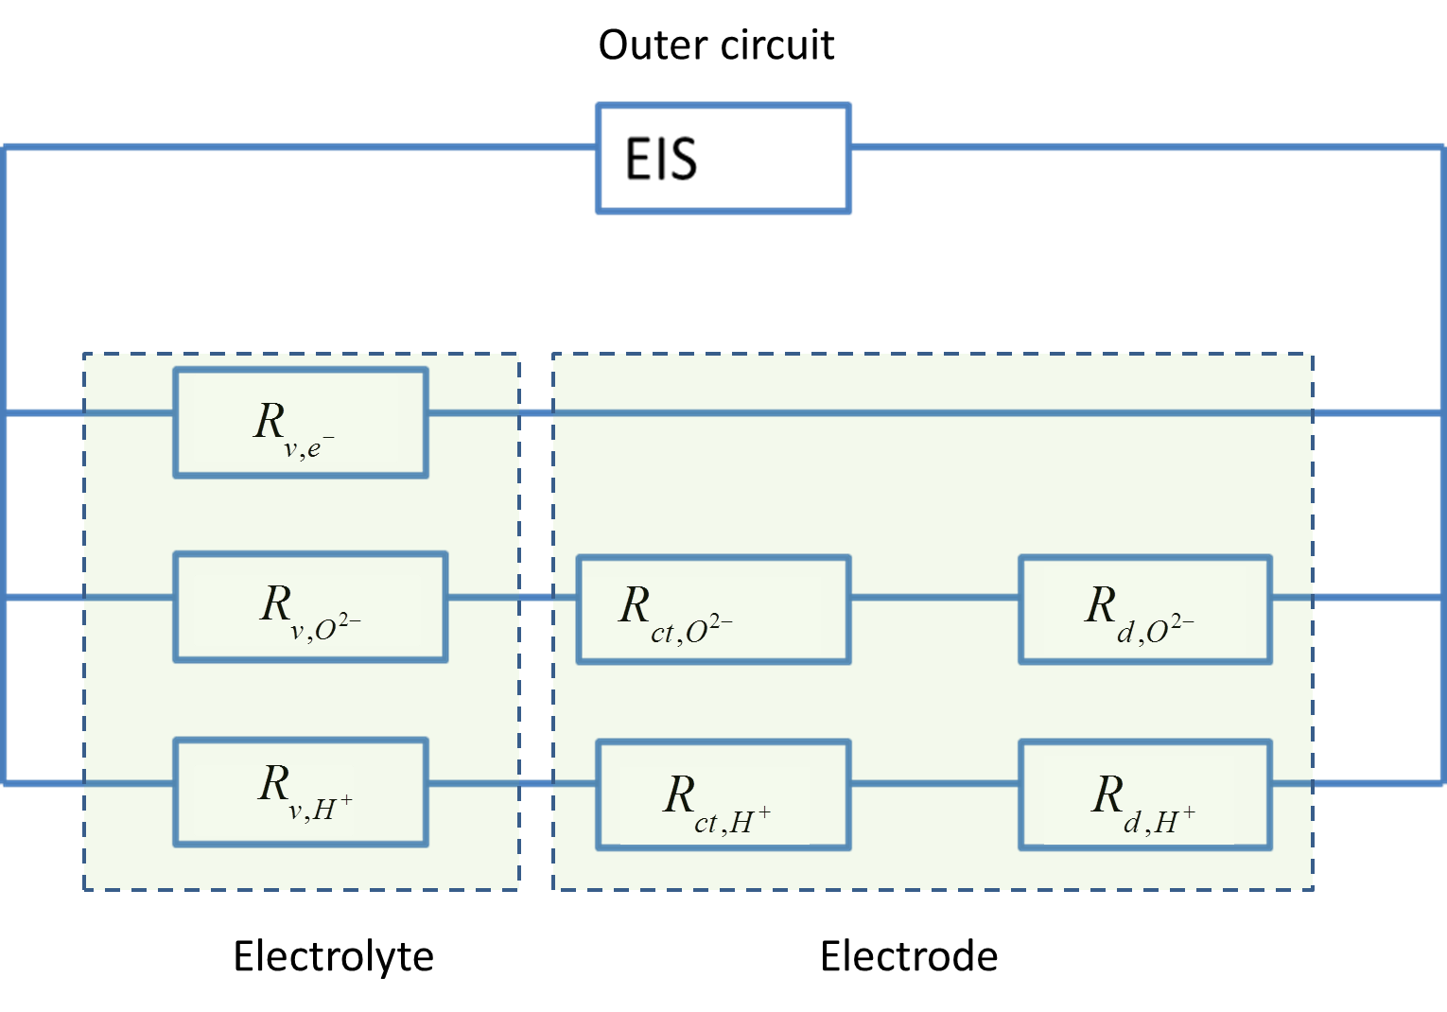
Double Perovskite oxides show promise as O₂-electrodes for PCEC
BGLC: Ba_{1-x}Gd_{0.8}La_{0.2+x}Co₂O_{6-δ}
H⁺
BGLC
4e⁻
BaZr_{0.7}Ce_{0.2}Y_{0.1}O_{3-d}
10 Ωcm²
2O²⁻
2O²⁻
O₂
100 µm
4e⁻
4H⁺
O₂
2H₂O
O²⁻
400°C
* R. Strandbakke et al., Solid State Ionics (2015)

Slide 11
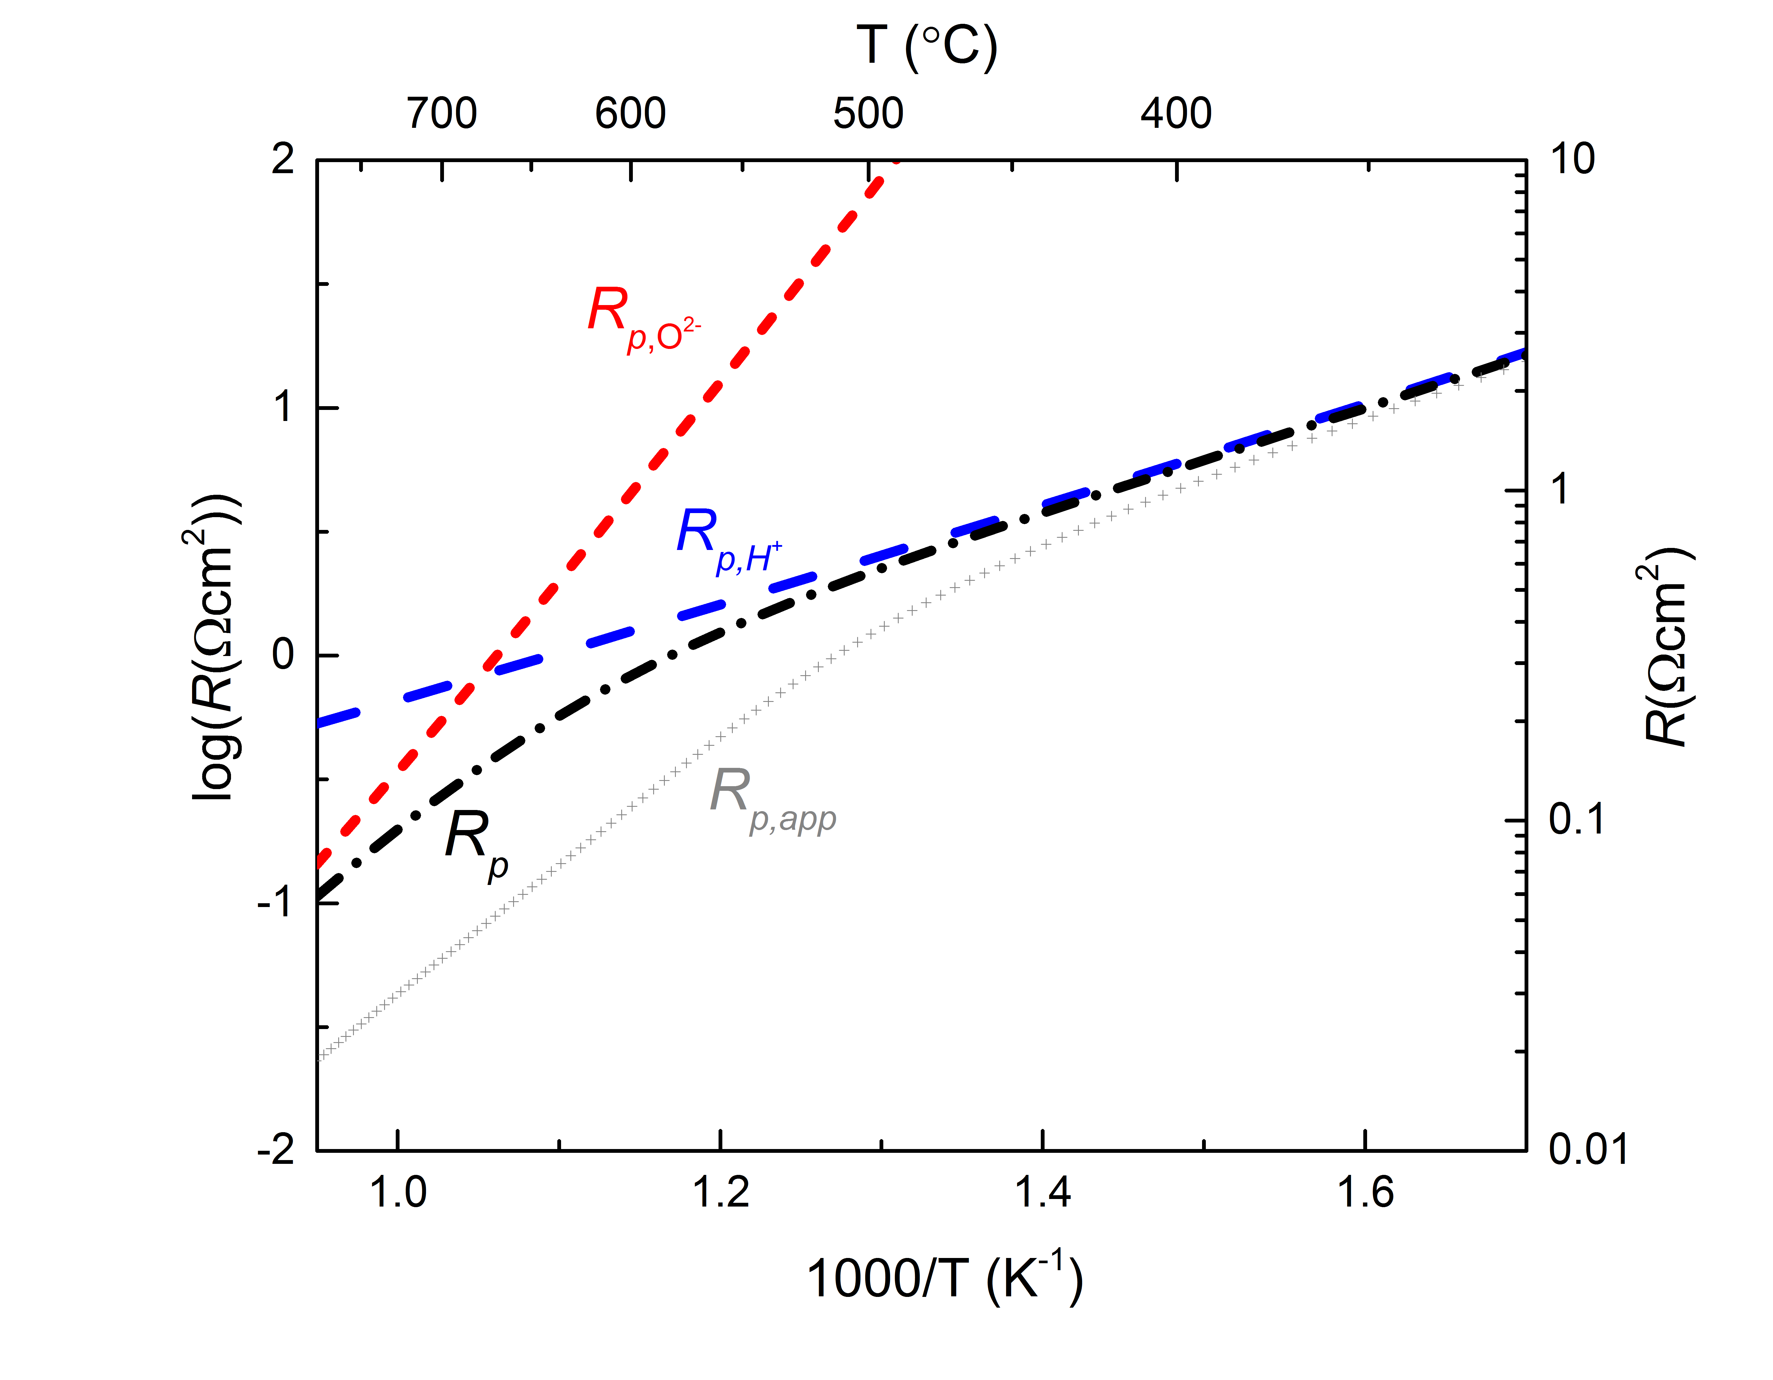
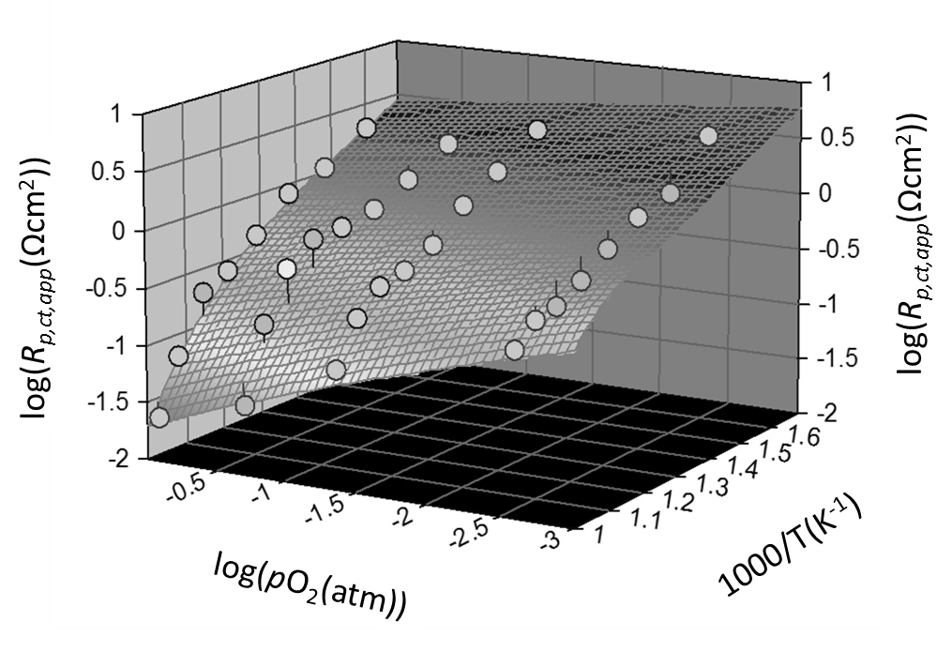
Carefully modelled data reveal a lower active surface area for H⁺ than for O²⁻
50 kJmol⁻¹
Improved microstructure for proton reaction needed to further improve the electrode performance
R. Strandbakke et al., Solid State Ionics (2015)
Session K5.01; 1.30 pm

Slide 12
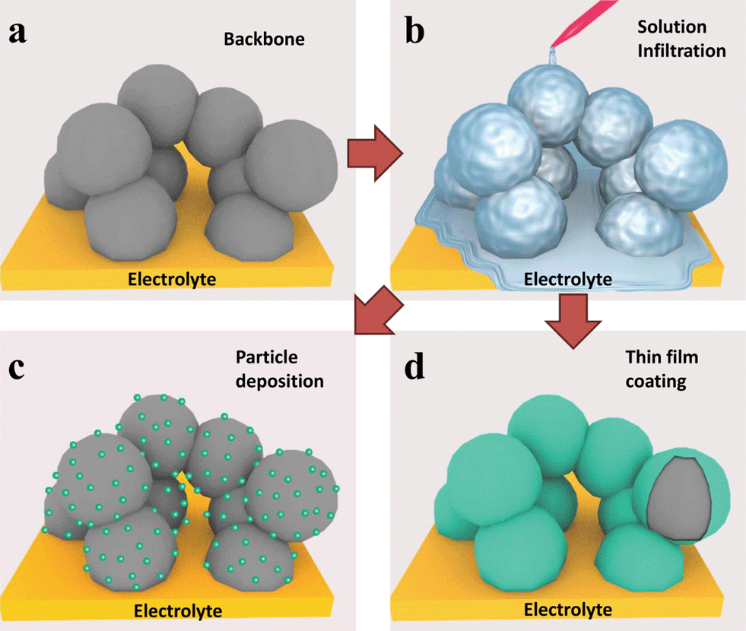
Infiltrated backbones may increase active surface area for PCEC O₂ electrodes
Ding et al., Energy. Environ. Sci., 2014

Slide 13
Three types of BZCY backbone microstructures were investigated
Sample name | BB1 a-d | BB2 | BB3
Powder batch | BZCY72, Cerpotech | BZCY27, Cerpotech + 1wt% ZnO | BZCY27, Cerpotech
Pore Former | Charcoal | Graphite | Charcoal
Sintering parameters | 1500°C, 5h | 1400°C, 8h | 1500°C, 5h
Deposition method | Spray coating | Brush painting | Spray Coating
50 µm
50 µm
50 µm
BB1 a-d
BB2
BB3

Slide 14
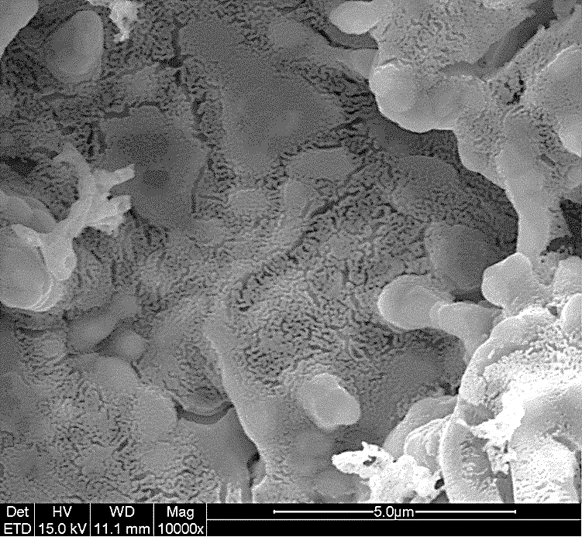
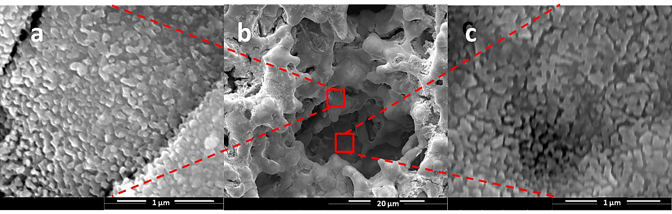
Infiltrated BGLC yields well-dispersed nanostructure after calcination at 800°C
Cation nitrate solution: Gd(NO₃)₃, La(NO₃)₃, Co(NO₃)₃ and BaCO₃
  Selective complexing agents:
    Ammonium EDTA (large cations),
    1:1 molar ratio
    Triethanolamine (TEA) (for small Co),
    2:1 molar ratio
  Wetting agent: Triton X
  Concentration: 0.5M
  Loading: 1 mL/cm²
Calcination at 800°C for 5h
5 µm

Slide 15
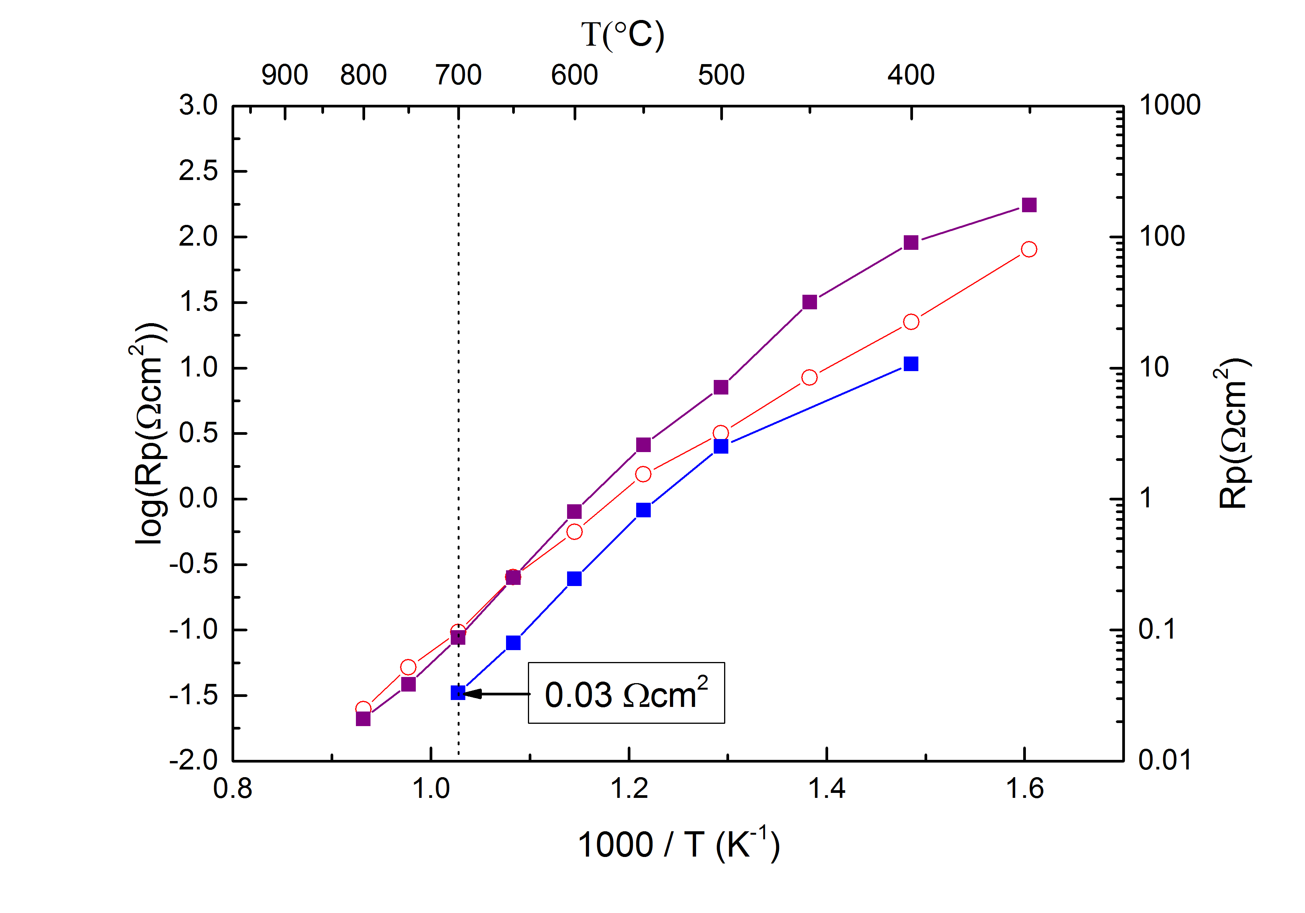
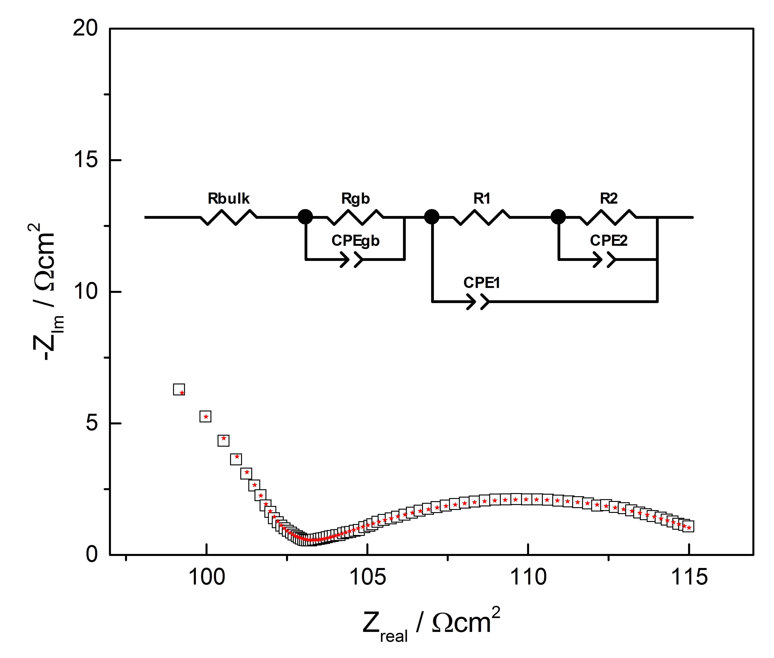
Polarization resistances of infiltrated and single phase electrodes
Slight variations between the different backbone microstructures
BB2
BB1
BB3
500°C, pO₂ = 1

Slide 16
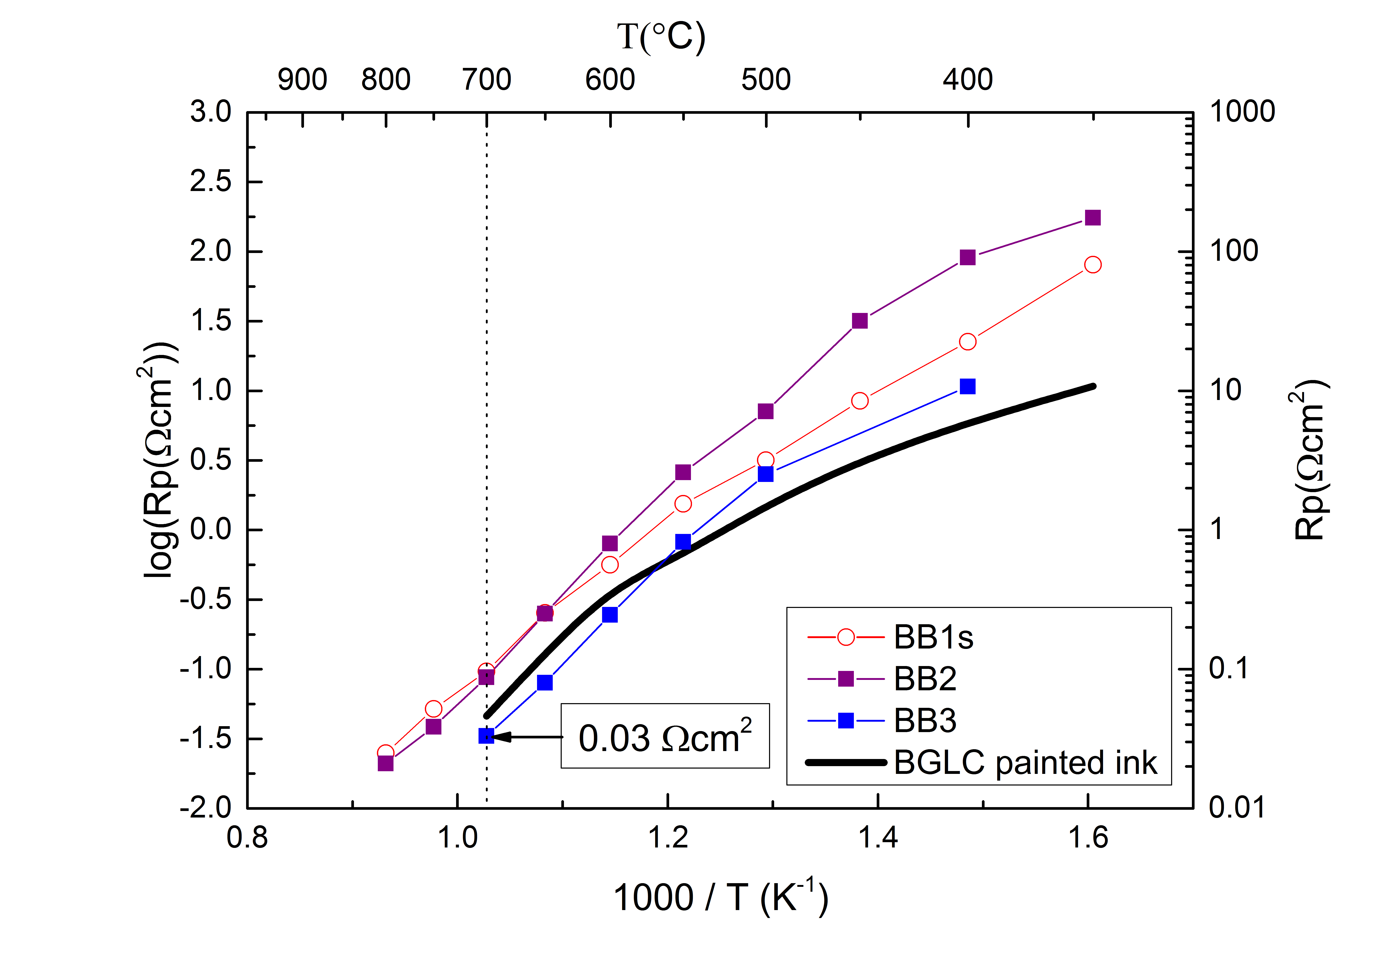
Polarization resistances of infiltrated and single phase electrodes
Slight variations between the different backbone microstructures
No observed improvement on the polarization resistance by infiltraton
500°C, pO₂ = 1

Slide 17
No apparent improvement in the active surface area of the infiltrated electrodes
Apparent increase in activation energy for proton reaction
  50 vs 70 kJmol⁻¹
Non-significant change in pre-exponential
  Why?
E_{a,H}≈70 kJmol⁻¹
(modelled)
log(R_{p,ct,app}(Ωcm²))
log(pO₂(atm))
1000/T(K⁻¹)

Slide 18
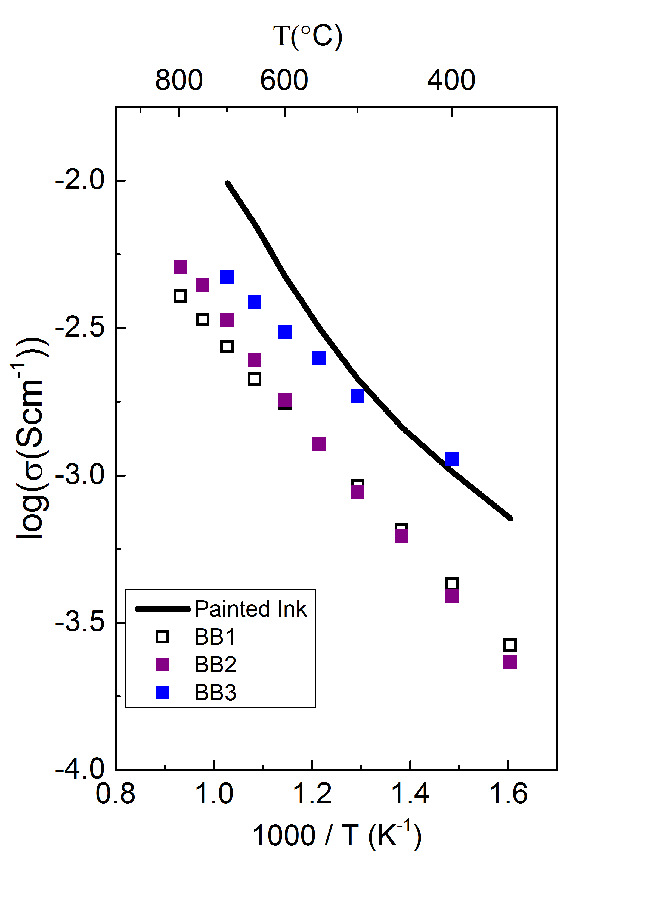
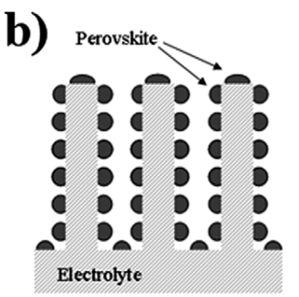
Infiltrated electrodes display higher ohmic resistivity
- Possible indication of current collection losses
Lower apparent electrolyte conductivity for the infiltrated samples
Insufficient electronic conductivity within the composite electrode may reduced the active surface area to the upper layers
Possible optimization strategies
  Increase BGLC loading
  Integrate current collector
  Improve microstructure
“Ohmic” resistivity:
500°C, pO₂ = 1
R_{s}
R_{backbone}

Slide 19
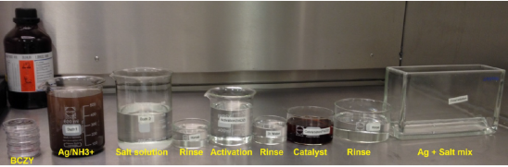
Electroless deposition of Ag into BZCY backbones on BZCY tube segments
Procedure
1. Degrease 5 min ultrasonic bath
2. 30 sec deionized water rinse
3. 1.5 min SnCl2 surface activation
4. 30 sec rinse
5. 1.5 min PdCl2 catalyst
6. 30 sec rinse
7. Autocatalytic Ag-plating (varying time)
8. 30 sec rinse
Uniform 60 nm thick silver film
4 µm
4 µm

Slide 20
Two different backbone samples deposited on tube segments studied by EIS in wet 5% H₂
Backbone from calcined BZCY powder
Backbone from SSRS suspension
50 µm
40 µm
10 µm
4 µm

Slide 21
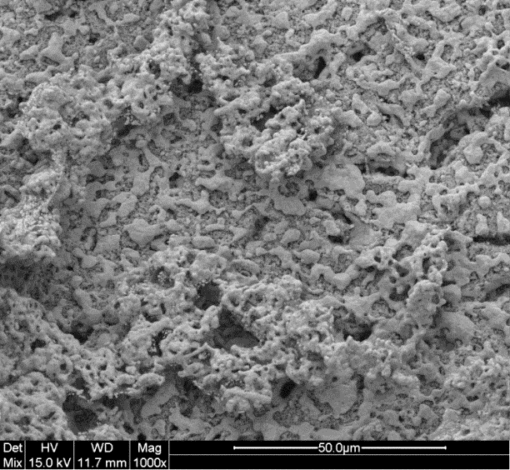
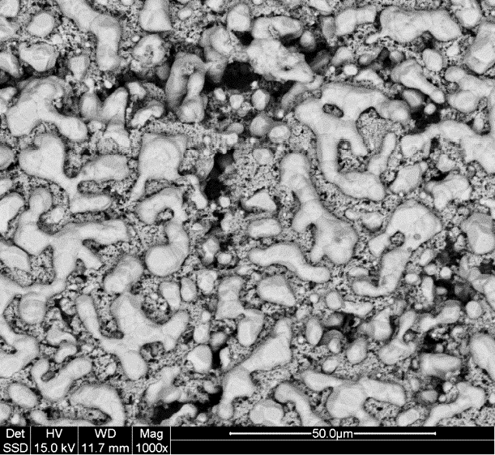
Significant Ag-coarsening above 600°C
After reduction @485°C:
Decreasing temperature
50 µm
Increasing temperature
After EIS measurements:
50 µm

Slide 22
SSRS based backbone presents much lower polarization resistance upon cooling

Slide 23
Less significant silver coarsening with the SSRS backbone
Backbone from SSRS suspension
Backbone from calcined BZCY powder

Slide 24
Conclusions
ELECTRA project aims to produce tubular PCECs for hydrogen and DME production from renewable energy sources
Development of mixed proton electron conducting electrodes is vital for efficient operation at intermediate temperatures
The double perovskite BGLC is identified as very promising material with remarkably low polarization resistance at low temperature
  Proton reaction identified as the dominating mechanism at low temperatures
Proper characterization of activation energies and pre-exponentials is essential to understand the mechanisms and identify routes for improvement
Initial results on electroless deposition of Ag into BZCY backbones shows promise
  Long term stability towards coarsening remains to be studied

Slide 25
Acknowledgements
The research leading to these results has received funding from the European Union's Seventh Framework Programme (FP7/2007-2013) for the Fuel Cells and Hydrogen Joint Technology Initiative under grant agreement n° 621244.
My colleagues at UiO/ELECTRA:
Thank you for your attention!
Ragnar Strandbakke
Truls Norby
Marie-Laure Fontaine
Jose Serra
Cecilia Solis
Runar Dahl-Hansen
Nuria Bausá

Slide 26
Conclusions
ELECTRA project aims to produce tubular PCECs for hydrogen and DME production from renewable energy sources
Development of mixed proton electron conducting electrodes is vital for efficient operation at intermediate temperatures
The double perovskite BGLC is identified as very promising material with remarkably low polarization resistance at low temperature
  Proton reaction identified as the dominating mechanism at low temperatures
Proper characterization of activation energies and pre-exponentials is essential to understand the mechanisms and identify routes for improvement
Initial results on electroless deposition of Ag into BZCY backbones shows promise
  Long term stability towards coarsening remains to be studied

