Slide 1









Infiltrated Double Perovskite Electrodes for Proton Conducting Steam Electrolysers
Einar Vøllestad, Ragnar Strandbakke and Truls Norby
U
4e⁻
PCEC
4H⁺
2H₂O
2H₂
600°C
O₂

Slide 2
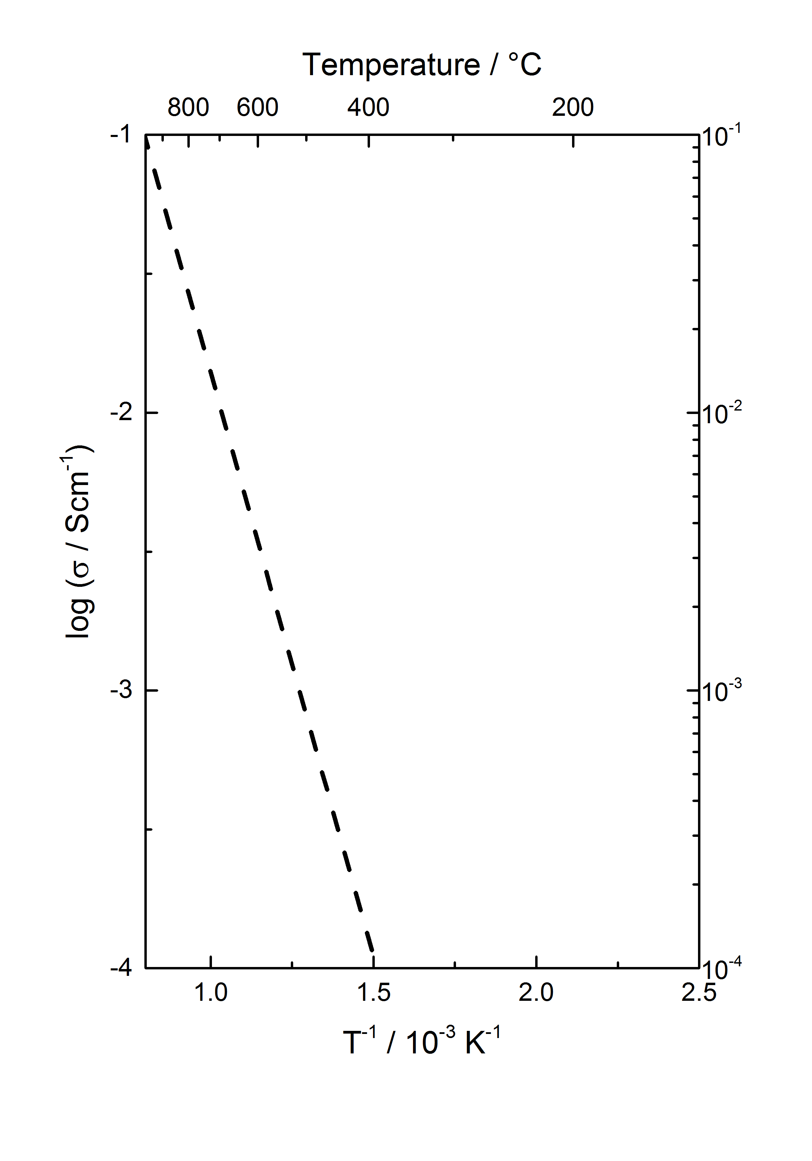
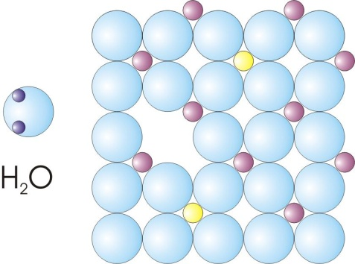
Proton conducting oxides
Zr_{0.9}Y_{0.1}O_{1.95}
+ BaO →
BaZr_{0.9}Y_{0.1}O_{2.95}

Slide 3
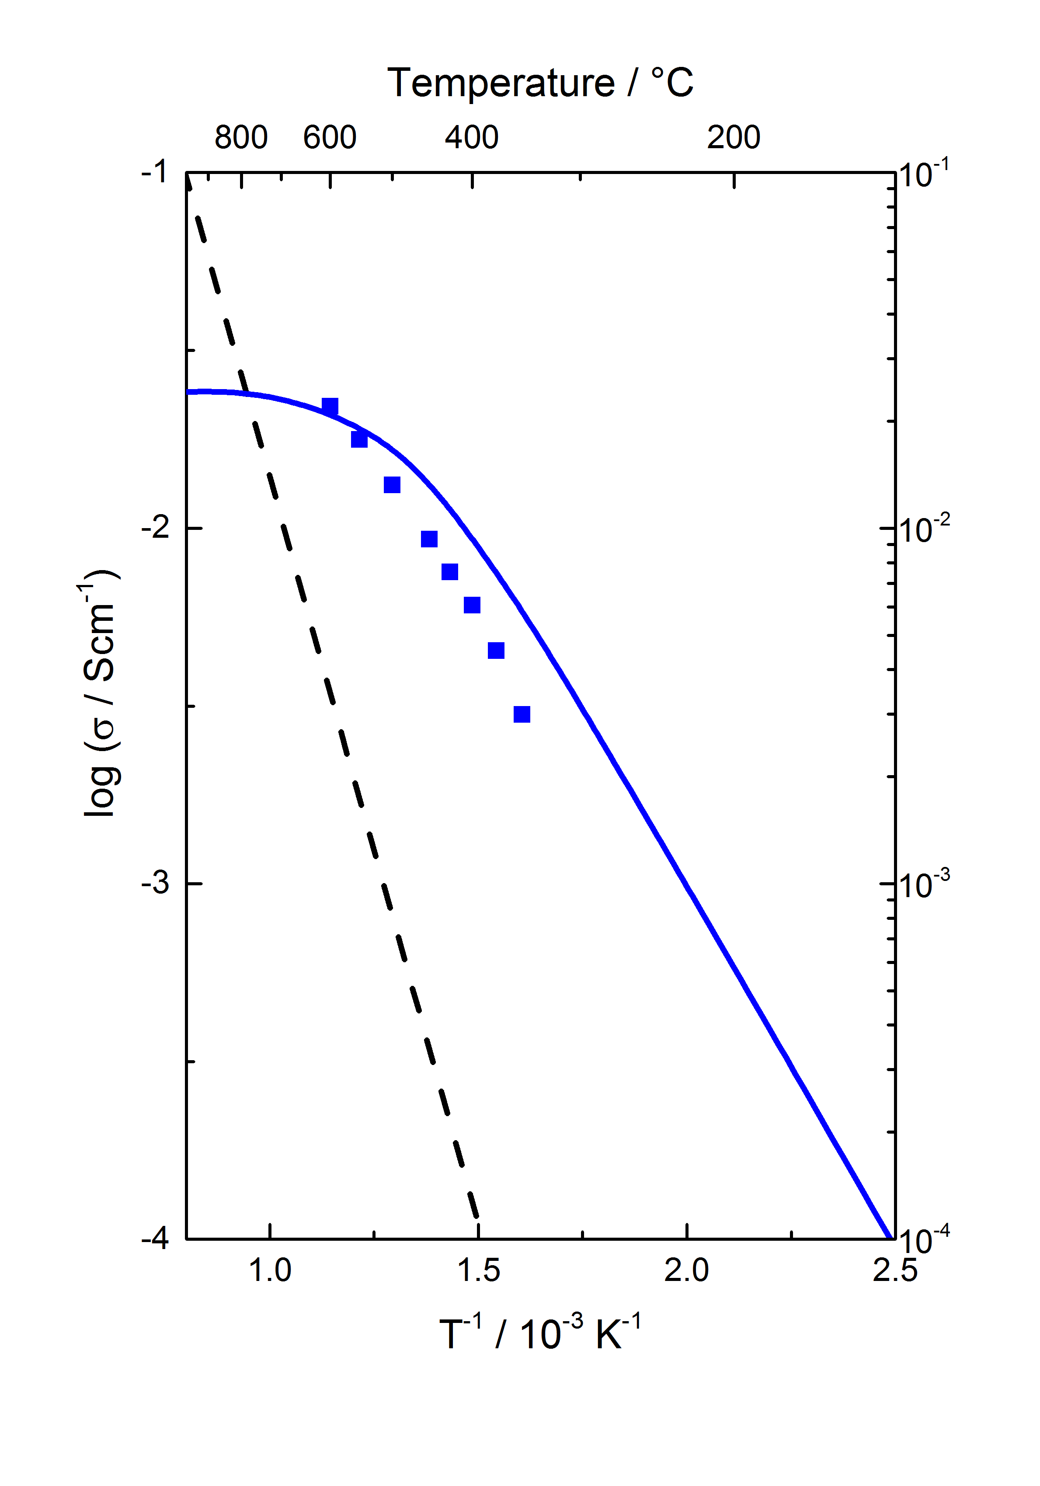
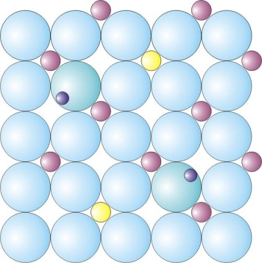
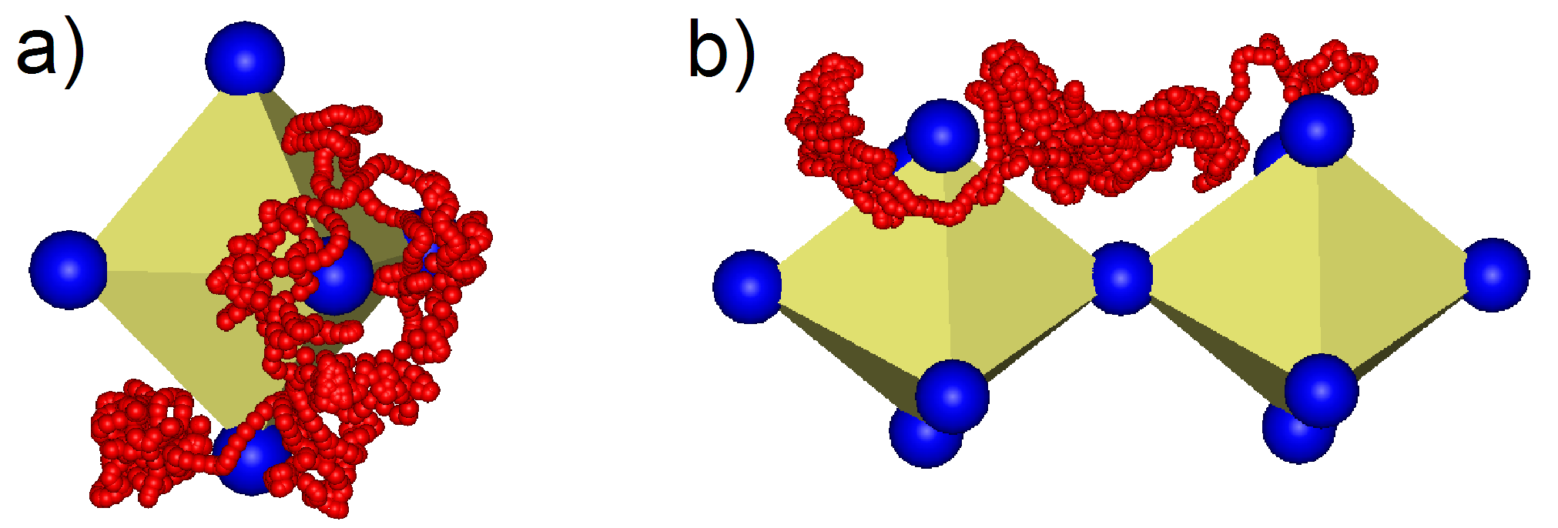

Proton conducting oxides
Zr_{0.9}Y_{0.1}O_{1.95}
+ BaO →
BaZr_{0.9}Y_{0.1}O_{2.95}
$$E_{a, H^{+}} ≈\frac{2}{3}E_{a, O^{2−}}$$
Kreuer, 2001
From K.-D. Kreuer, 2008

Slide 4
Key differences between SOEC and PCEC
- advantages and challenges
Solid Oxide Electrolyser Cell
  Well established technology
  Delamination of anode
  Oxidation of cathode at OCV
  High temperatures
Proton Ceramic Electrolyser Cell
  Less mature technology
  Produces dry H₂ directly
  Potentially intermediate temperatures
    Slow anode kinetics
U
4e⁻
SOEC
2H₂O
2O²⁻
600-800°C
O₂
2H₂
U
4e⁻
PCEC
4H⁺
2H₂O
2H₂
400-700°C
O₂

Slide 5
O₂-electrodes for PCECs involve multiple species
Ideal H⁺ conductor
Ideal
PCEC anode
Typical oxide H⁺ conductor
Typical
PCEC anode
e⁻
e⁻
4e⁻
4e⁻
2O²⁻
2O²⁻
O₂
4H⁺
4H⁺
O₂
4e⁻
4H⁺
O₂
2H₂O
2H₂O

Slide 6
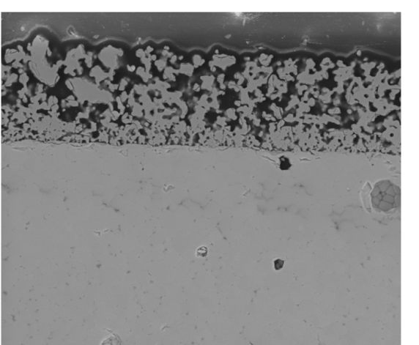
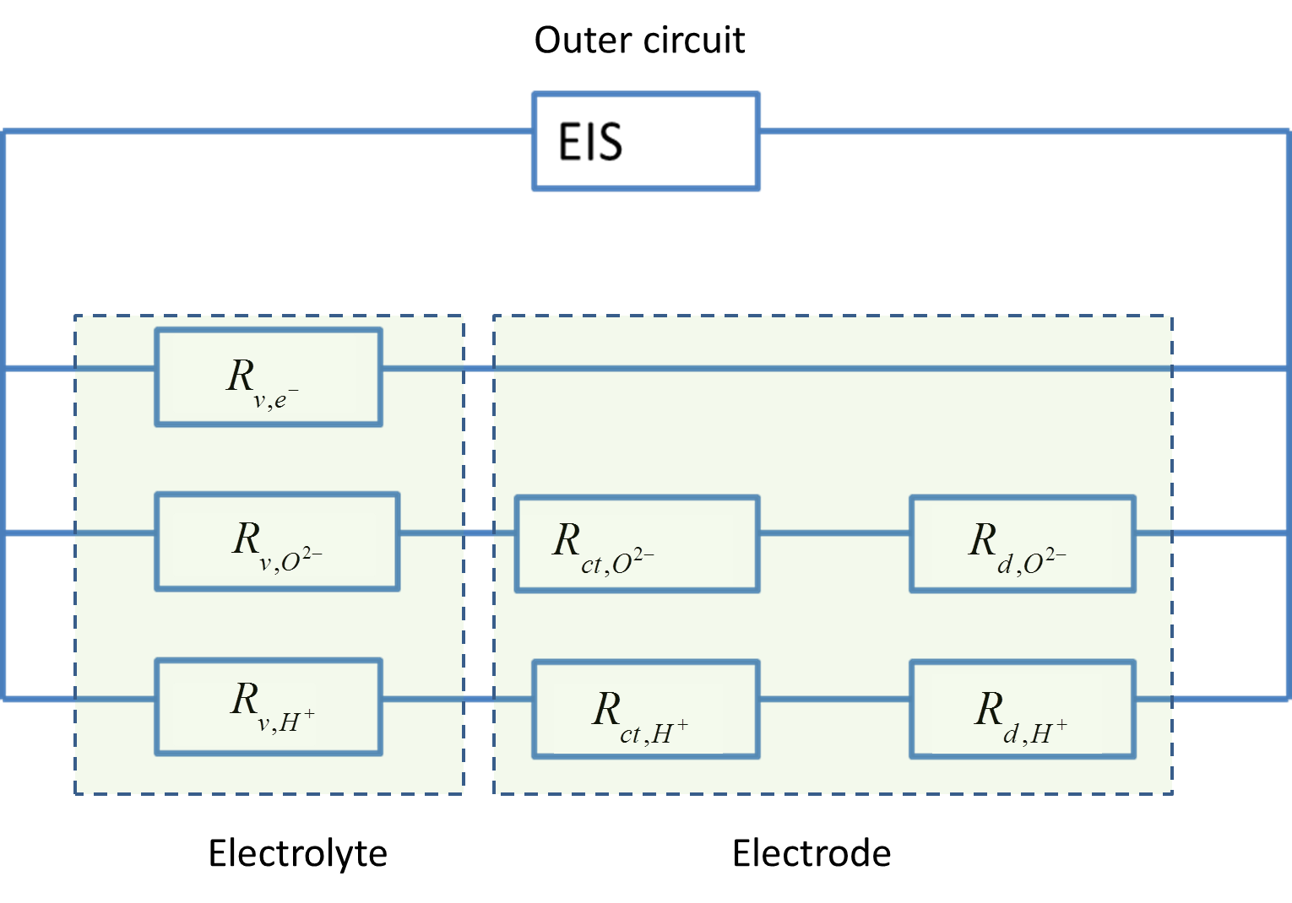
Double Perovskite oxides show promise as O₂-electrodes for PCEC
BGLC: Ba_{1-x}Gd_{0.8}La_{0.2+x}Co₂O_{6-δ}
H⁺
BGLC
4e⁻
2O²⁻
2O²⁻
O₂
BaZr_{0.7}Ce_{0.2}Y_{0.1}O_{3-d}
100 µm
4e⁻
4H⁺
O₂
O²⁻
2H₂O

Slide 7
Carefully modelled data reveal a lower active surface area for H⁺ than for O²⁻
ln(1/R_{v}T(Scm-¹K))
Improved microstructure for proton reaction needed to further improve the electrode performance
log(pO₂(atm))
1000/T(K⁻¹)

Slide 8
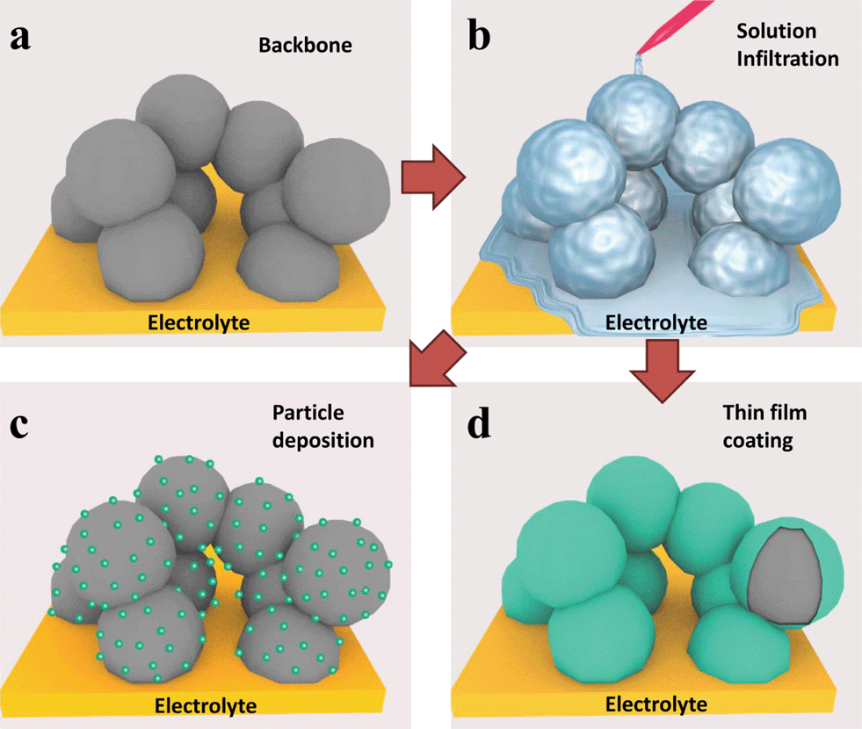
Infiltrated backbones may increase active surface area for PCEC O₂ electrodes
Ding et al., Energy. Environ. Sci., 2014

Slide 9
Three types of BZCY backbone microstructures were investigated
Sample name | BB1 a-d | BB2 | BB3
Powder batch | BZCY72, Cerpotech | BZCY27, Cerpotech + 1wt% ZnO | BZCY27, Cerpotech
Pore Former | Charcoal | Graphite | Charcoal
Sintering parameters | 1500°C, 5h | 1400°C, 8h | 1500°C, 5h
Deposition method | Spray coating | Brush painting | Spray Coating
BB1 a-d
BB2
BB3

Slide 10
Infiltrated BGLC yields well-dispersed nanostructure after calcination at 800°C
Cation nitrate solution: Gd(NO₃)₃, La(NO₃)₃, Co(NO₃)₃ and BaCO₃
  Selective complexing agents:
    Ammonium EDTA (large cations),
    1:1 molar ratio
    Triethanolamine (TEA) (for small Co),
    2:1 molar ratio
  Wetting agent: Triton X
  Concentration: 0.5M
  Loading: 1 mL/cm²
Calcination at 850°C for 5h

Slide 11
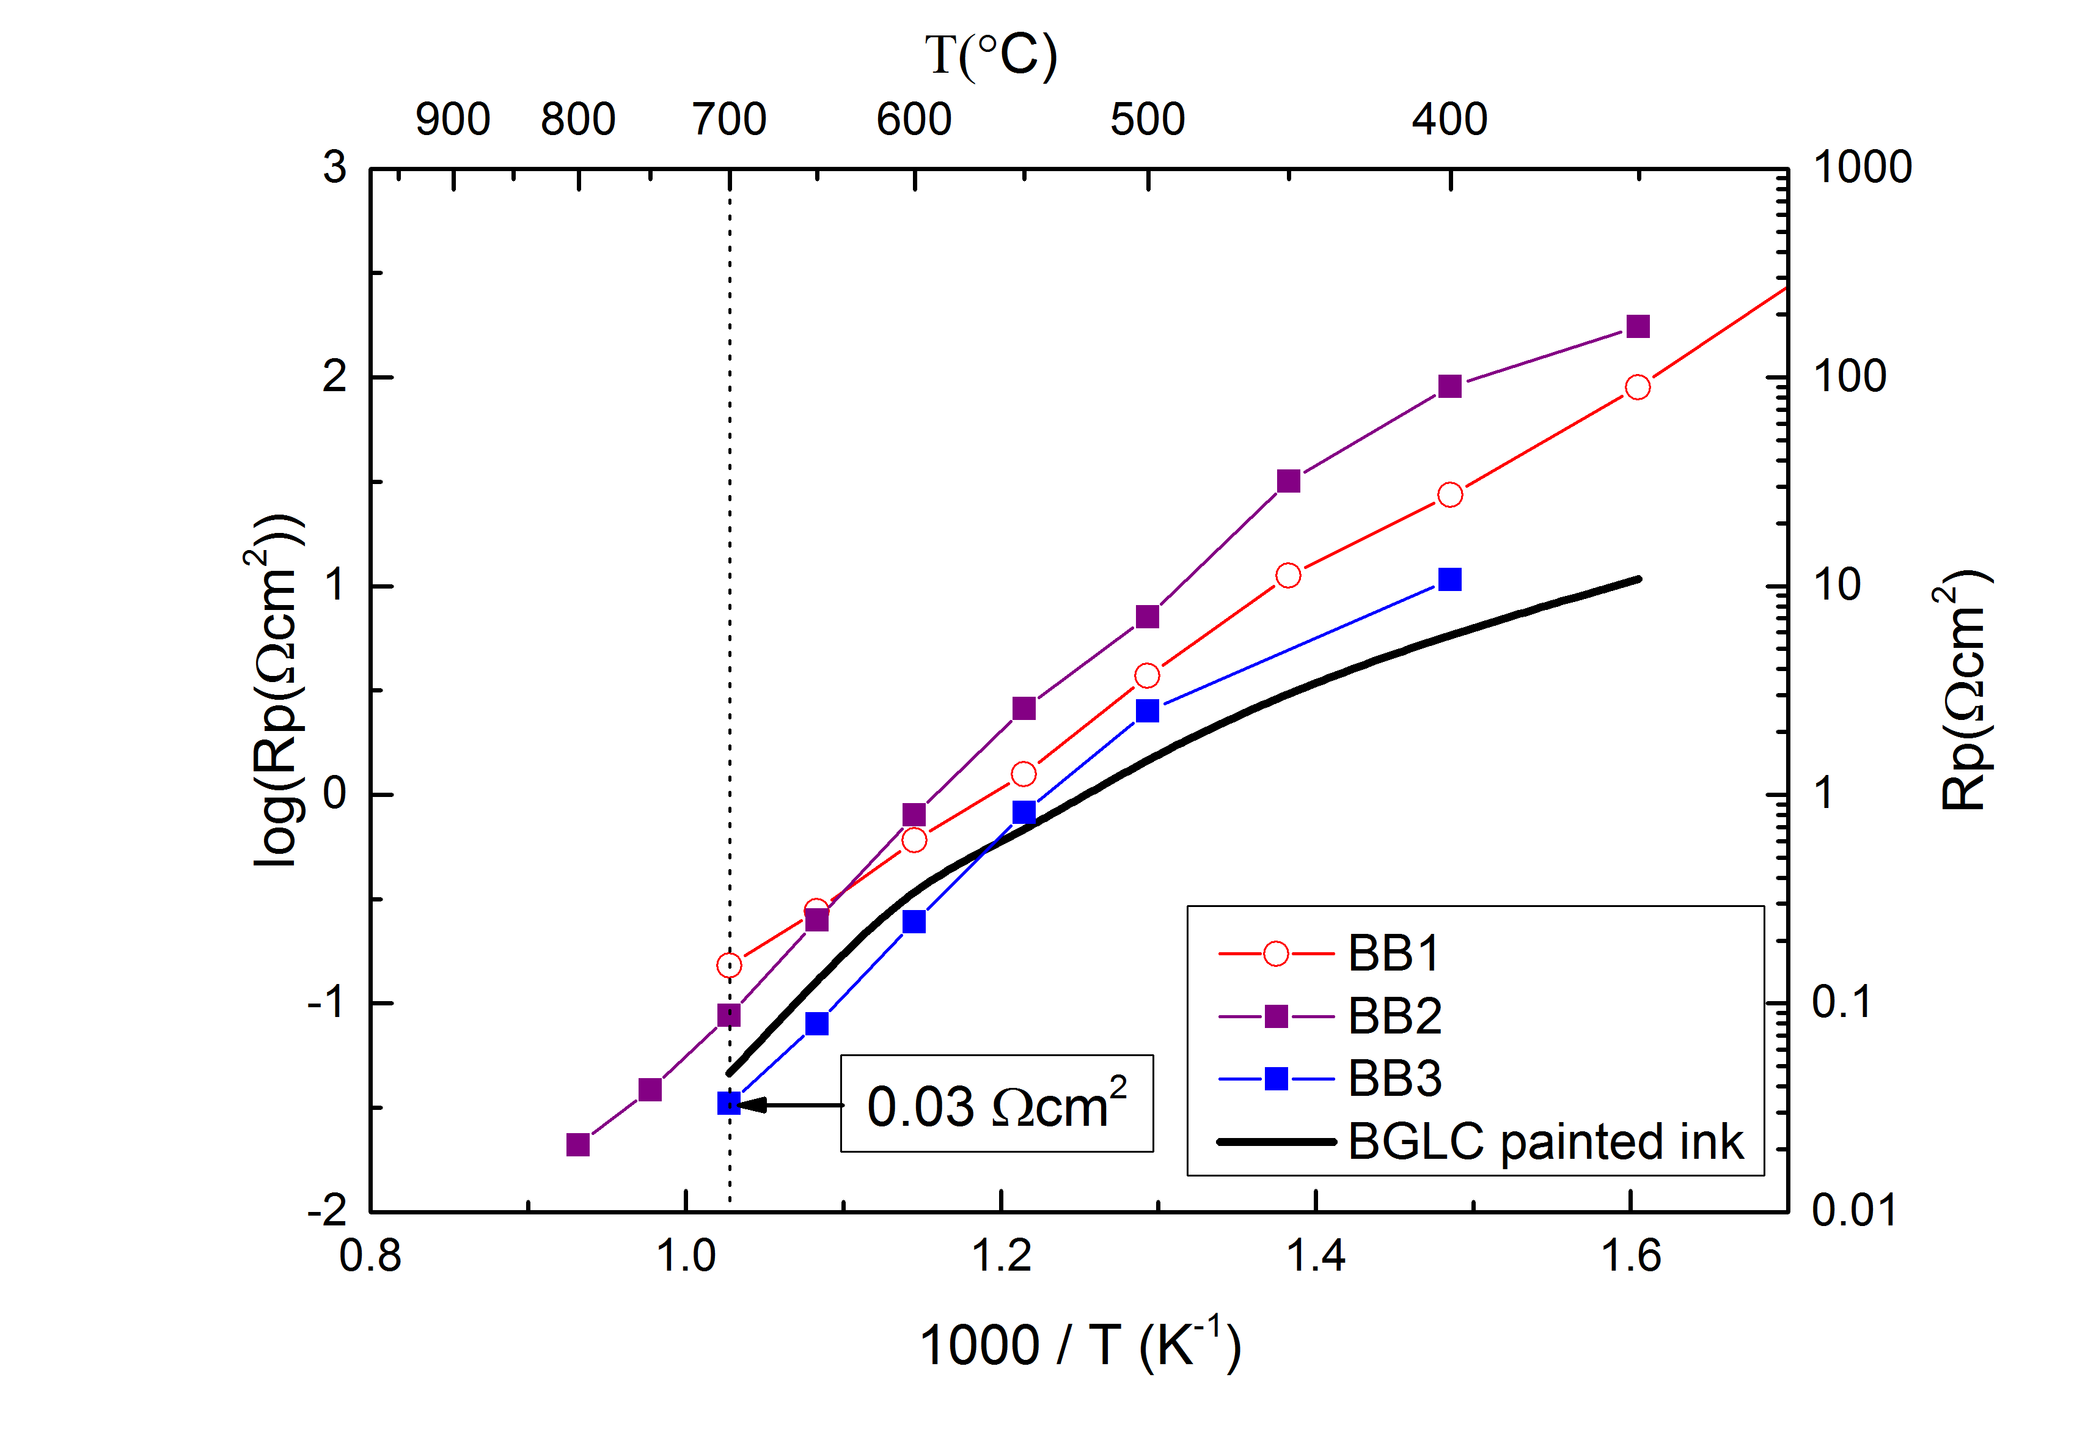
Polarization resistances of infiltrated and single phase electrodes
The infiltrated electrodes display similar ASR as the single phase electrode.
Only small variations between the different backbone microstructures.
No significant increase of the active surface area

Slide 12
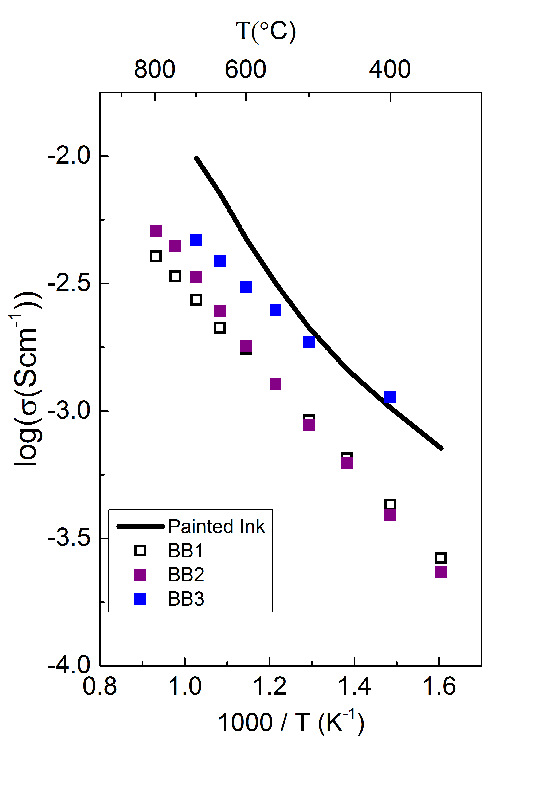
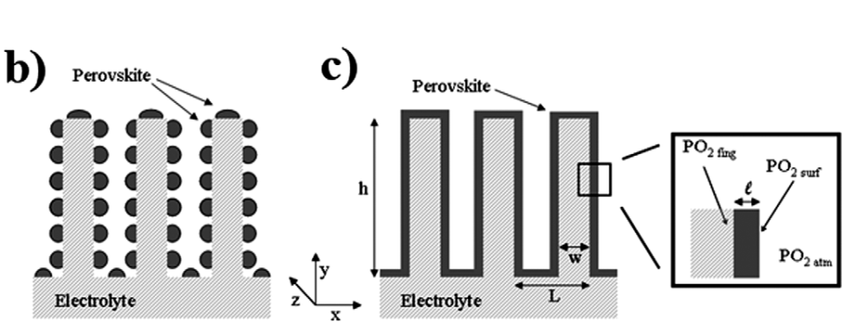
Infiltrated electrodes display higher ohmic resistivity
- Possible indication of current collection losses
Insufficient electronic conductivity within the composite electrode may reduced the active surface area to the upper layers
Possible optimization strategies
  Increase BGLC loading
  Integrate current collector
  Improve microstructure
Ohmic resistivity:

Slide 13
Conclusions
Mixed proton electron conductivity is desired for PCEC electrodes
BGLC identified as a candidate material with fast electrode kinetics
  Low activation energy indicates proton reaction dominates at low temperatures
  Increased mixed proton-electron conduction is needed to utilize more of the electrode surface and further enhance the pre-exponential
Further work on improved microstructure and optimized current collection within the composite electrode is needed to further reduce the polarization resistance

Slide 14

Acknowledgement
The research leading to these results has received funding from the European Union's Seventh Framework Programme (FP7/2007-2013) for the Fuel Cells and Hydrogen Joint Technology Initiative under grant agreement n° 621244.
My colleagues at UiO/ELECTRA:
Thank you for your attention!
Ragnar Strandbakke
Truls Norby
Jose Serra
Cecilia Solis
Marie-Laure Fontaine
Nuria Martínez

Slide 15
Conclusions
Mixed proton electron conductivity is desired for PCEC electrodes
BGLC identified as a candidate material with fast electrode kinetics
  Low activation energy indicates proton reaction dominates at low temperatures
  Increased mixed proton-electron conduction is needed to utilize more of the electrode surface and further enhance the pre-exponential
Further work on improved microstructure and optimized current collection within the composite electrode is needed to further reduce the polarization resistance

